Slide 1

Frontiers of Network Science
Fall 2022
Class 13: Degree Correlations part II
(Chapter 7 in Textbook)
based on slides by
Albert-László Barabási
and Roberta Sinatra
Boleslaw Szymanski
www.BarabasiLab.com

Slide 2
Structural cut-off
High assortativity→ high number of links between the hubs.
If we allow only one link between two nodes, we can simply run out of hubs to connect to each other to satisfy the assortativity criteria.
Number of edges between the set of
nodes with degree k and degree k’:
Maximum number of edges between
the two groups:
If we only have simple edges, we cannot have more links between the two groups, than if we connect every node with degree k to every node with degree k’ once.
There cannot be more links between the two groups, than the overall number of edges joining the nodes with degree k.
This is true even if we allow multiple edges.
M. Boguñá, R. Pastor-Satorras, A. Vespignani, EPJ B 38, 205 (2004)

Slide 3
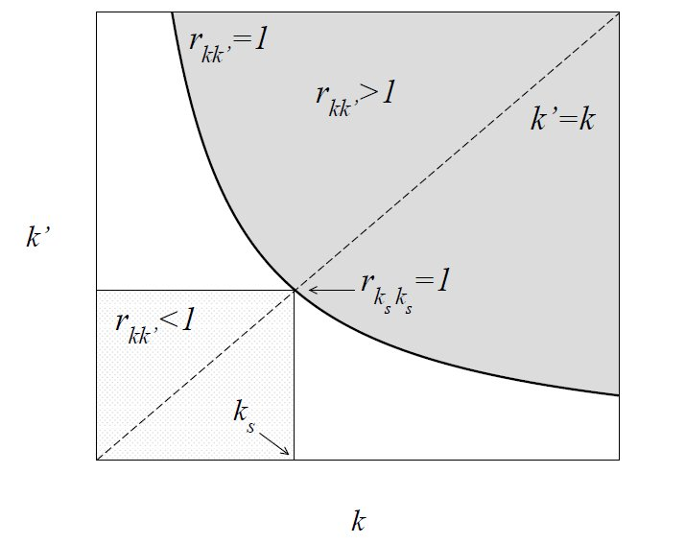
Structural cut-off
The ratio of E_{kk’} and m_{kk’} has to be ≤ 1 in the physical region!
defines the structural cut-off
M. Boguñá, R. Pastor-Satorras, A. Vespignani, EPJ B 38, 205 (2004)

Slide 4
Structural cut-off for uncorrelated networks
Uncorrelated networks:
k_{s}(N) represents a structural cutoff:
one cannot have nodes with degree larger than k_{s}(N) ,
→if there are nodes with k> k_{s}(N) we cannot find sufficient links between the highly connected nodes to maintain the neutral nature of the network.
Solution:
Introduce a structural cutoff (i.e. do not allow nodes with k> k_{s}(N)
Let the network become more dissasortative, having fewer links between hubs.

Slide 5
Example: Degree sequence introduces disassortativity
Scale-free network generated with the configuration model (N=300, L=450, γ=2.2).
The measured r=-0.19! → Dissasortative!
Red hub: 55 neighbors.
Blue hub: 46 neighbors.
Let’s calculate the expectation number of links between red node (k=55) and blue node (k=46) for uncorrelated networks!
Here N₅₅=N₄₆=1, hence
m_{55,46}=1 so r_{55,46}=E_{55,46}
In order for the network to be neutral, we need 2.8 links between these two hubs.

Slide 6
<k_{nn}>
The largest nodes have k_{nn}< <k_{nn}>

Slide 7
The effect is particularly clear for N=10,000:
<k_{nn}>
The red curves are those of interest to us: one can see that a clear dissasortativity property is visible in this case.

Slide 8
Natural cutoffs in scale-free networks
All real networks are finite → let us explore its consequences.
→ We have an expected maximum degree, K_{max}
Estimating K_{max}
Why: the probability to have a node larger than K_{max} should not exceed the prob. to have one node, i.e. 1/N fraction of all nodes
Natural cutoff:

Slide 9
Structural cut-off for uncorrelated networks
Structural cutoff:
Natural cut-off:
γ=3: k_{s}(N) and k_{max}(N) scale the same way, i.e. ~N^{1/2}.
The size of the largest hub is above the structural cutoff, which means that it cannot have enough links to the other hubs to maintain its neutral status.
→ disassortative mixing
γ<3:
→a randomly wired network with γ<3 will be
dissasortative
Or will have to have a cutoff at k_{s}(N)< k_{max}(N)
Notes:
We are interested only in SF networks, as ER network do not have hubs, and thus the problem is less acute.

Slide 10
Example: introducing a structural cut-off
Scale-free network generated with the configuration model (N=300, L=450, γ=2.2) with structural cut-off ~ N^{½}.
r=0.005 → neutral
Red hub: 12 neighbors.
Blue hubs: 11 neighbors.
Again we can calculate the expectation number of edges between the hubs.

Slide 11
<k_{nn}>
The largest nodes have k_{nn}~ <k_{nn}>

Slide 12
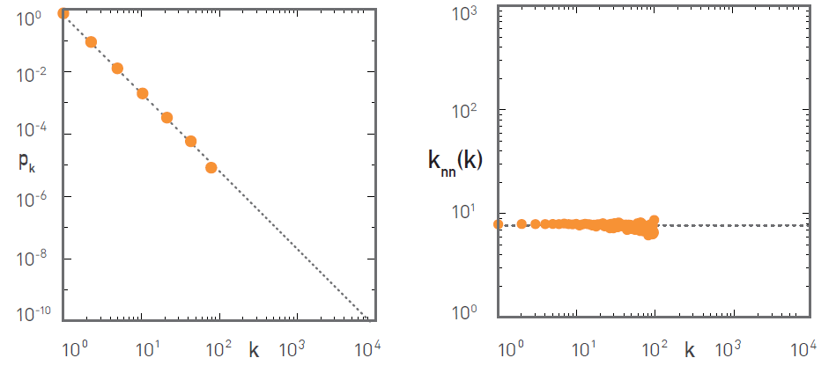
The effect is particularly clear for N=10,000:
A clear case of neutral assortativity property is visible in this case thanks to imposing structural cut-off.

Slide 13
DIRECTED NETWORKS
α,β: {in,out}
in-in
in-out
out-in
out-out
J. G. Foster, D. V. Foster, P. Grassberger, M. Paczuski, PNAS 107, 10815 (2010)

Slide 14
DIRECTED NETWORKS

Slide 15
MULTIPOINT DEGREE CORRELATIONS
P(k): not enough to characterize a network
Large degree nodes tend to connect to large degree nodes
Ex: social networks
Large degree nodes tend to connect to small degree nodes
Ex: technological networks

Slide 16
MULTIPOINT DEGREE CORRELATIONS
Measure of correlations:
P(k’,k’’,…k^{(n)}|k): conditional probability that a node of degree k is connected to nodes of degree k’, k’’,…
Simplest case:
P(k’|k): conditional probability that a node of degree k’ is connected to a node of degree k

Slide 17
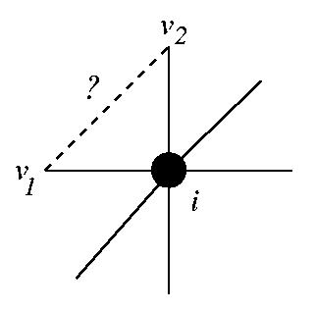
2-POINTS: CLUSTERING COEFFICIENT
P(k’,k’’|k): cumbersome, difficult to estimate from data
Do your friends know each other ?
# of links between neighbors

Slide 18
CORRELATIONS: CLUSTER SPECTRUM
Average clustering coefficient
= average over nodes with very different characteristics

Slide 19


EMPIRICAL DATA FOR REAL NETWORKS
Pathlenght
Clustering
Degree Distr.
P(k) ~ k^{-γ}
Regular network
P(k)=δ(k-k_{d})
Erdos-
Renyi
Watts-
Strogatz
Exponential
Barabasi-Albert
P(k) ~ k^{-γ}
Notes:
As we can see, the BA model gets approximatelly right the small world effect, the degree distribution. When it comes to the clustering coefficient, the bad news is that it still decreases with the system size. The good news, is that it decreases slower that the ER prediction. Most important, however, the real difference is this: the model is really a modeling platform, that can be adjusted to the properties of real networks– we will see that in fact it can generate a finite, system size independnet clustering coefficient, if our main goal is to do just that.

Slide 20
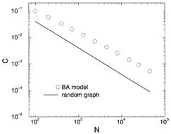
CLUSTERING COEFFICIENT OF THE BA MODEL
Reminder: for a random graph we have:
The numerical results indicate a slightly slower decay for BA network than for random networks.
But not slow enough...
Clustering coefficient versus size of the Barabasi-Albert (BA) model with <k>=4, compared with clustering coefficient of random
graph,
Konstantin Klemm, Victor M. Eguiluz,
Growing scale-free networks with small-world behavior,
Phys. Rev. E 65, 057102 (2002), cond-mat/0107607

Slide 21
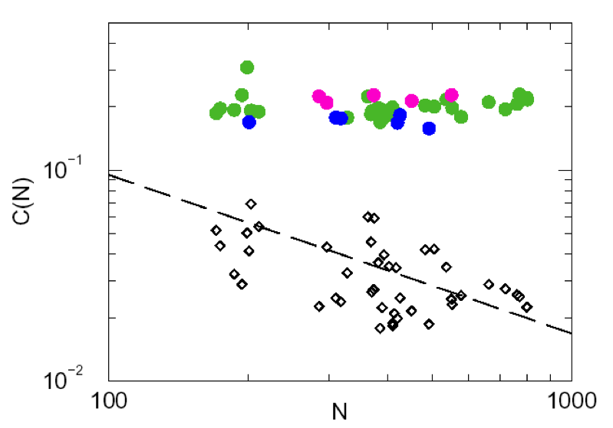
MODULARITY IN THE METABOLISM
Clustering Coefficient:
# links between k neighbors
C(k)=
k(k-1)/2
←Metabolic network
(43 organisms)
← Scale-free model

Slide 22
THE MEANING OF C(N)
Existence of a high degree of local modularity in real networks, that is not captured by the current models.
C(N)– the average number of triangles around each node in a system of size N.
The fact that C(N) does not decrease means that the relative number of triangles around a node remains constant as the system size increases—in contrast with the ER and BA models, where the relative number of triangles around a node decreases.
(here relative means relative to how many triangles we expected if all triangles that could be there would be there)
But C has some unexpected behavior, if we measure C(k)– the average clustering coefficient for nodes with degree k.

Slide 23
CORRELATIONS: CLUSTER SPECTRUM
Average clustering coefficient
= average over nodes with very different characteristics
Clustering spectrum:
putting together nodes which have the same degree
class of degree k
(link with hierarchical structures)

Slide 24
C(k) for the ER and BA models
Erdos-Renyi
Barabasi-Albert
This is not true, however, for real networks. Let us look at some empirical data.

Slide 25
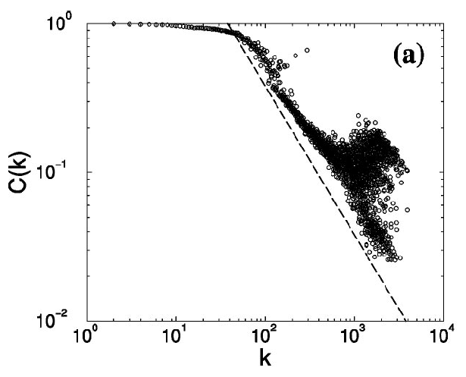
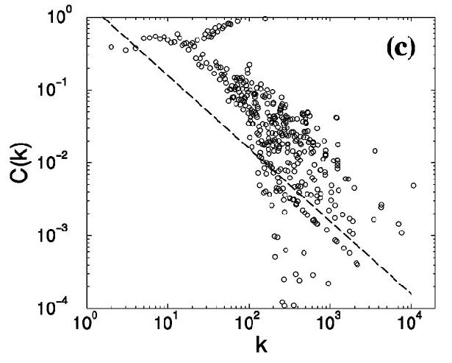

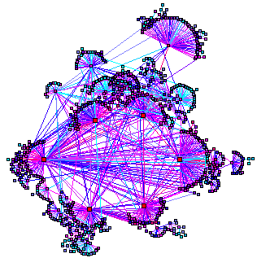
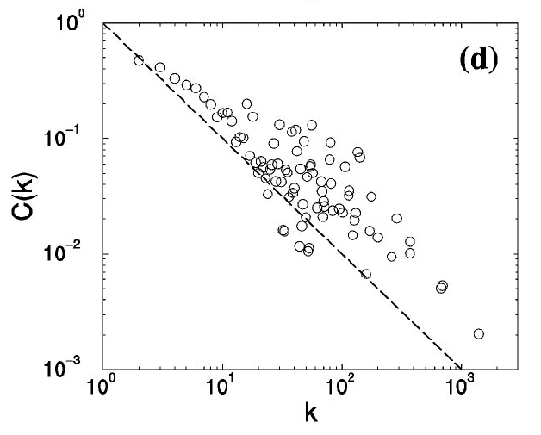
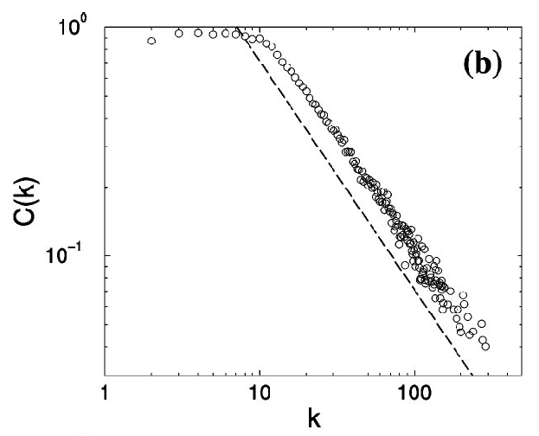

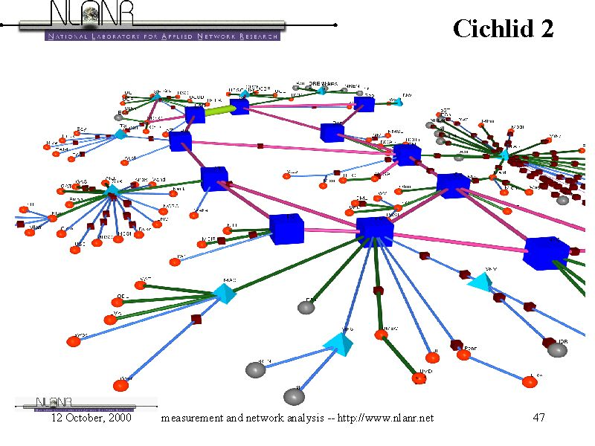
HIERARCHICAL NETWORKS
Society
The electronic skin
Hollywood
WWW
Eckmann & Moses, ‘02
Human communication
Internet (AS)
Vazquez et al,'01
Language

Slide 26
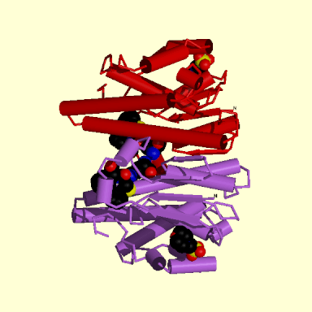
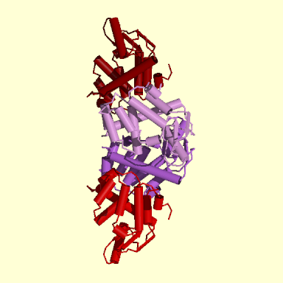
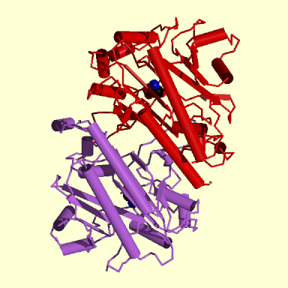
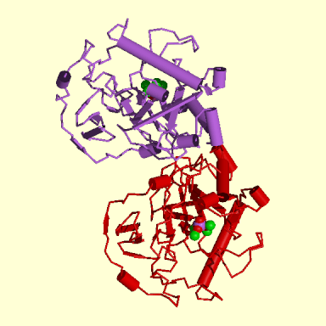
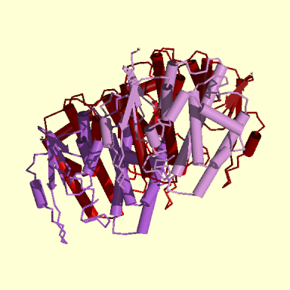
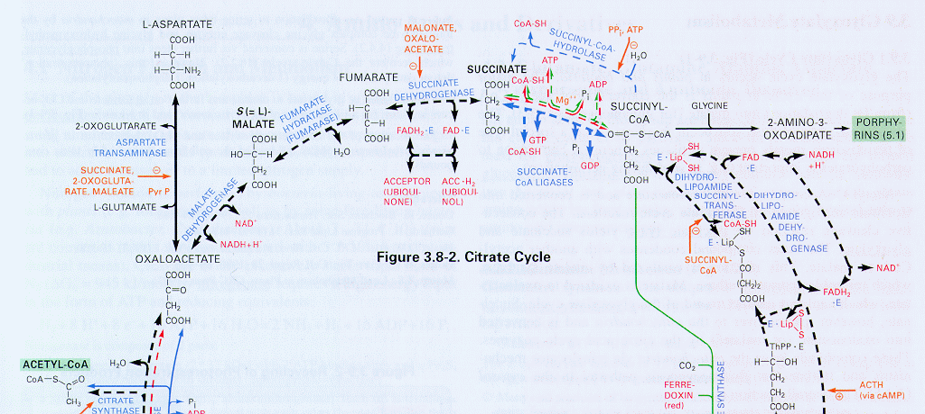
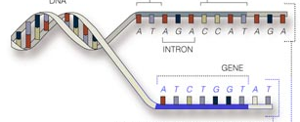
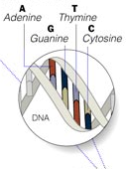

Cellular networks:
GENOME
protein-gene interactions
PROTEOME
protein-protein interactions
METABOLISM
Bio-chemical reactions
Citrate Cycle

Slide 27
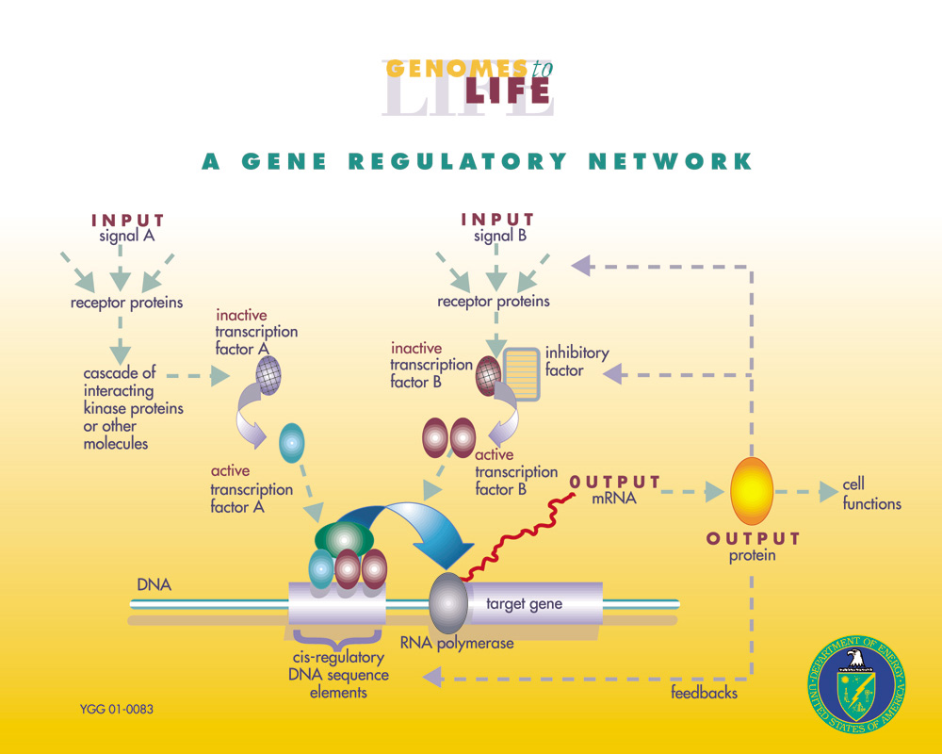

Slide 28
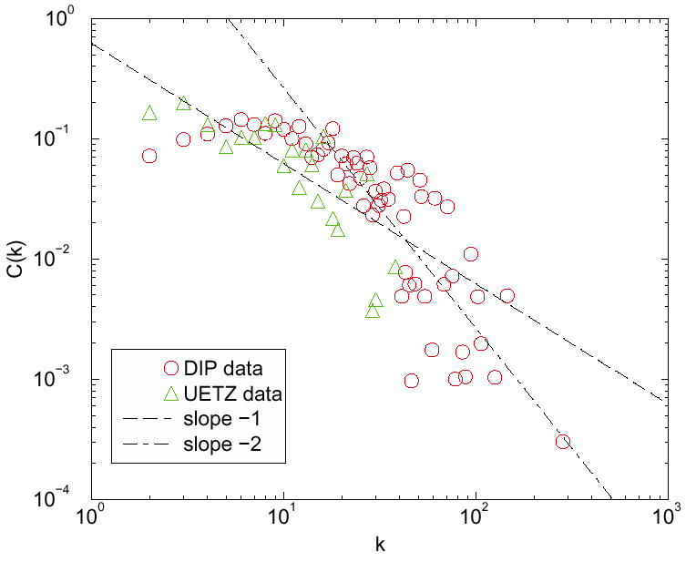
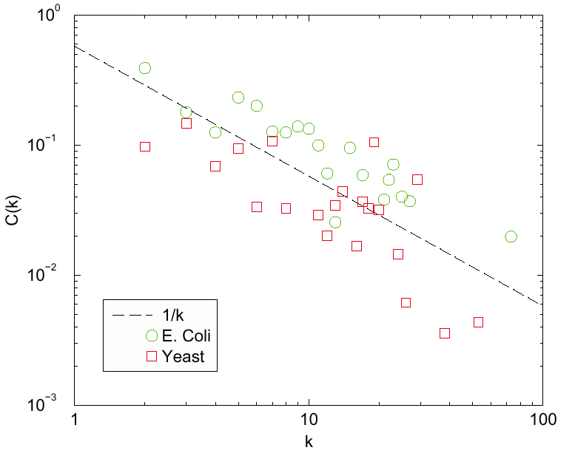
BIOLOGICAL SYSTEMS
Protein-protein interaction
Regulatory networks

Slide 29
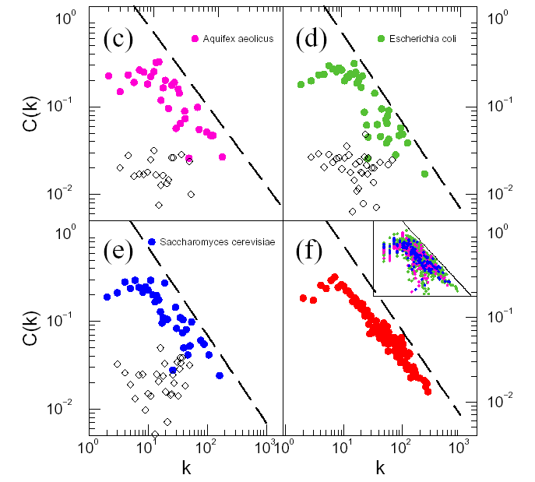
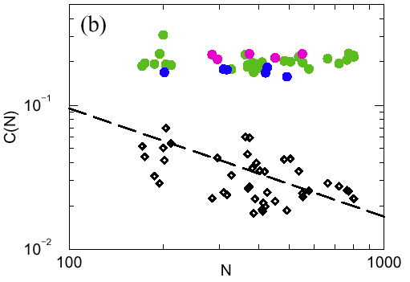
SCALING OF THE CLUSTERING COEFFICIENT C(k)
The metabolism forms a hierarchical network.
Ravasz, Somera, Mongru, Oltvai, A-L. B, Science 297, 1551 (2002).

Slide 30
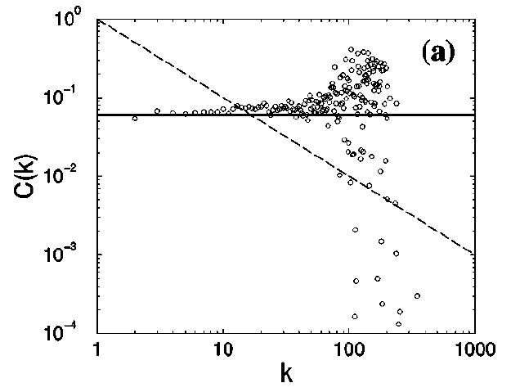
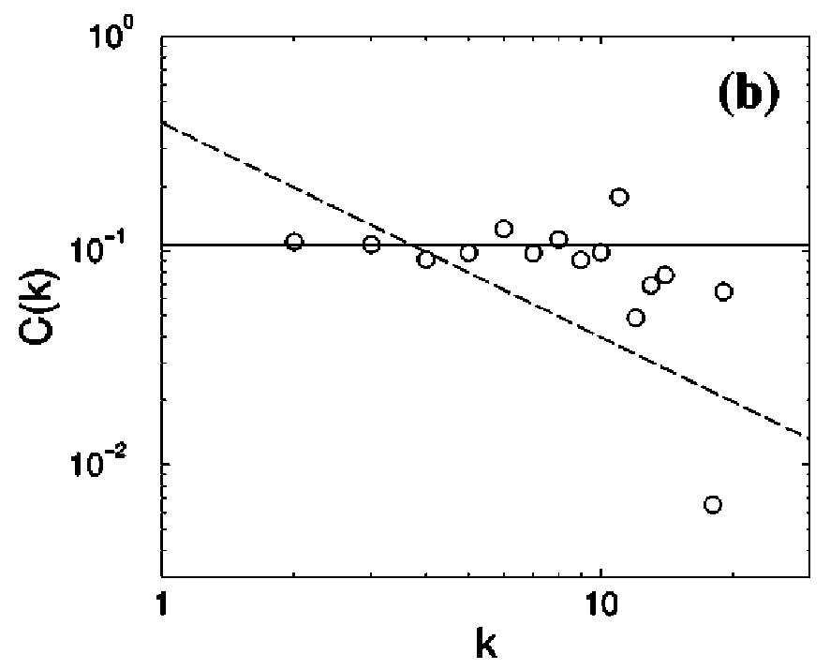
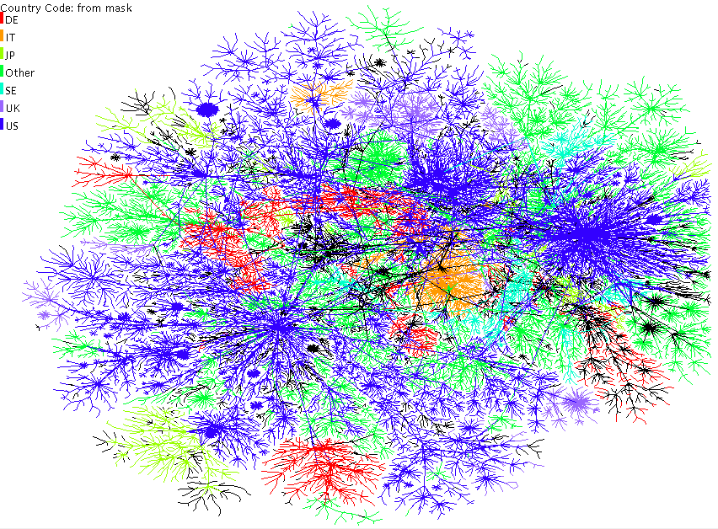

ABSENCE OF HIERARCHY
Geographically localized networks
Internet (router)
Power Grid

Slide 31
SUMMARY OF EMPIRICAL RESULTS
C(k)~k^{-β}
C(k) indep. of k
Internet (AS)
WWW
Metabolism
Protein interaction network
Regulatory network
Language
Internet (router)
Power grid
Real systems
ER model
WS model
BA model
?
Models
But there is a deeper issue as stake, that need to consider– that of modularity.

Slide 32
HIERARCHICAL EXPONENT
All models predict
Is the exponent universal?
Or could we have for example:

Slide 33
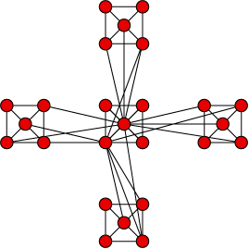
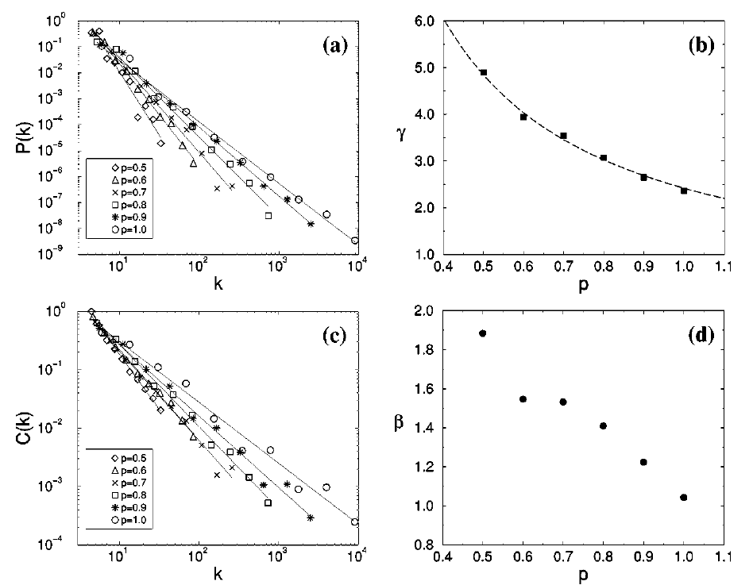

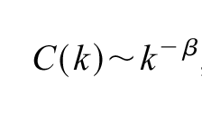
STOCHASTIC VERSION
Randomly pick a p fraction of the newly added nodes and connect each of them independently to the nodes belonging to the central module.
-use preferential attachment to decide, to which central node the selected nodes link to.
-at the next level p² fraction will link, back, then p³, …p^{i}

Slide 34
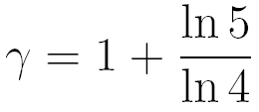

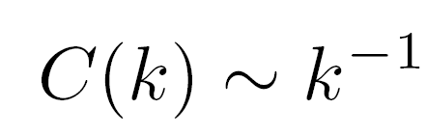

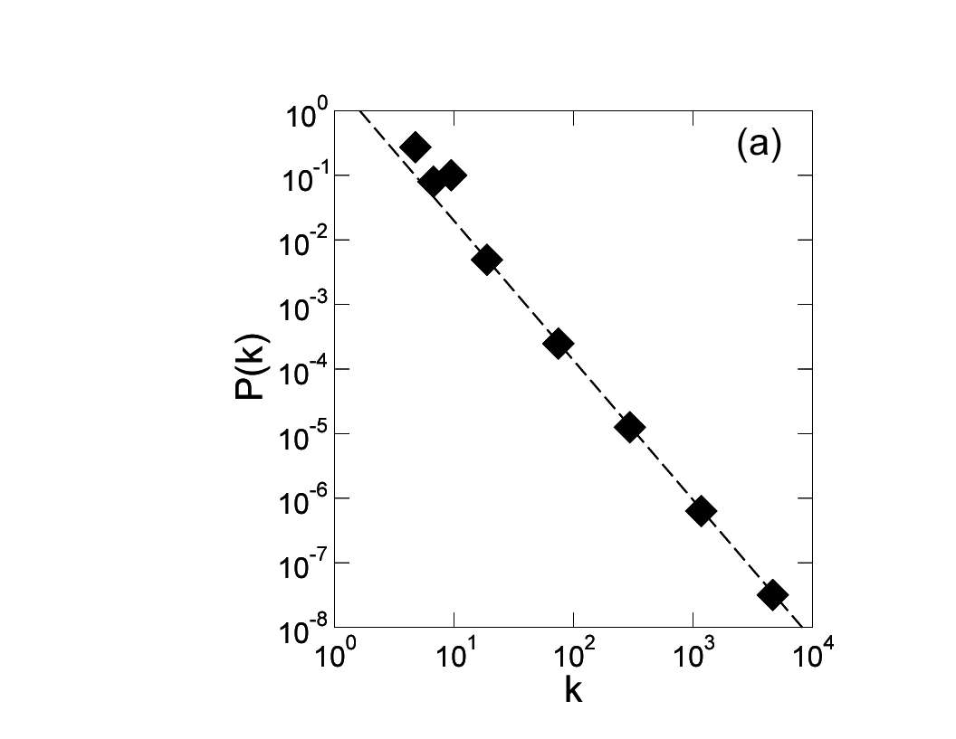
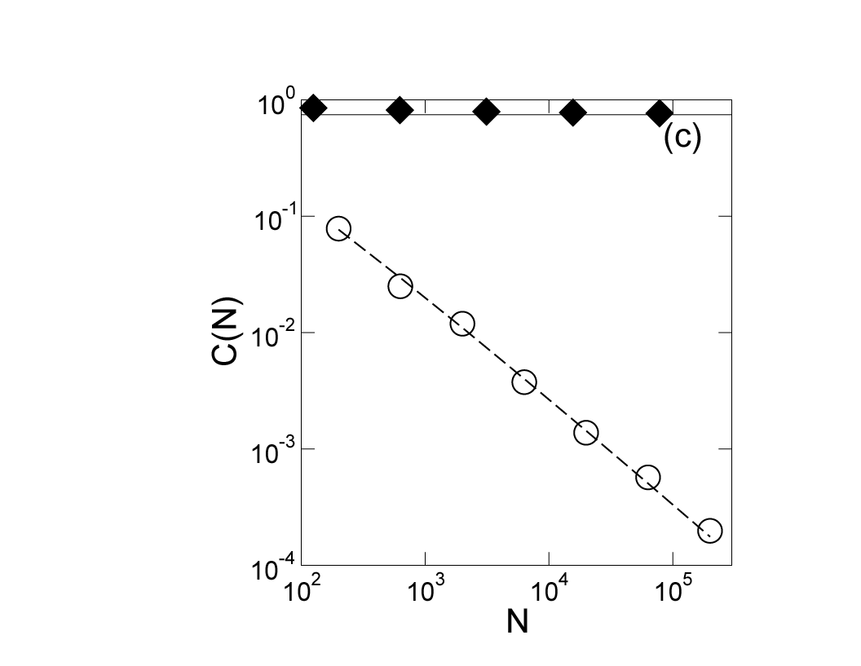
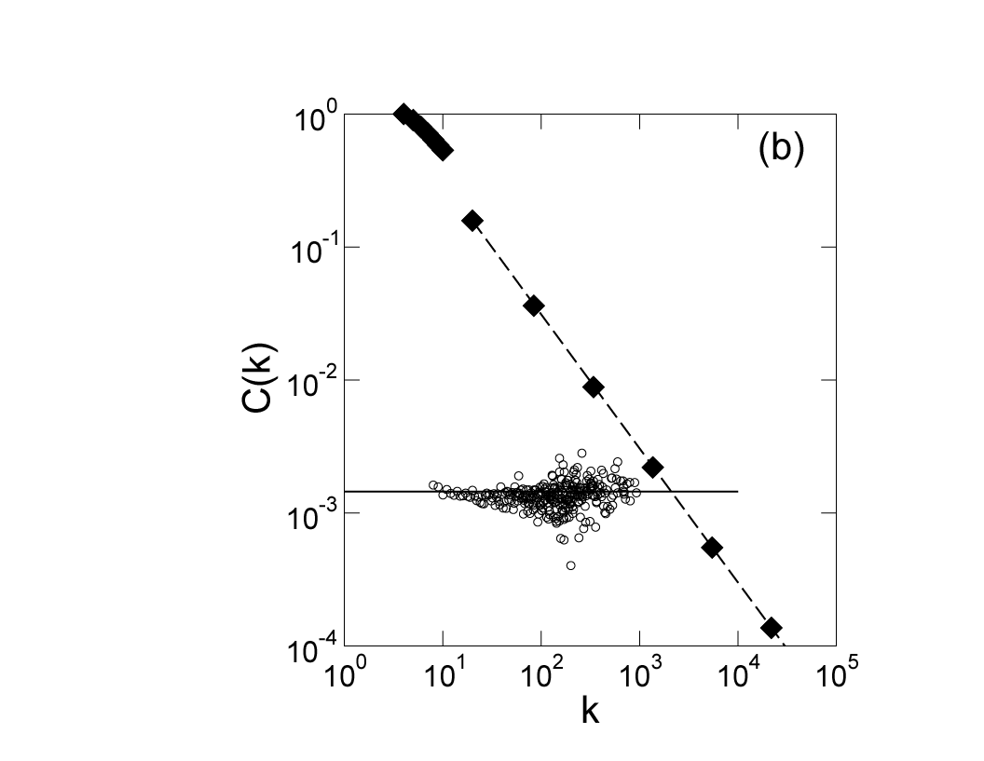
SUMMARY
1. Scale-free
2. Clustering coefficient
independent of N
3. Clustering
spectrum
In real systems C(k) does not always decrease as a power law.
What matters, however, that it decreases, i.e. it is not independent of k.

Slide 35
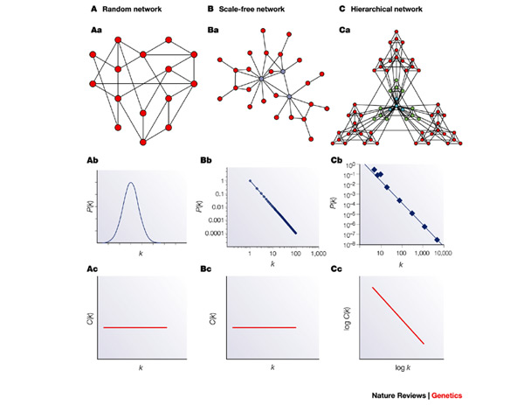
THE BIG PICTURE
Hierarchy is a new rather generic
network property.
A.-L. Barabasi and Z.N. Oltvai, Nat. Rev. Gen.(2004)

Slide 36
What does happen in real systems? Is a prediction that all systems with γ<3 should be automatically dissasortative, or have a cutoff – is this the case?
Let’s see: www, γ=2.1, no cutoff, dissasortative NICE
Actor network, no cutoff, but it is ASSORTATIVE (how is this possible?).
Internet: γ=2.5, disassortative, cutoff , NICE
Networks with γ<3 don’t have to be assortative:
Lets suppose we have a neutral network. High assortativity means a high degree nodes neighbors have high average degree. If we want to make it assortative we have to increase the degree of the neighbors of hubs. Even if the degree of the top neighbors cannot be increased because we used up all of the hubs, the low degree neighbors still can be replaced with higher ones, thus making the network assortative.
Anyway, the social networks checked (actor network, coauthorship network) have cut-offs according to Newman and Stanley.
http://samoa.santafe.edu/media/workingpapers/00-07-037.pdf
http://viseu.chem-eng.northwestern.edu/site_media/publication_pdfs/Amaral-2000-Proc.Natl.Acad.Sci.U.S.A.-97-11149.pdf

Slide 37
Static model used for examples
Start with N unconnected nodes.
Assign a w_{i} weight to each node i.
Randomly select two nodes with probability proportional to w_{i}. Connect these nodes. Repeat L times.
If
Upper cut-off may be added by introducing i₀:
For large N this should be equivalent to the configuration model.

Slide 38
Static model used for examples
Start with N unconnected nodes.
Assign a w_{i} weight to each node i.
Randomly select two nodes with probability proportional to w_{i}. Connect these nodes. Repeat L times.
If
Upper cut-off may be added by introducing i₀:
For large N this should be equivalent to the configuration model.

Slide 39

MALLOY-REED CRITERIA: THE EXISTENCE OF A GIANT COMPONENT
A giant cluster exists if each node is connected to at least two other nodes.
The average degree of a node i linked to the GC, must be 2, i.e.
Bayes’ theorem
P(k_{m}|i <-> j): joint probability that a node has degree k_{m} and is connected to nodes i and j.
For a randomly connected network (does NOT mean random network!) with P(k):
i can choose between N-1 nodes to link to, each with probability 1/(N-1). I can try k_{i} times.
κ>2: a giant cluster exists
κ<2: many disconnected clusters
Malloy, Reed, Random Structures and Algorithms (1995); Cohen et al., Phys. Rev. Lett. 85, 4626 (2000).
Notes:
A : For a graph having degree distribution P(k) to have a giant component, a node that is reached by following a link from the giant component must have at least one other link on average to allow the component to exist. For this to occur, the average degree must be at least 2 (one incoming and one outgoing link) given that the node i is connected to j:
B:

Slide 40
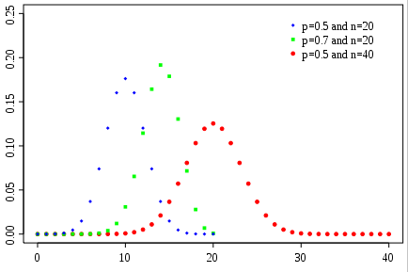
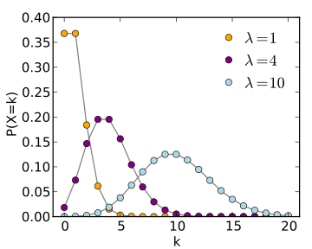
Apply the Malloy-Reed Criteria to an Erdos-Renyi Network
Discrete Formulation
-binomial distribution-
Continuum Formulation
-Poisson distribution-
Probability Distribution Function
(PDF)

Slide 41
Apply the Malloy-Reed Criteria to an Erdos-Renyi Network
A giant cluster exists if each node is connected to at least two other nodes.
κ>2: a giant cluster exists;
κ<2: many disconnected clusters;
Malloy-Reed; Cohen et al., Phys. Rev. Lett. 85, 4626 (2000).

