Slide 1

Frontiers of Network Science
Fall 2022
Class 17: Robustness II
(Chapter 8 in Textbook)
based on slides by
Albert-László Barabási
and Roberta Sinatra
Boleslaw Szymanski
www.BarabasiLab.com

Slide 2
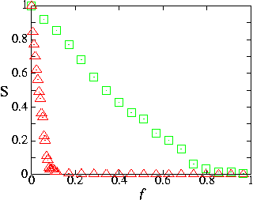
Summary: Achilles’ Heel of complex networks
failure
attack
Internet
R. Albert, H. Jeong, A.L. Barabasi, Nature 406 378 (2000)

Slide 3
Historical Detour: Paul Baran and Internet
1958
A network of n-ary
degree of connectivity
that has n links per
node was simulated
The simulation revealed that networks where n ≥ 3 had a significantly increased resilience against the large failure involving at least 50% node loss. Baran's insight gained from the simulation was that redundancy was the key.
Notes:
While working at the RAND Corporation, Paul Baran was assigned the task of designing a "survivable" communications system that could maintain communication between end points in the face of damage from nuclear attack. Using mini-computer technology of the day, Baran and his team developed a simulation suite to test basic connectivity of an array of nodes with varying degrees of linking. That is, a network of n-ary degree of connectivity would have n links per node. The simulation randomly 'killed' nodes and subsequently tested the percentage of nodes who remained connected. The result of the simulation revealed that networks where n >= 3 had a significant increase in resilience against even as much as 50% node loss. Baran's insight gained from the simulation was that redundancy was the key.
As a result of President Eisenhower's Defense Reorganization Act of 1958, there was a major shift in leadership in the Pentagon around the time Baran's work was accepted by the US Air Force and DoD for implementation and testing. When Baran discovered an older Navy admiral would oversee the project he decided the project would be better off sitting on the shelf as reference material, claiming that an 'old analog guy' couldn't grasp what it was the project aimed to accomplish, and thus would likely fail from lack of understanding.
Around the same time when ARPA was developing the idea of an inter-networked set of terminals to share computing resources, among the number of reference materials considered was Paul Baran and the RAND Corporation's On Distributed Communications volumes. The ARPANET was never intended to be a survivable communications network, but some still maintain the myth that it was. Instead, the resilience feature of a packet switched network that uses link-state routing protocols is something we enjoy today in some part from the research done to develop a network that could survive a nuclear attack.
(Source: Wikipedia, Paul Baran)

Slide 4
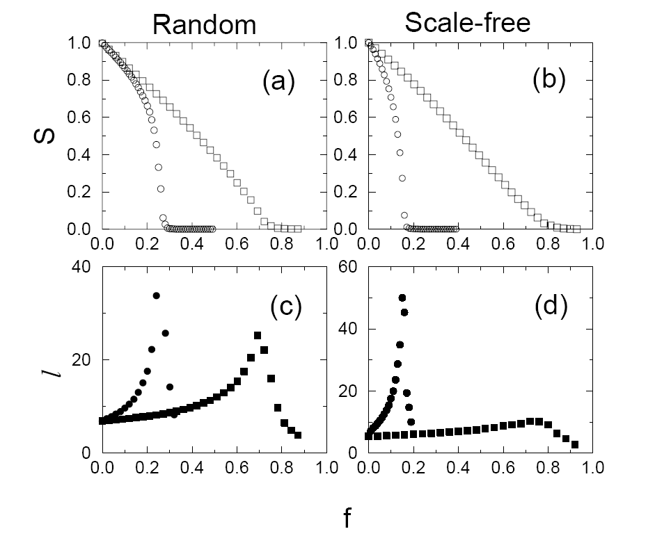
Scale-free networks are more error tolerant, but also more vulnerable to attacks
squares: random failure
circles: targeted attack
S surviving fraction of GC
l average distance between
nodes
Failures: little effect on the integrity of the network.
Attacks: fast breakdown

Slide 5
Real scale-free networks show the same dual behavior
blue squares: random failure
red circles: targeted attack
open symbols: S (size of surviving
component)
filled symbols: l (average distance)
break down if 5% of the nodes are eliminated selectively (always the highest degree node)
resilient to the random failure of 50% of the nodes.
Similar results have been obtained for metabolic networks and food webs.

Slide 6

Cascades
Potentially large events triggered by small initial shocks
Information cascades
social and economic systems
diffusion of innovations
Cascading failures
infrastructural networks
complex organizations

Slide 7

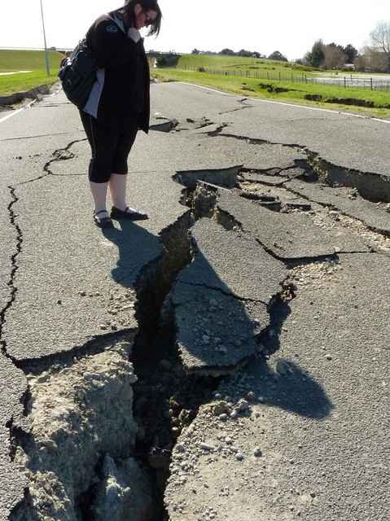
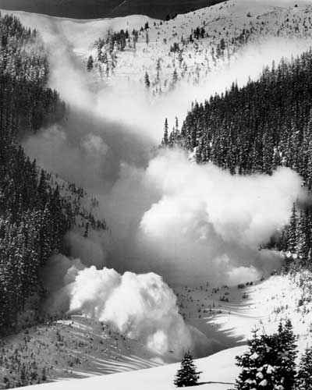
Cascading Failures in Nature and Technology
Blackout
Earthquake
Avalanche
Flows of physical quantities
congestions
instabilities
Overloads
Cascades depend on
Structure of the network
Properties of the flow
Properties of the net elements
Breakdown mechanism

Slide 8
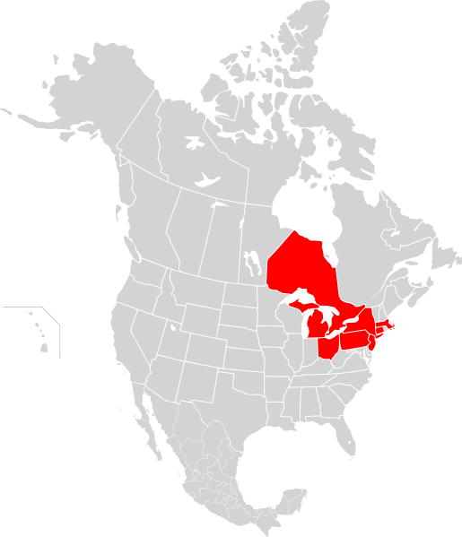
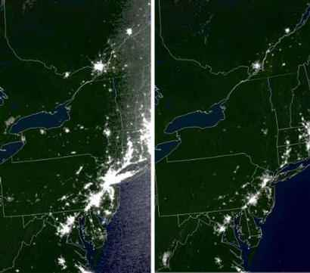
Northeast Blackout of 2003
Origin
A 3,500 MW power surge (towards Ontario) affected the transmission grid at 4:10:39 p.m. EDT. (Aug-14-2003)
Before the blackout After the blackout
Consequences
More than 508 generating units at 265 power plants shut down during the outage. In the minutes before the event, the NYISO-managed power system was carrying 28,700 MW of load. At the height of the outage, the load had dropped to 5,716 MW, a loss of 80%.

Slide 9
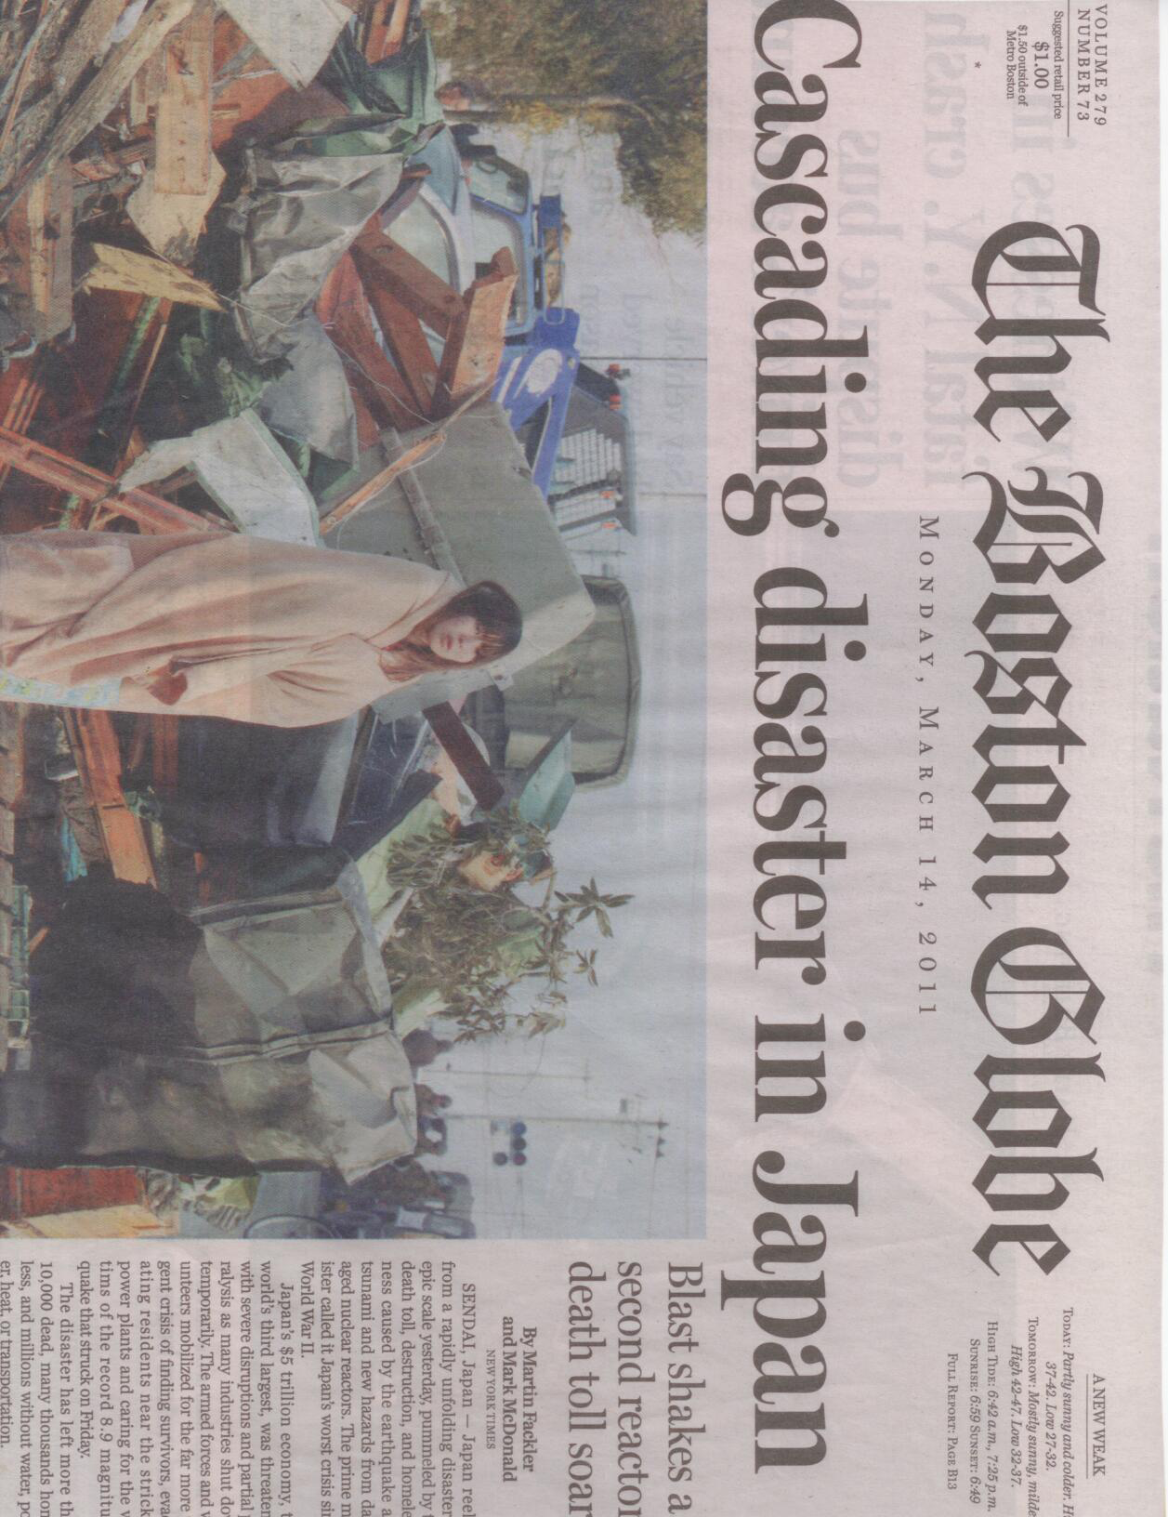
Network Science: Robustness Cascades

Slide 10
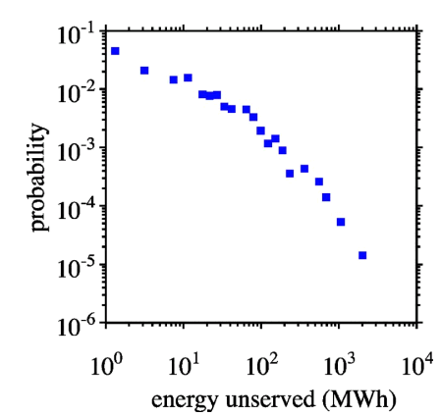
Cascades Size Distribution of Blackouts
Unserved energy/power magnitude (S) distribution
P(S) ~ S ^{−α}, 1< α < 2
Probability of energy unserved during North American blackouts 1984 to 1998.
Source | Exponent | Quantity
North America | 2.0 | Power
Sweden | 1.6 | Energy
Norway | 1.7 | Power
New Zealand | 1.6 | Energy
China | 1.8 | Energy
I. Dobson, B. A. Carreras, V. E. Lynch, D. E. Newman, CHAOS 17, 026103 (2007)

Slide 11
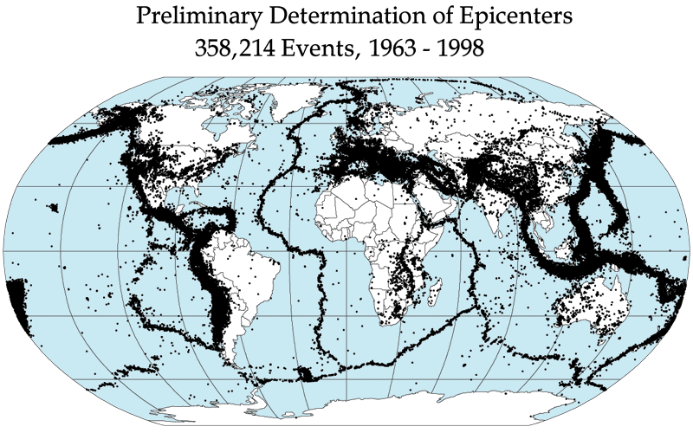
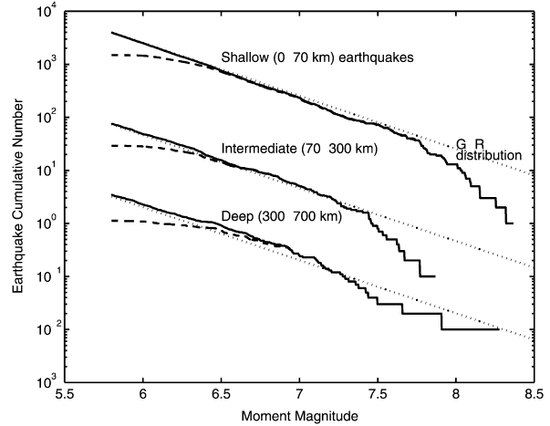
Cascades Size Distribution of Earthquakes
Earthquake size S distribution
Earthquakes during 1977–2000.
P(S) ~ S ^{−α},α ≈ 1.67
Y. Y. Kagan, Phys. Earth Planet. Inter. 135 (2–3), 173–209 (2003)

Slide 12
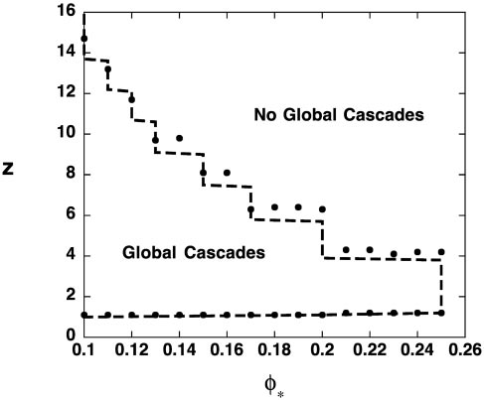
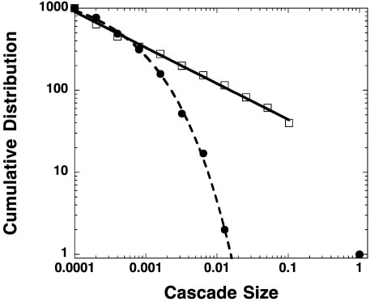
Failure Propagation Model
Initial Setup
Random graph with N nodes
Initially each node is functional.
Cascade
Initiated by the failure of one node.
f_{i} : fraction of failed neighbors of node i. Node i fails if f_{i} is greater than a global threshold φ.
Undercritical
<k>
Critical
Network falls apart (<k>=1)
Overcritical
φ =0.4
● Overcritical
f = 1/2
□ Critical
f = 1/2
f = 0
f = 1/2
f = 1/3
f = 2/3
Erdos-Renyi network
P(S) ~ S ^{−3/2}
D. Watts, PNAS 99, 5766-5771 (2002)

Slide 13
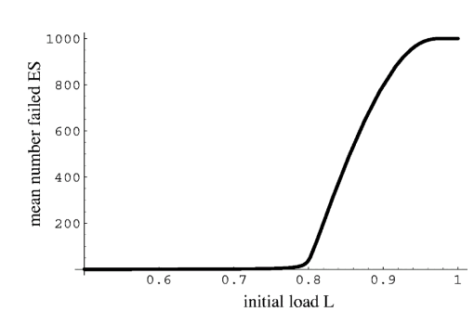
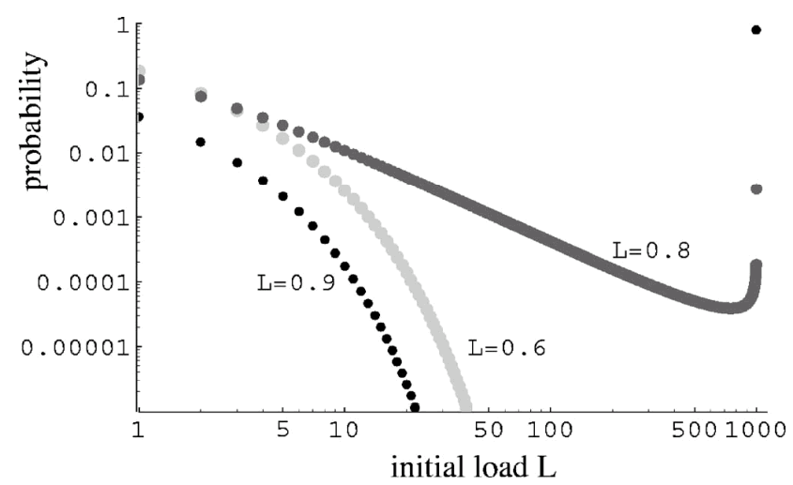
Overload Model
Undercritical
Overcritical
Initial Conditions
N Components (complete graph)
Each components has random initial load L_{i} drawn at random uniformly from [L_{min}, 1].
Cascade
Initiated by the failure of one component.
Component fail when its load exceeds 1.
When a component fails, a ﬁxed amount P is transferred to all the rests.
Critical
L_{min}
Overcritical
L_{i} =0.95
L_{i} =0.8
Critical
Undercritical
P=0.15
L_{i} =0.7
L_{i} =0.9
L_{i} =0.85
L_{i} =1.05
P(S) ~ S ^{−3/2}
I. Dobson, B. A. Carreras, D. E. Newman, Probab. Eng. Inform. Sci. 19, 15-32 (2005)

Slide 14
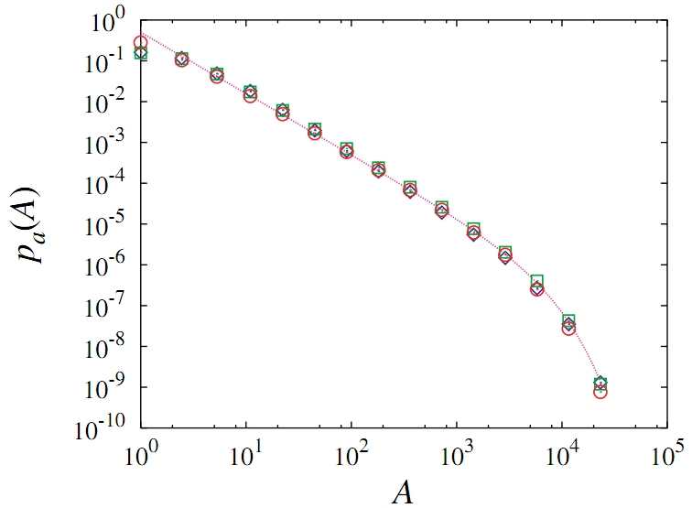
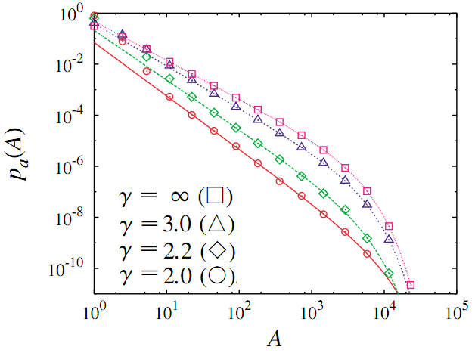
Self-organized Criticality AKA Sandpile Model
Initial Setup
Random graph with N nodes
Each node i has height h_{i} = 0.
Cascade
At each time step, a grain is added at a randomly chosen node i: h_{i} ← h_{i} +1
If the height at the node i reaches a prescribed threshold z_{i} = k_{i}, then it becomes unstable and all the grains at the node topple to its adjacent nodes: h_{i} = 0 and h_{j} ← h_{j} +1
if i and j are connected.
Homogenous case
Scale-free network
Homogenous network: <k²> converges
P(S) ~ S ^{−3/2}
Scale-free network : p_{k} ~ k^{-γ} (2<γ<3)
P(S) ~ S ^{−γ/(γ −1)}
K.-I. Goh, D.-S. Lee, B. Kahng, and D. Kim, Phys. Rev. Lett. 91, 148701 (2003)
Notes:
the avalanche size 𝑆, the number of toppling events in a given avalanche

Slide 15
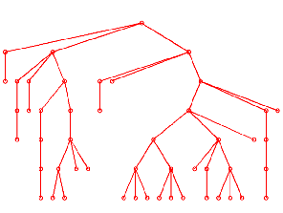
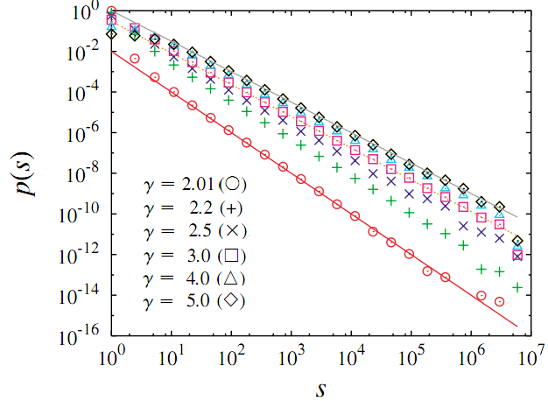
Branching Process Model
Branching Process
Starting from a initial node, each node in generation t produces k number of offspring nodes in the next t + 1 generation, where k is selected randomly from a fixed probability distribution q_{k}=p_{k-1}.
Fix <k>=1 to be critical → power law P(S)
Hypothesis
No loops (tree structure)
No correlation between branches
Narrow distribution: <k²> converged
P(S) ~ S ^{−3/2}
Fat tailed distribution: q_{k} ~ k^{-γ} (2<γ<3)
P(S) ~ S ^{−γ/(γ −1)}
K.-I. Goh, D.-S. Lee, B. Kahng, and D. Kim, Phys. Rev. Lett. 91, 148701 (2003)

Slide 16
Short Summary of Models: Universality
Models | Networks | Exponents
Failure Propagation Model | ER | 1.5
Overload Model | Complete Graph | 1.5
BTW Sandpile Model | ER/SF | 1.5 (ER) γ/(γ - 1)(SF)
Branching Process Model | ER/SF | 1.5 (ER) γ/(γ - 1)(SF)
Universal for homogenous networks
P(S) ~ S ^{−3/2}
Same exponent for percolation too (random failure, attacking, etc.)

Slide 17
Explanation of the 3/2 Universality
Simplest Case: q₀ = q₂ = 1/2, <k> = 1
S: number of nodes
X: number of open branches
½ chance
S = S+1
X = X -1
S = 2, X = 0
k= 0
S = 1
X = 1
S = S+1
X = X+1
S = 2, X = 2
½ chance
k=2
X
X >0, Branching process stops when X = 0
S
Dead

Slide 18
Explanation of the 3/2 Universality
X
S
Dead
Equivalent to 1D random walk model, where X and S are the position and time , respectively.
Question: what is the probability that X = 0 after S steps?
First return probability ~ S^{-3/2}
M. Ding, W. Yang, Phys. Rev. E. 52, 207-213 (1995)

Slide 19
Size Distribution of Branching Process (Cavity Method)
S₁
S₁
S₂
k = 0
k = 1
k = 2
S = 1
S = 1+S₁
S = 1+S₁+S₂
K.-I. Goh, D.-S. Lee, B. Kahng, and D. Kim, Physica A 346, 93-103 (2005)

Slide 20
Solving the Equation by Generating Function
Definition:
G_{S}(x) = Σ_{S=0} P(S)x^{S}
G_{k}(x) = Σ_{k=0} q_{k}x^{k}
Property:
G_{S}(1) = G_{k}(1) = 1
G_{S}’(1) = <S>, G_{k}’(1) = <k>
Phase Transition
<S> = G_{S}’(1) = 1+ G_{k}’(1) G_{S}’(1) = 1 + <k> <S>, then
<S> = 1/(1- <k>)
The average size <S> diverges at <k>_{c} = 1

Slide 21
Finding the Critical Exponent from Expansion
Definition:
G_{S}(x) = Σ_{S=0} P(S)x^{S}
G_{k}(x) = Σ_{k=0} q_{k}x^{k}
Theorem:
If P(k) ~ k^{-γ} (2<γ<3), then for δx < 0, |δx| << 1
G(1+ δx) = 1 + <k>δx + <k(k-1)/2> (δx)² + … + O(|δx|^{γ - 1})
P(S) ~ S ^{−α},1< α < 2
G_{S}(1+ δx) ≈ 1 + A|δx|^{α -1}
Homogenous case: <k²> converged <k> = 1, <k²> < ∞
G_{k}(1+ δx) ≈ 1 + δx + Bδx²
Inhomogeneous case: <k²> diverged
<k> = 1, q_{k} ~ k^{-γ} (2<γ<3)
G_{k}(1+ δx) ≈ 1 + δx + B|δx|^{γ - 1}

Slide 22
Critical Exponent for Homogenous Case
Homogenous case
G_{k}(1+ δx) ≈ 1 + δx + Bδx²
G_{S}(1+ δx) ≈ 1 + A|δx|^{α -1}
G_{S}(x) = xG_{k}(G_{S}(x))
G_{S}(x) ≈ 1 + A|δx|^{α -1}
xG_{k}(G_{S}(x)) ≈ (1+δx)[1+ (G_{S}(1+δx)-1) + B (G_{S}(1+δx)-1)²]
≈ (1+δx)[1+ A|δx|^{α -1} + AB|δx|^{2α -2}]
= 1 + A|δx|^{α -1} + AB|δx|^{2α -2} + δx + O(|δx|^{α})
The lowest order reads AB|δx|^{2α -2} + δx = 0, which requires
2α -2 = 1and A = 1/B. Or,
α = 3/2

Slide 23
Critical Exponent for Inhomogeneous Case
Inhomogeneous case
G_{k}(1+ δx) ≈ 1 + δx + B|δx|^{γ - 1}
G_{S}(1+ δx) ≈ 1 + A|δx|^{α -1}
G_{S}(x) = xG_{k}(G_{S}(x))
G_{S}(x) ≈ 1 + A|δx|^{α -1}
xG_{k}(G_{S}(x)) ≈ (1+δx)[1+ (G_{S}(1+δx)-1) + B |G_{S}(1+δx)-1|^{γ -1}]
≈ (1+δx)[1+ A|δx|^{α -1} + AB|δx|^{(α -1)(γ -1)}]
= 1 + A|δx|^{α -1} + AB|δx|^{(α -1)(γ -1)} + δx + O(|δx|^{α})
The lowest order reads AB|δx|^{(α -1)(γ -1)} + δx = 0, which requires
(α -1)(γ -1) = 1and A = 1/B. Or,
α = γ/(γ −1)

Slide 24
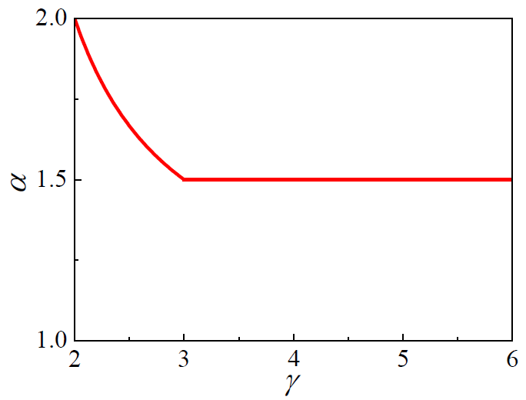
Comparing the Prediction with the Real Data
Blackout
Blackout
Source | Exponent | Quantity
North America | 2.0 | Power
Sweden | 1.6 | Energy
Norway | 1.7 | Power
New Zealand | 1.6 | Energy
China | 1.8 | Energy
Earthquake α ≈ 1.67
I. Dobson, B. A. Carreras, V. E. Lynch, D. E. Newman, CHAOS 17, 026103 (2007)
Y. Y. Kagan, Phys. Earth Planet. Inter. 135 (2–3), 173–209 (2003)

