Slide 1
Response Prediction and Clustering on Social and Criminal Networks
By: Aamir Mandviwalla

Slide 2
Who am I?
Aamir Mandviwalla
Computer science PhD student at RPI
Dr. Szymanski is my advisor
B.S. in Mathematics and Computer Science from Temple University in 2019

Slide 3
DARPA Challenge – Response Prediction for Twitter users on 2017 French election

Slide 4
Background on 2017 French Election
French presidential elections – once every 5 years
Initial round with all candidates – top 2 advance to second round
Five main candidates:
Jean-Luc Melenchon (far left wing) – 19.5% vote
Benoit Hamon (left center) – 6.3% vote
Emmanuel Macron (center) – 24.0% vote
Francois Fillon (right center) – 20.0% vote
Marine Le Pen (far right wing) – 21.3% vote
Le pen and Macron advanced – Macron won (66.1% vs. 33.9%)

Slide 5
Mention Analysis

Slide 6
Mention Analysis (logarithmic axis)

Slide 7
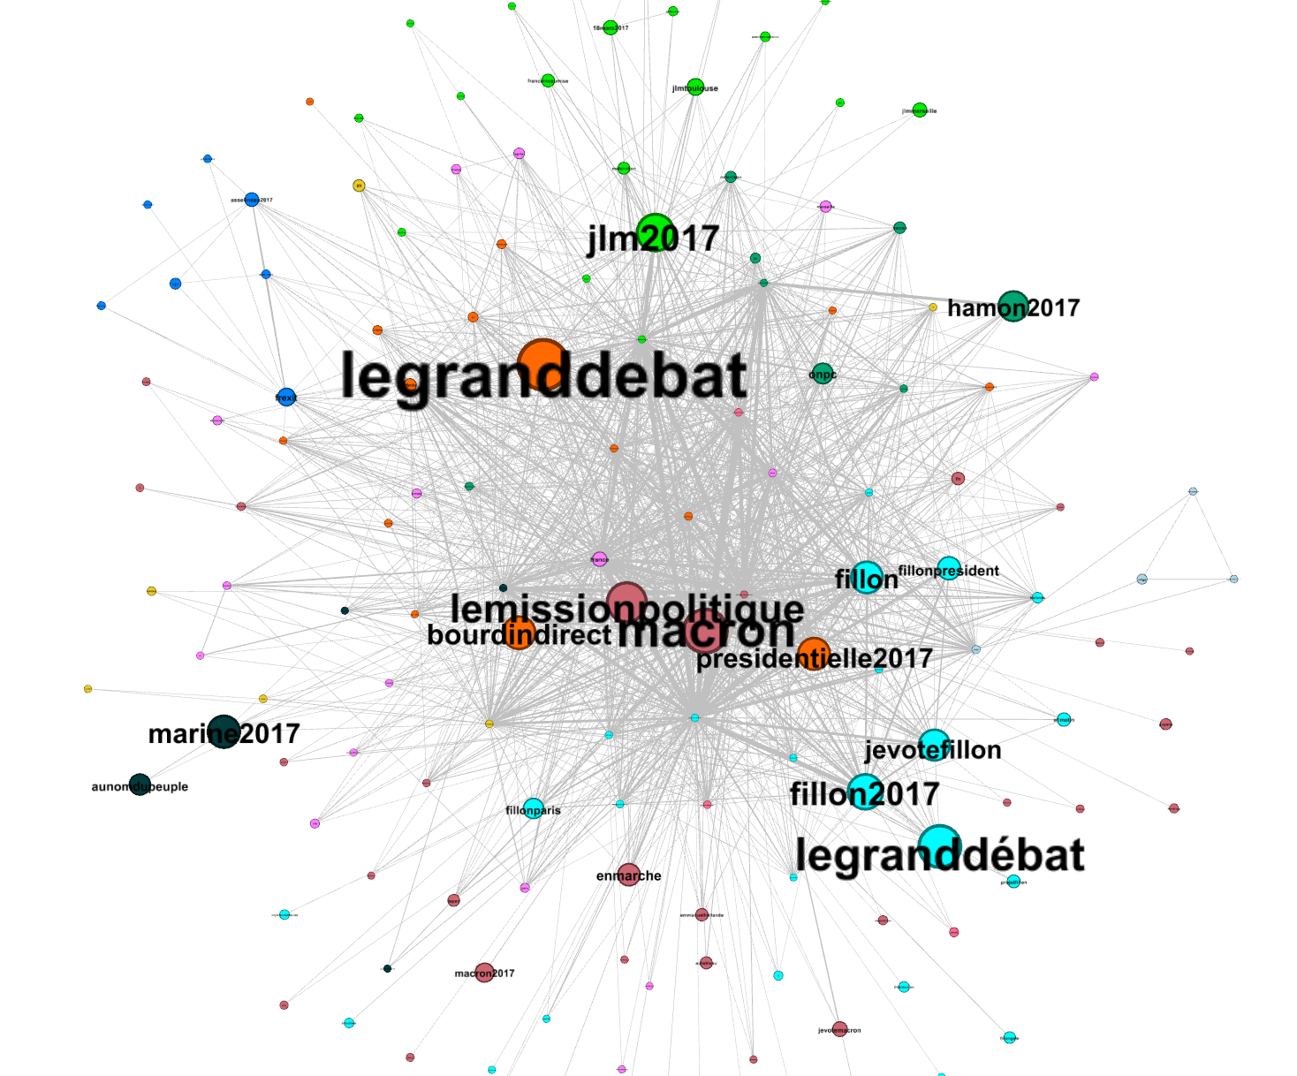
Trend-Trend graph
Pull out trends from raw messages as hashtags
If a single user interacts with two trends (uses them in their own tweets or replies to a tweet which contains them) we increase the edge weight between these two trends by 1
Only edges with weight greater than 50 are kept in the graph
Nodes which do not have any such edges (w > 50) are removed from the graph

Slide 8
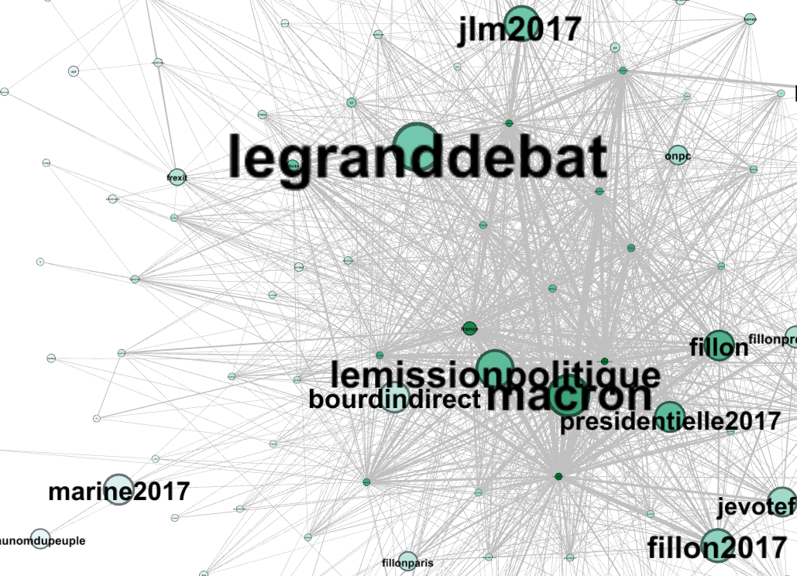
Isolation
Size of nodes based on total # of mentions
Darker color for greater degree in trend-trend graph
Far-right candidate (marine2017) similar size to other candidates but much weaker connection to the graph
Users that post about this trend do not frequently use other hashtags

Slide 9
Enrichment 1 - ActorRelatedTrends
List of trends interacted with by each actor
Normalized weights between 0 and 1 reflecting relative activity level for each trend
Compare two actors with sum of weights of intersecting trends divided by sum of weights of union of trends

Slide 10
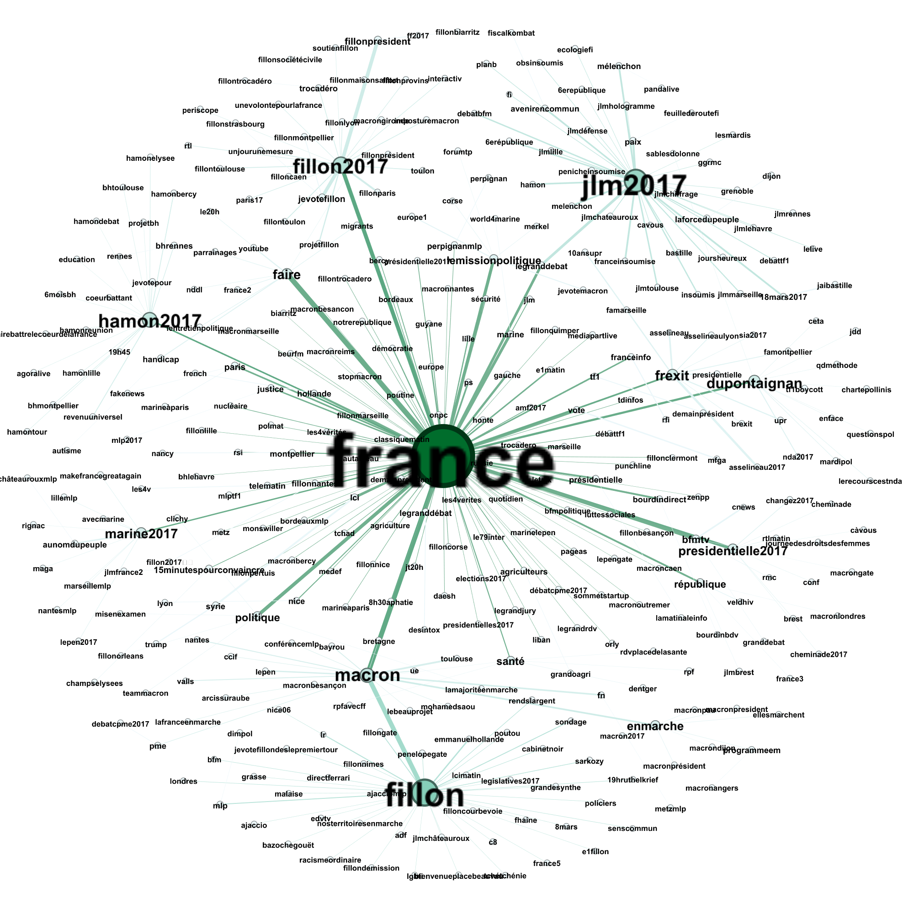
Trend-Trend Maximum Spanning Tree

Slide 11
Francois Fillon

Slide 12
Marine Le Pen (mlp)

Slide 13
Enrichment 2 – ActorNicheTrendInterest
Value between 0 and 1 for each actor
Normalized mean distance of actors’ interacted with trends from root of Max spanning tree (France)
Provides a measure of how niche/generic an actor’s interests are (distance from origin)

Slide 14
Actor X
Actor X
ActorRelatedTrends – jlm2017 1.0, jlmchateauroux 1.0, fillon2017 0.5
Direction
ActorNicheTrendInterest – 2.2
Distance

Slide 15
Performance Analysis

Slide 16
Linear Regression vs. Random Forest Regression
RF-A <<< LR-B < LR-A << RF-B
RF-A: a random forest regressor that uses only the time series as an input feature
RF-B: a random forest regressor that uses both the time series and our enrichments as input features
LR-A: a linear regressor that uses only the time series as an input feature
LR-B: a linear regressor that uses both the time series and our enrichments as input features
Summary:
The linear regressor has much higher prediction accuracy than the random forest when using only numeric/linearly related features
The random forest has a significant improvement over the linear regressor when including additional categorical features as inputs

Slide 17
Clustering on Covert Networks

Slide 18
Covert Networks
Includes criminal and terrorist networks
Problem: Lack of data
Participants intentionally try to hide their activities
Legal restrictions make it difficult to get access to law enforcement data

Slide 19
Solution
Generate synthetic networks (make our own data)!
First, we study some datasets to learn important properties of covert networks
Next, we construct an algorithm to reproduce these properties in a synthetic/generated network
Finally, we test our results by comparing the generated networks with real networks

Slide 20
Caviar Network
Project Caviar – Canadian police wiretapped a drug (hashish and cocaine) network between 1994 and 1996
Although 11 drug shipments were seized over the period, no arrests were made until the end of the investigation
318 individuals were named in the wiretappings. 110 were determined to have a clear participatory role in the network

Slide 21
Caviar Network
The network was released as a set of communication matrices by Carlo Morselli in his book “Inside Criminal Networks” in 2009.
Morselli got permission from the Montreal police to access their files. He collected over 1000 pages of telephone conversations
He released the data as a set of 11 snapshots. Each snapshot covers a 2 month span during the 22 month investigation.

Slide 22
Sample Snapshot

Slide 23
Caviar 6
Snapshot 6 was identified as the most stable snapshot
In earlier snapshots, many of the participants have not been identified yet and there are less active wiretaps so there is less data
In later snapshots, the network begins to fall apart in reaction to law enforcement repeatedly seizing the network’s drug shipments
This snapshot features 27 nodes, and a total of 668 communications (avg of 24.7 communications per node)

Slide 24
Ciel Network
Project Ciel – another Canadian police wiretapping operation
A hashish network was tracked from May 1996 to June 1997
75 total individuals; 25 were identified with participatory roles
Three shipment seizures during the investigative period

Slide 25
Ciel Network
Again, Morselli obtained the data and published it in his book
Only 1 snapshot for the entire period
Much less observed activity vs. Caviar 6:
Ciel – 198 communications between 25 individuals over 13 months
Caviar 6 – 668 communications between 27 individuals over 2 months
15.2 comm/month for ciel vs. 334.0 comm/month for caviar
Why? (open to class discussion)

Slide 26
Why?
Scope of the network
Ciel only imported hashish from Jamaica to Montreal
Caviar imported both hashish and cocaine from multiple different locations
Timescale
The caviar 6 snapshot features 27 participants over just 2 months
The ciel network features 25 participants over 13 months
There are 110 total participants over all 22 months of the caviar
Some participants are mainstays, but others only appear in a limited number of snapshots – if we assume the same was true for ciel, then we can guess that the network was overall much smaller at any given time

Slide 27
Why?
Leadership differences
Morselli identifies many of the key leader nodes in each network in his book
In Caviar, these leaders are free and interact a great deal
In Ciel, one of the main leaders is already incarcerated at the start of the investigation, so he is unable to communicate much with the others
In both networks, the free leaders account for the vast majority of communications, especially between each other
Other reasons:
We can speculate on plenty of other possibilities
For example, perhaps the ciel network members simply chose to be a bit more cautious? The ciel investigation takes place in the same area as caviar and directly after caviar was bought down (94-96 and then 96-97)

Slide 28
So, what is similar?
Leadership Nodes, Hierarchy, and Betweenness Centrality:
Morselli identifies several important leadership nodes in his book
In Caviar, N1 is the leader of the hashish traffickers, N12 is the leader of the cocaine traffickers, and N76 and N3 are both considered important traffickers
In Ciel, N1 and N2 are each lead traffickers of their own parts of the network. N10 is also identified as an important member who was incarcerated before the investigation

Slide 29
Betweenness Centrality Review
The betweenness centrality of node v = the number of shortest paths from node s to node t which contain v divided by the total number of shortest paths from s to t (summed up for every pair of nodes s and t excluding v)
Relative betweenness centrality: we divide by the highest possible betweenness centrality so that values are scaled between 0 and 1

Slide 30
Hierarchy – Communities, Leaders, and Subordinates
Each network we studied featured multiple “communities” that could be detected using standard community detection algorithms like Louvain Modularity or Dr. Szymanski’s SpeakEasy
Similar to the concept of clusters in machine learning, a community comprises a set of nodes that are closely related
In each of the networks we studied, the detected communities matched closely with the leadership nodes identified by Morselli
Subordinate nodes inside of each community tended to be primarily connected to their leadership node, with occasional connections to other nodes in their community and very rarely any connections outside of their community

Slide 31
Randomized Anonymous Network Generator (RANG)
Algorithm developed by fellow PhD student Amr Elsisy and Dr. Szymanski
Takes as input a network and outputs a statistically similar network
Shakes up the network (removing and adding edges/weight)
Attempts to maintain betweenness centrality of nodes
Uses Stochastic Block Model to retain relative weight of edges between and inside of communities

Slide 32
Future/Current Work
With RANG we can generate 100 statistically similar covert networks
We can run community detection algorithms on each one
If you don’t know the ground truth communities (almost always true), you would probably just take the most common set of communities detected over these 100
Can we beat this?
Preliminary results:
On an LFR benchmark network with similar properties to caviar, shaken 100 times:
Mode NMI score – 0.423
Our method NMI score – 0.537 – 27% improvement

Slide 33
Questions?

