Slide 1
Graph Convolutional Networks
Harshaa
Hiremagalur Narayan
Dhruva

Slide 2
The papers we are presenting
1. Graph convolutional networks: a comprehensive review
Si Zhang, Hanghang Tong, Jiejun Xu and Ross Maciejewski (UIUC)
2. Graph Convolutional Networks for Text Classification
Liang Yao, Chengsheng Mao, Yuan Luo (Northwestern University)

Slide 3
Contents
Spectral GCNs
Spatial GCNs
Classic-CNN based
Propagation based
Related general frameworks
Applications
Computer Vision
NLP
Science
Challenges

Slide 4
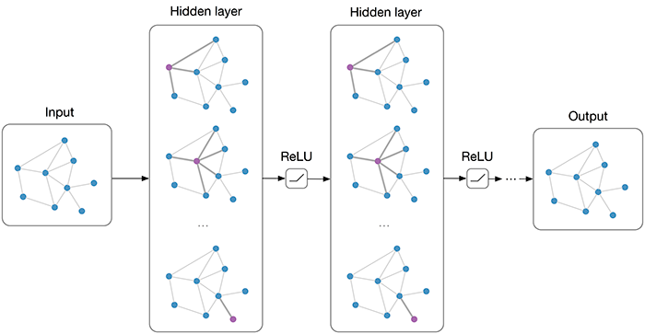
The GCN
Semi-Supervised Classification with Graph Convolutional Networks
Thomas N. Kipf, Max Welling

Slide 5
Spectral GCNs
What properties of a graph are exposed/revealed if we
1) represent the graph as a matrix?
2) study the eigenvectors/eigenvalues of that matrix?
V is a matrix of Eigenvectors of L. O(n^3) time complexity.

Slide 6
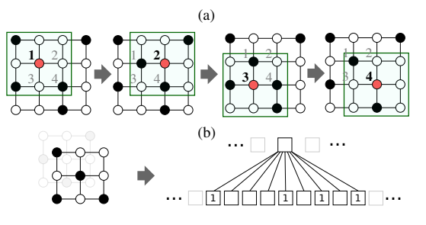
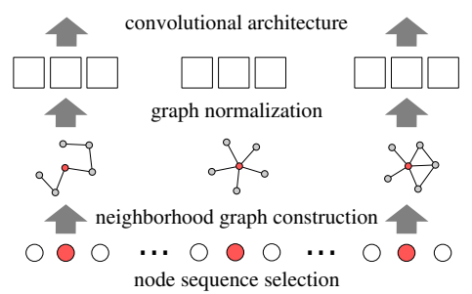
Spatial GCNs – CNN based
Learning Convolutional Neural Networks for Graphs
Mathias Niepert, Mohamed Ahmed, Konstantin Kutzkov
PATCHY-SAN architecture

Slide 7
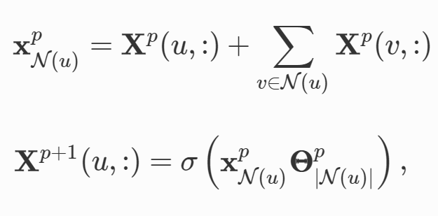
Spatial GCNs – propagation based
Convolutional networks on graphs for learning molecular fingerprints.
graph convolution for node u at the pth layer is designed as:
where $θ_{\left|N(u)\right|}^{p}$is the weight matrix for nodes with the same degree as |N(u)| at the $p^{th}$ layer.

Slide 8
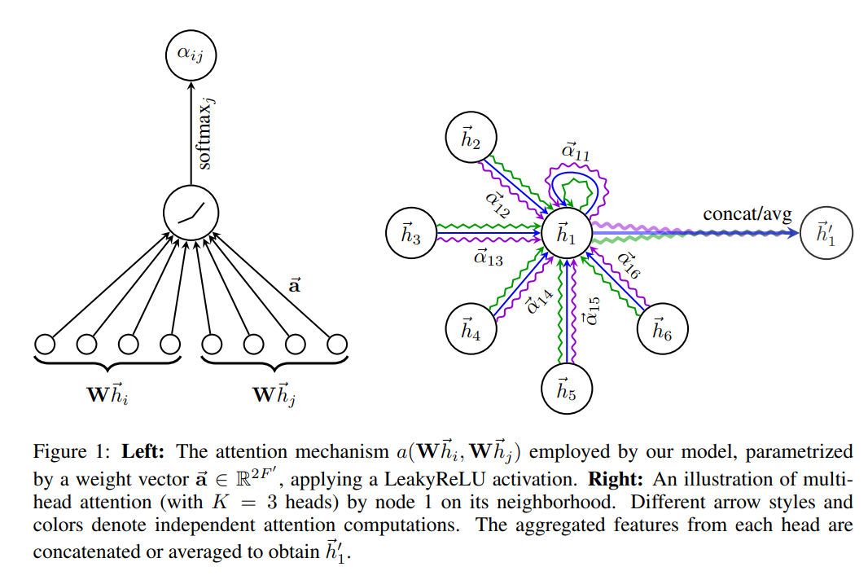
Spatial GCNs – related frameworks

Slide 9
Applications
Computer Vision
Natural Language Processing
Science

Slide 10
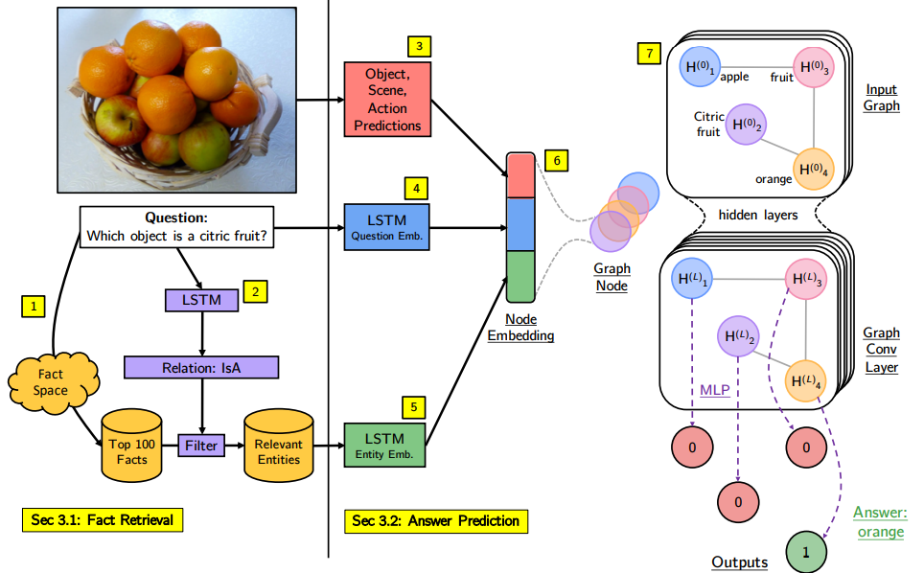
Applications in CV - Images
Out of the Box: Reasoning with Graph Convolution Nets for Factual Visual Question Answering
Medhini Narasimhan, Svetlana Lazebnik, Alexander G. Schwing
Notes:
Given an image and a question, we use a similarity scoring technique (1) to obtain relevant facts from the fact space. An LSTM (2) predicts the relation from the question to further reduce the set of relevant facts and its entities. An entity embedding is obtained by concatenating the visual concepts embedding of the image (3), the LSTM embedding of the question (4), and the LSTM embedding of the entity (5). Each entity forms a single node in the graph and the relations constitute the edges (6). A GCN followed by an MLP performs joint assessment (7) to predict the answer. Our approach is trained end-to-end.

Slide 11
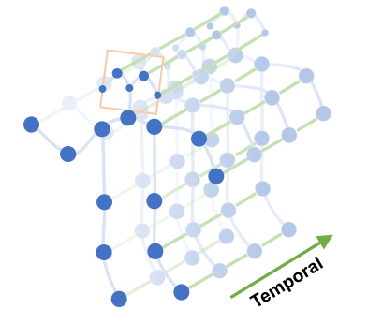
Applications in CV - Videos
Spatial Temporal Graph Convolutional Networks for Skeleton-Based Action Recognition
Sijie Yan, Yuanjun Xiong, Dahua Lin

Slide 12
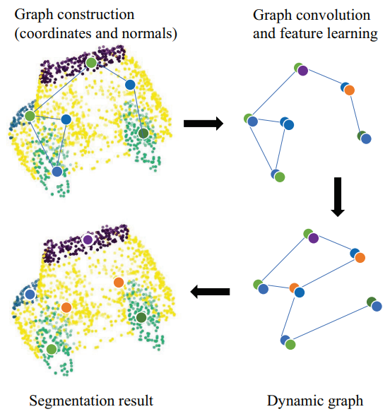
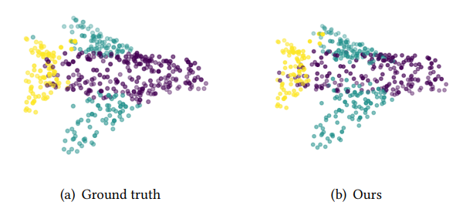
Applications in CV – Point clouds
RGCNN: Regularized Graph CNN for Point Cloud Segmentation
Gusi Te, Wei Hu, Zongming Guo, Amin Zheng
Notes:
Classifying objects and segmenting objects

Slide 13
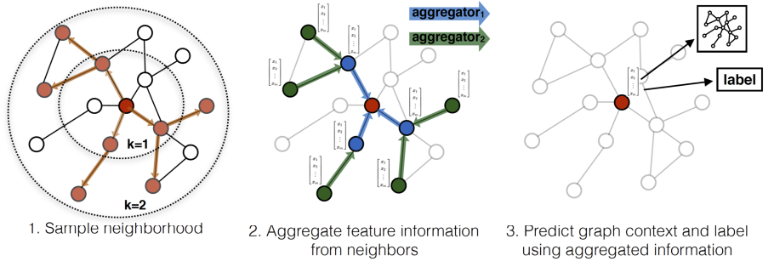
Applications in NLP
Inductive Representation Learning on Large Graphs
William L. Hamilton, Rex Ying, Jure Leskovec

Slide 14
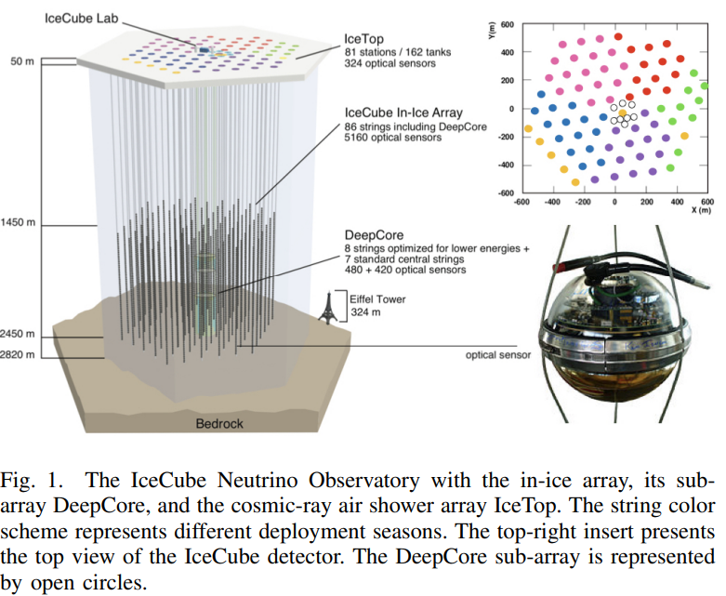
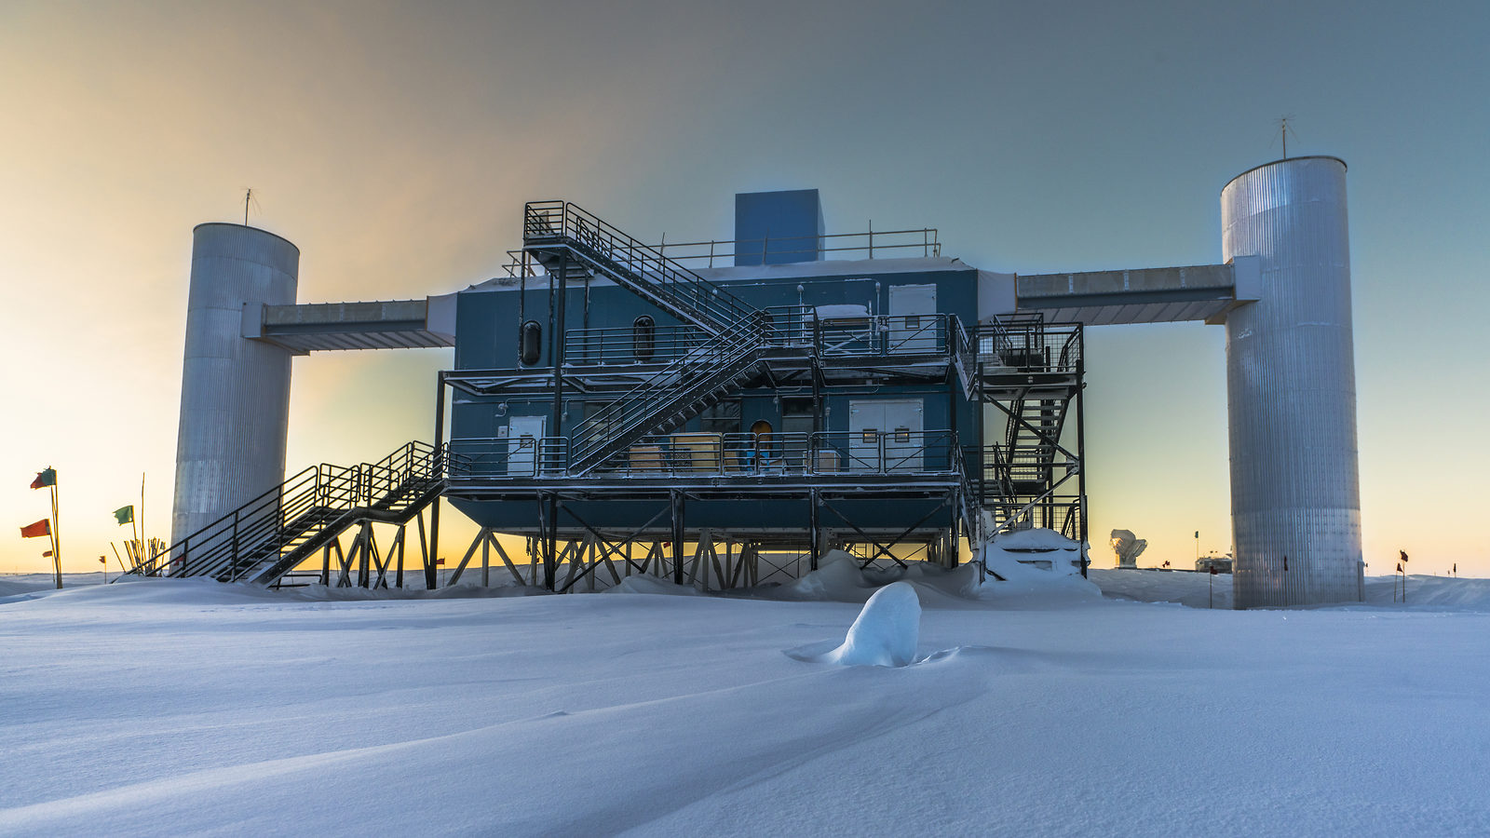
Applications in Science - Physics
Graph Neural Networks for IceCube Signal Classification
Choma et al.

Slide 15
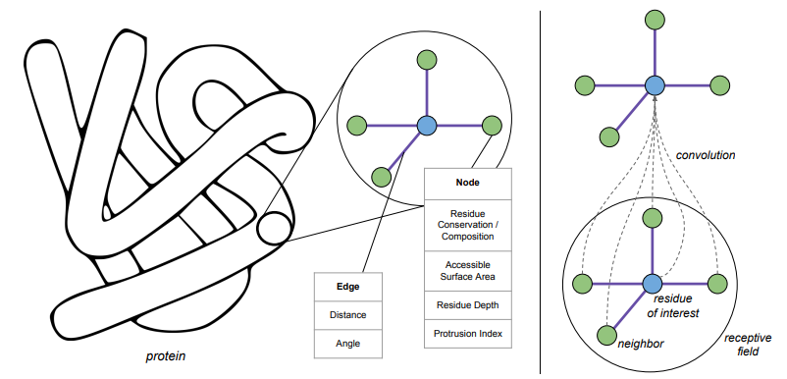
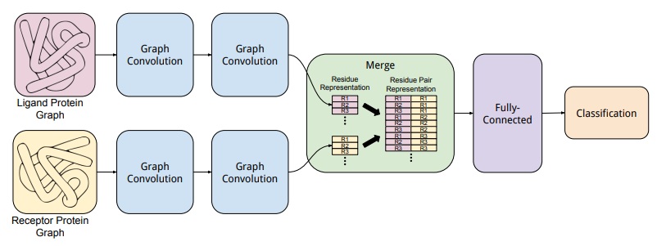
Applications in Science - Biology
Protein Interface Prediction using Graph Convolutional Networks
Alex Fout, Jonathon Byrd, Basir Shariat, Asa Ben-Hur

Slide 16
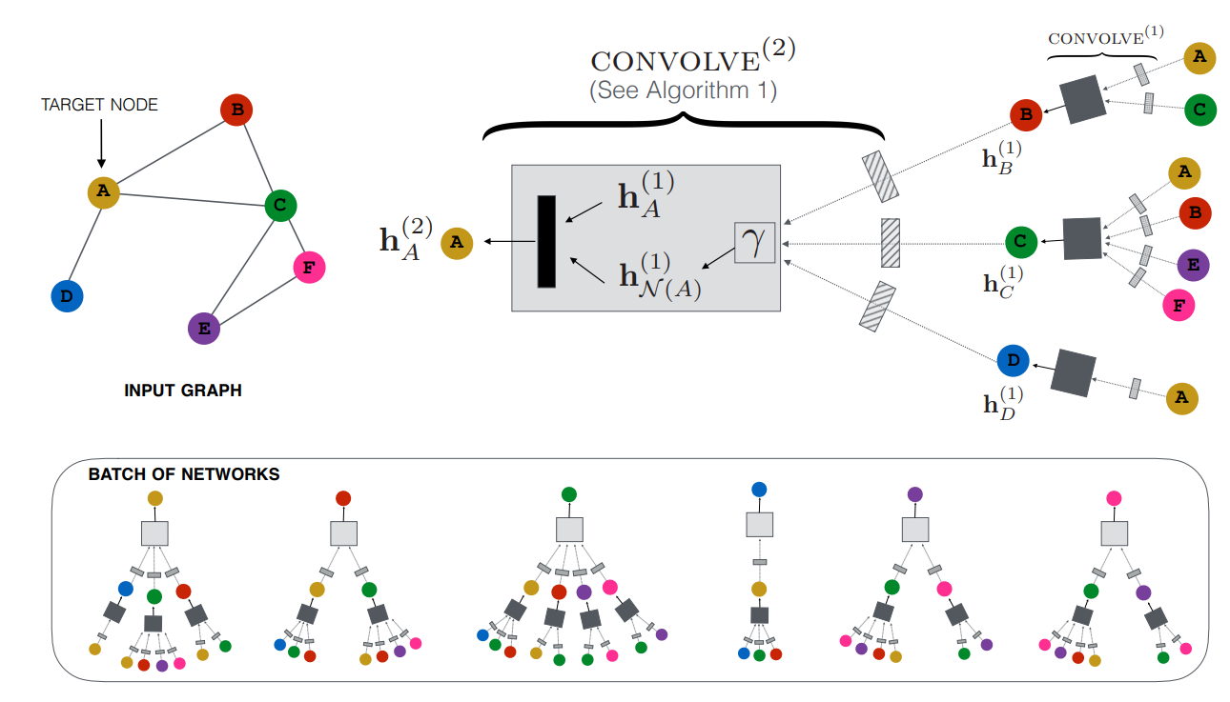
Applications in Science – Social Networks
Graph Convolutional Neural Networks for Web-Scale Recommender Systems
Rex Ying, Ruining He, Kaifeng Chen, Pong Eksombatchai, William L. Hamilton, Jure Leskovec

Slide 17
Challenges for the future
Deep graph convolutional networks
Graph convolutional networks for dynamic graphs
More powerful graph convolutional networks
Multiple graph convolutional networks
Notes:
Models with skip connections
Changing graphs for example social networks
Currently neighbourhood aggregations (spatial GCNs)
Spectral graphs can’t adapt from one graph to another if they have different fourier basis

Slide 18
Conclusion

Slide 19
Graph Convolutional Networks for Text Classifification
Liang Yao, Chengsheng Mao, Yuan Luo

Slide 20
What we’ll go through
Previous methods
GCNs reviewed
Datasets used
Methodology
Paper results
Our experiment

Slide 21
Text classification: previous methods and shortcoming
Deep learning algorithms like CNN,RNN and LSTM have been used to learn text representations and classify text.
While these methods can successfully capture information in local consecutive word sequences, they ignore global word co-occurrence in a corpus.
The method used in the paper overcomes this shortcoming.

Slide 22
GCN explained
A GCN is a multilayer neural network that takes a graph as an input.
The graph is represented by:
Embedding representation of each node.
A matrix representing the edges.
A matrix representing the weights of each of those edges.
Each layer In the GCN is represented by the equation:
A is the adjacency matrix, and D is the diagonal matrix

Slide 23
Datasets used by the authors
Five datasets were used by the authors in this paper:
20NG dataset
Ohsumed corpus
R52
R8
MR

Slide 24
Dataset details
20NG dataset : contains news documents belonging to different news groups.
Ohsumed corpus: documents are snippets of medical literature where the snippets correspond to different types of cardiovacular diseases
R52: Subset of the Reuters 21578 dataset contains 52 categories
R8:Subset of the Reuters 21578 dataset contains 8 categories
MR: movie review dataset for binary classification task

Slide 26
Graph creation – Initial details
Each document is a node.
Each word is also a node.
These nodes are connected based on the interaction between them.

Slide 27
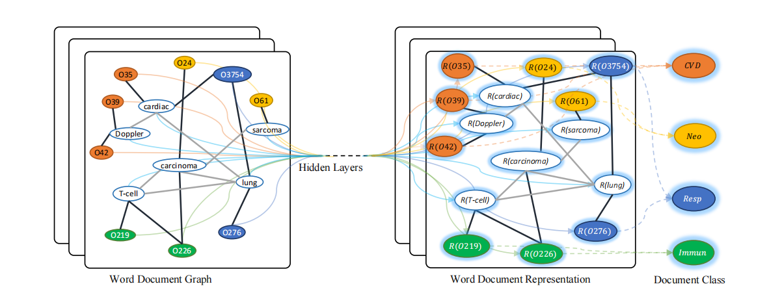
Making the Node representations
The positions are:
d₁
d₂
:
d_{n}
w₁
w₂
:
w_{m}

Slide 28
Making the Adjacency matrix
The adjacency matrix will be populated based on the following conditions:

Slide 29
TF-IDF
Term frequency-inverse document frequency.
tf(t,d): count of t in d / number of words in d
N: number of documents in the corpus
df: number of documents in which t occurs
Talks about the relevance of the term to the document.

Slide 30
PMI
Pointwise mutual information
Tells us if the words are likely to occur together or not in a fixed window size, this is therefore a good way to find the word-to-word relationship.

Slide 31
Results by the authors

Slide 32
Test accuracy by varying training data proportions

Slide 33
PMI sliding window size vs test accuracy

Slide 34
T-SNE visualizations of the word embeddings

Slide 35
Conclusion and future work
The authors have proposed a text classification method termed text GCN.
A heterogenous word document graph was built to capture global word co-occurance information and convert the problem to a node classification problem.
Worked well with limited data.
The model outperformed many of the state-of-the-art models.
Future directions were to use attention (GAT) and develop unsupervized GCN for large unlabelled data.

Slide 36
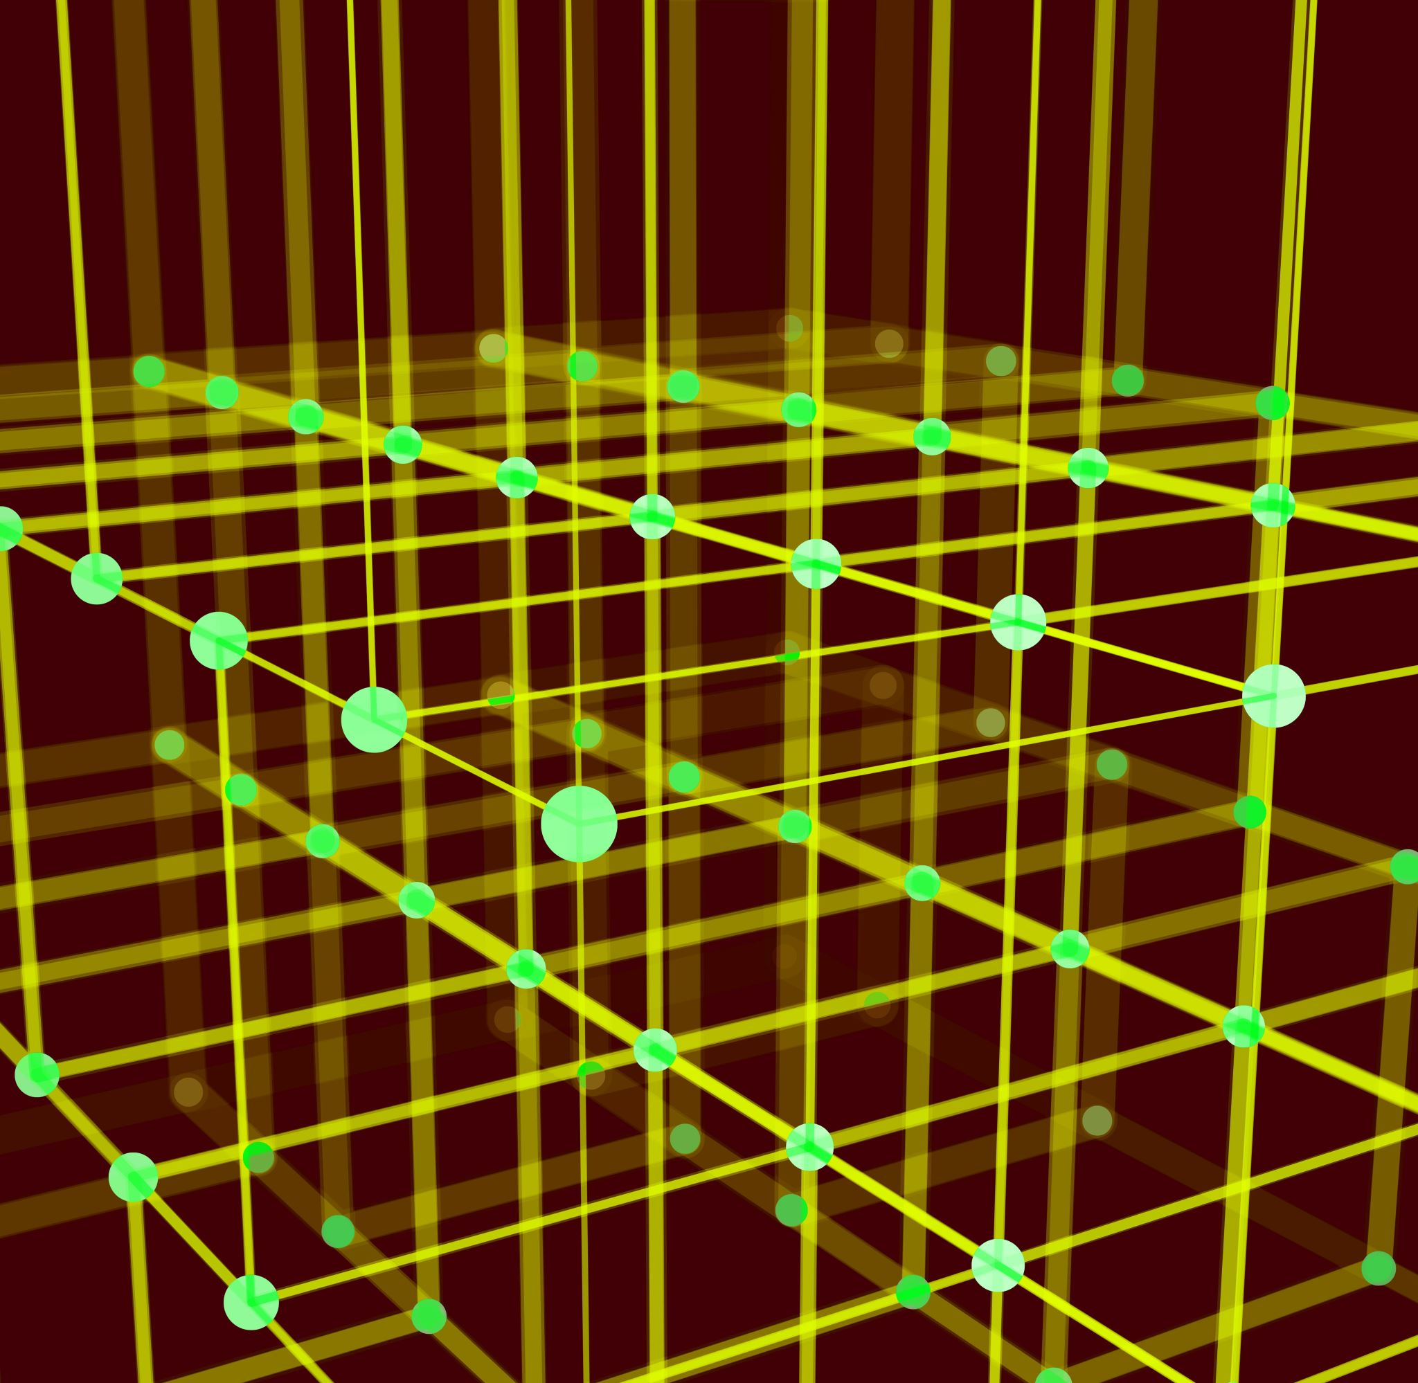
Our experiment

Slide 37
What we did
The authors only used English datasets in their paper. We wanted to see if the method worked well on non-English datasets as well.
We used a Spanish language dataset for text classification called TASS-2020. This is a dataset compiled by the “Workshop on Semantic Analysis at SEPLN (TASS)”.
We modified the GCN’s attributes so that the GCN worked well for our chosen dataset.

Slide 38
Dataset details
TASS 2020 contained 1008 Spanish tweets with labels of which we used 80% for training and 20% for testing.
After pre-processing, the average word length of each tweet was ~8.
There were 4 labels that we had to classify for this task: P,N,NEU,NONE. These labels represented tweets with a positive sentiment, negative sentiment, neutral sentiment or None.

Slide 39
Preprocessing
The following steps were used to preprocess the data to make it easier for the GCN algorithm.
All user ids were removed
All hashtags were removed
The text was made to lowercase
Accents were removed
‘re’ and ‘100%’ were replaced by ‘muy’
‘x’ replaced by ‘por’ and ‘k’ by ‘que’
All variations of laughter (‘jajajaja’,’jejejeje’) were replaced by ‘jaja’
Multiple duplicate characters (‘Buenooooooo’) were cleaned.

Slide 40
Selection of parameters
The paper is very clear about the model, so we didn’t alter their model too much. We did experiment with some other parameters:
Number of hidden layers
Sliding window size
Training hyperparameters
Number of layers was kept constant. Why?

Slide 41
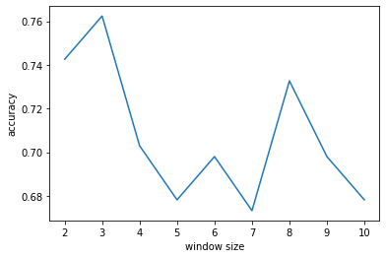
Results
Test accuracy by varying the sliding window size during PMI calculation
Using a window size of 3, we were able to achieve a training accuracy of 94.5% and a test accuracy of 76.2%

Slide 42
Questions?

