Slide 1
Immunization
Presentation by Heng-Min Tan

Slide 2
Immunization
If a pathogen’s spreading rate λ is under the critical threshold λ_{c} it will die out
Epidemic threshold vanishes in scale-free networks
Immunization rate: random networks vs. heterogeneous networks
For high <k>², must immunize almost all nodes in the network

Slide 3
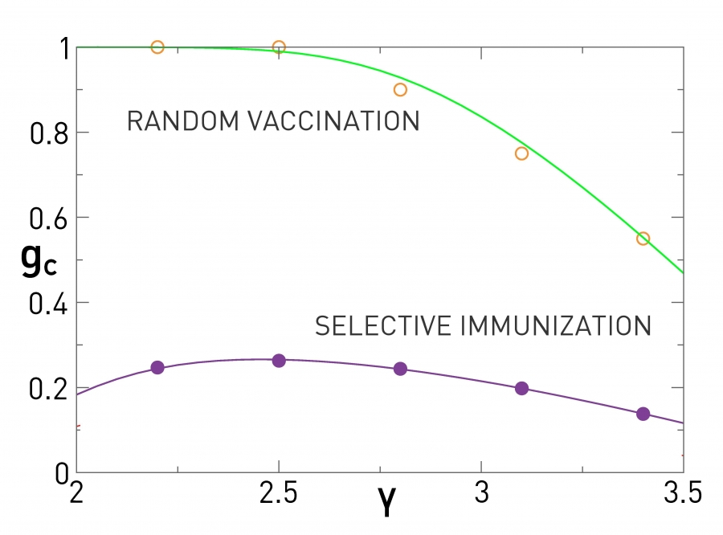
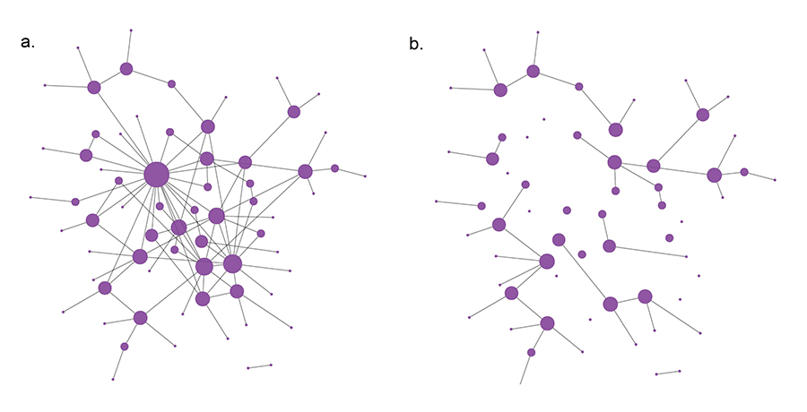
Immunization Strategies
Selective immunization - randomly chosen neighbor of randomly chosen node
On average, neighbors of a node have higher degree than node itself
Degree-based strategy - target hubs
Closeness-based strategy - target node with shortest average paths lengths
Betweenness-based strategy - target nodes with most shortest path

Slide 4
Communities
Community structure strongly affects pathogen spreading process
Community - subgroup of nodes within a network that are more strongly connected to each other than to nodes outside of the community

Slide 5
Models
Erdos-Renyi (ER) random graph
Configuration model
Edges placed randomly between nodes
Maintains pre-defined node degree
Produces multiple graphs with same degree sequence
Stochastic block model (SBM)
Nodes organized as blocks, edges placed between nodes independently at random
Each node is associated with a block assignment
Edges between nodes is independently distributed following Bernoulli distribution
Depends on block assignments

Slide 6
Models
Degree-corrected SBM
Number of edges between any pair of nodes follows Poisson distribution
Planted Partition model
Edge between two nodes within a block given by probability p
Edge between two nodes between blocks given by probability q

Slide 7
Community Detection
Resolution limit anomaly
Statistical inference
Find partition which maximizes the likelihood of a random graph model generating the observed network data
Monte Carlo Markov Chain
Every node in network assigned to random block independently
Probability of moving node from block r to s based on neighbor’s block t

Slide 8
Time Evolving Communities
Snapshot based approach
Measure overlap between communities at each time step
Evolutionary algorithms
Optimize for structure of network at any time point
Keep change in community structure between time steps
Incremental clustering
Only given data up to current time step
Give current best partitioning based on changes in network structure and update partition from previous time step

Slide 9
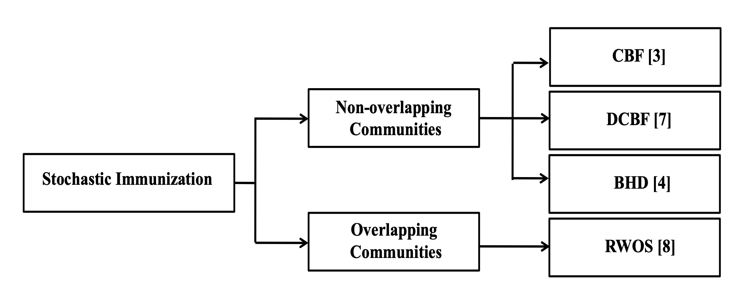
Immunization Strategies - Stochastic
Uses information at the node level; ignores full network structure
Non-overlapping - node can belong to a single community
Overlapping - node can belong to multiple communities

Slide 10
Immunization Strategies - Stochastic
Community Bridge Finder (CBF)
Identify nodes acting as bridges between communities using random-walk algorithm
Degree Community Bridge Finder (DCBF)
Target bridges with large amount of connections based on CBF algorithm
Bridge-Hub Detector (BHD)
Identify bridge hub nodes, based on expanding friendship circles of visited nodes
Random-Walk Overlap Selection (RWOS)
Target highly connected overlapping nodes

Slide 11
Immunization Strategies - Deterministic
Uses knowledge of whole network
Non-overlapping methods organized into three categories: global, local, and global and local

Slide 12
Immunization Strategies - Deterministic
Global strategies target bridge nodes
Bridges connect different subgroups or communities of nodes in networks
Local strategies target hubs
Hubs are high degree nodes with a larger than average number of connections
In modular networks, hubs can be found in all communities
Modular centrality
Local influence on nodes belonging to own community
Global influence on nodes of other communities

Slide 13
Summary
Community-based strategies performed better
Deterministic strategies outperform stochastic strategies
Strong community structure - local strategies
Loose community structure - global strategies

Slide 14
Sources
Barabási Albert-László. Network Science. Cambridge University Press, 2016.
Cherifi, H., Palla, G., Szymanski, B.K. et al. On community structure in complex networks: challenges and opportunities. Appl Netw Sci 4, 117 (2019). https://doi.org/10.1007/s41109-019-0238-9

