Slide 1
Ordinal Preference Representation and Aggregation Game-Theoretic and Combinatorial Aspects of Computational Social Choice
Lirong Xia
EPFL
June 15, 2012

Slide 2
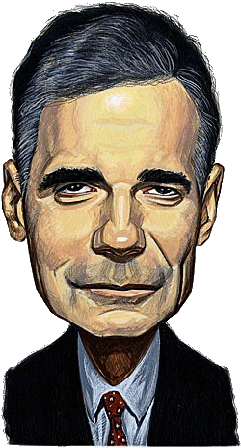
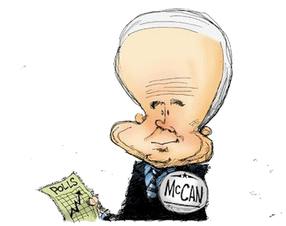
Preference Aggregation: Social Choice
> >
voting rule
> >
> >

Slide 3
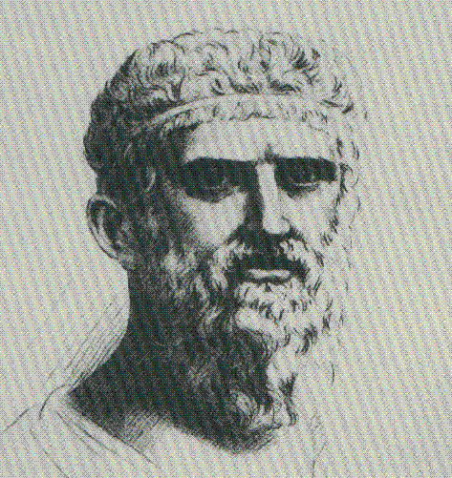
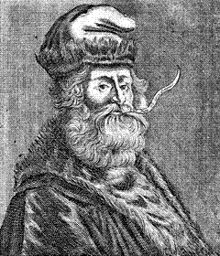
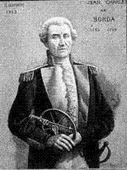
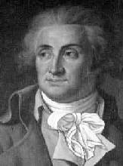
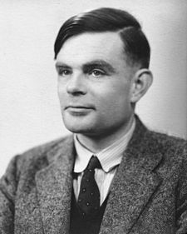
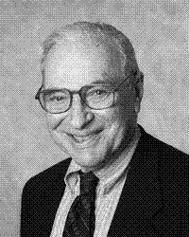
Social Choice
and Computer Science
Computational thinking + optimization algorithms
CS
Social Choice
21th Century
Strategic thinking + methods/principles of aggregation
PLATO
4thC. B.C.
LULL
13thC.
BORDA
18thC.
CONDORCET
18thC.
ARROW
20thC.
PLATO et al.
4thC. B.C.---20thC.
TURING et al.
20thC.

Slide 4
Many applications
People/agents often have conflicting preferences, yet they have to make a joint decision

Slide 5
Applications
Multi-agent systems [Ephrati and Rosenschein 91]
Recommendation systems [Ghosh et al. 99]
Meta-search engines [Dwork et al. 01]
Belief merging [Everaere et al. 07]
Human computation (crowdsourcing)
etc.

Slide 6
A burgeoning area
Recently has been drawing a lot of attention
IJCAI-11: 15 papers, best paper
AAAI-11: 6 papers, best paper
AAMAS-11: 10 full papers, best paper runner-up
AAMAS-12 9 full papers, best student paper
EC-12: 3 papers
Workshop: COMSOC Workshop 06, 08, 10, 12
Courses taught at Technical University Munich (Felix Brandt), Harvard (Yiling Chen), U. of Amsterdam (Ulle Endriss)

Slide 7
Outline
1. Game-theoretic aspects
NP-
Hard
2. Combinatorial voting
NP-
Hard

Slide 8
Common voting rules (what has been done in the past two centuries)
Mathematically, a voting rule is a mapping from {All profiles} to {outcomes}
an outcome is usually a winner, a set of winners, or a ranking
m : number of alternatives (candidates)
n : number of voters
Positional scoring rules
A score vector s₁,...,s_{m}
For each vote V, the alternative ranked in the
i-th position gets s_{i} points
The alternative with the most total points is the winner
Special cases
Borda, with score vector (m-1, m-2, …,0)
Plurality, with score vector (1,0,…,0) [Used in the US]

Slide 9
An example
Three alternatives {c₁, c₂, c₃}
Score vector (2,1,0) (=Borda)
3 votes,
c₁ gets 2+1+1=4, c₂ gets 1+2+0=3,
c₃ gets 0+0+2=2
The winner is c₁
2 1 0
2 1 0
2 1 0

Slide 10
Single transferable vote (STV)
Also called instant run-off voting or alternative vote
The election has m-1 rounds, in each round,
The alternative with the lowest plurality score drops out, and is removed from all of the votes
The last-remaining alternative is the winner
[used in Australia and Ireland]
10 | 7 | 6 | 3
a > b > c > d
a > c > d
a > c
a > c
c > d > a
c > d > a >b
d > a > b > c
c > a
c > a
d > a > c
b > c > d >a
c > d >a
a

Slide 11
Strategic voters
Manipulation: a voter (manipulator) casts a vote that does not represent her true preferences, to make herself better off
A voting rule is strategy-proof if there is never a (beneficial) manipulation under this rule
How important strategy-proofness is as an desired axiomatic property?
compared to other axiomatic properties

Slide 12
Manipulation under plurality rule (ties are broken in favor of )
>
>
> >
Plurality rule
> >
> >

Slide 13
Any strategy-proof voting rule?
No reasonable voting rule is strategyproof
Gibbard-Satterthwaite Theorem [Gibbard Econometrica-73, Satterthwaite JET-75]: When there are at least three alternatives, no voting rules except dictatorships satisfy
non-imposition: every alternative wins for some profile
unrestricted domain: voters can use any linear order as their votes
strategy-proofness
Axiomatic characterization for dictatorships!

Slide 14
Computational thinking
Use a voting rule that is too complicated so that nobody can easily figure out who will be the winner
Dodgson: computing the winner is -complete [Hemaspaandra, Hemaspaandra, &Rothe JACM-97]
Kemeny: computing the winner is NP-hard [Bartholdi, Tovey, &Trick SCW-89] and -complete [Hemaspaandra, Spakowski, & Vogel TCS-05]
The randomized voting rule used in Venice Republic for more than 500 years [Walsh&Xia AAMAS-12]
We want a voting rule where
Winner determination is easy
Manipulation is hard

Slide 15
Overview
Manipulation is inevitable
(Gibbard-Satterthwaite Theorem)
Can we use computational complexity as a barrier?
Why prevent manipulation?
Yes
May lead to very
undesirable outcomes
Is it a strong barrier?
No
How often?
Other barriers?
Seems not very often
Limited information

Slide 16
Manipulation: A computational complexity perspective
If it is computationally too hard for a manipulator to compute a manipulation, she is best off voting truthfully
Similar as in cryptography
For which common
voting rules manipulation is computationally hard?
NP-
Hard

Slide 17
Unweighted coalitional manipulation (UCM) problem
Given
The voting rule r
The non-manipulators’ profile P^{NM}
The number of manipulators n’
The alternative c preferred by the manipulators
We are asked whether or not there exists a profile P^{M} (of the manipulators) such that c is the winner of P^{NM}∪P^{M} under r

Slide 18
The stunningly big table for UCM
#manipulators | One manipulator |  | At least two
Copeland | P | [BTT SCW-89b] | NPC | [FHS AAMAS-08,10]
STV | NPC | [BO SCW-91] | NPC | [BO SCW-91]
Veto | P | [ZPR AIJ-09] | P | [ZPR AIJ-09]
Plurality with runoff | P | [ZPR AIJ-09] | P | [ZPR AIJ-09]
Cup | P | [CSL JACM-07] | P | [CSL JACM-07]
Borda | P | [BTT SCW-89b] | NPC | [DKN+ AAAI-11] [BNW IJCAI-11]
Maximin | P | [BTT SCW-89b] | NPC | [XZP+ IJCAI-09]
Ranked pairs | NPC | [XZP+ IJCAI-09] | NPC | [XZP+ IJCAI-09]
Bucklin | P | [XZP+ IJCAI-09] | P | [XZP+ IJCAI-09]
Nanson’s rule | NPC | [NWX AAA-11] | NPC | [NWX AAA-11]
Baldwin’s rule | NPC | [NWX AAA-11] | NPC | [NWX AAA-11]
My work

Slide 19
What can we conclude?
For some common voting rules, computational complexity provides some protection against manipulation
Is computational complexity a strong barrier?
NP-hardness is a worst-case concept

Slide 20
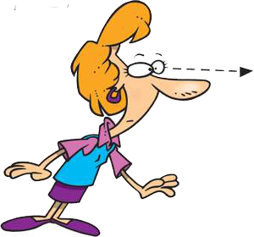
Probably NOT a strong barrier
Frequency of manipulability
Easiness of Approximation
Quantitative G-S

Slide 21
An approximation viewpoint
Unweighted coalitional optimization (UCO): compute the smallest number of manipulators that can make c win
A greedy algorithm has additive error no more than 1 for Borda [Zuckerman, Procaccia, &Rosenschein AIJ-09]

Slide 22
An approximation algorithm for positional scoring rules [Xia,Conitzer,& Procaccia EC-10]
A polynomial-time approximation algorithm that works for all positional scoring rules
Additive error is no more than m-2
Computational complexity is not a strong barrier against manipulation
The cost of successful manipulation can be easily approximated (for some rules)

Slide 23
A class of scheduling problems Q|pmtn|C_{max}
m* parallel uniform machines M₁,…,M_{m*}
Machine i’s speed is s^{i} (the amount of work done in unit time)
n* jobs J₁,…,J_{n*}
preemption: jobs are allowed to be interrupted (and resume later maybe on another machine)
We are asked to compute the minimum makespan
the minimum time to complete all jobs

Slide 24
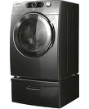
Thinking about UCO_{pos}
Let p,p₁,…,p_{m-1} be the total points that c,c₁,…,c_{m-1} obtain in the non-manipulators’ profile
P^{NM}
V₁
∪{V₁=[c>c₁>c₂>c₃]}
₌
c
p
c
∨
c₁
(J₁)
s¹=s₁-s₂
c₁
p₁
p
p₁ -p
p₁ –p-(s₁-s₂)
s₁-s₂
∨
c₃
c₂
(J₂)
s²=s₁-s₃
p₂
s₁-s₃
p
p₂ -p
p₂ –p-(s₁-s₄)
∨
c₃
(J₃)
p₃
c₂
p
p₃ -p
p₃ –p-(s₁-s₃)
s³=s₁-s₄
s₁-s₄

Slide 25
The algorithm in a nutshell
Scheduling problem
Original UCO
No more than
OPT+m-2
[Gonzalez&Sahni
JACM 78]
Solution to the
UCO
Solution to the
scheduling problem
Rounding

Slide 26
Helps to prove complexity of UCM for Borda
Manipulation of positional scoring rules = scheduling (preemptions only allowed at integer time points)
Borda manipulation corresponds to scheduling where the machines speeds are m-1, m-2, …, 0
NP-hard [Yu, Hoogeveen, & Lenstra J.Scheduling 2004]
UCM for Borda is NP-C for two manipulators
[Davies et al. AAAI-11 best paper]
[Betzler, Niedermeier, & Woeginger IJCAI-11 best paper]

Slide 27
Next step
The first attempt seems to fail
Can we obtain positive results for a restricted setting?
The manipulators has complete information about the non-manipulators’ votes

Slide 28
Information constraints [Conitzer,Walsh,&Xia AAAI-11]
Limiting the manipulator’s information can make dominating manipulation computationally harder, or even impossible

Slide 29
Overview
Manipulation is inevitable
(Gibbard-Satterthwaite Theorem)
Can we use computational complexity as a barrier?
Why prevent manipulation?
Yes
May lead to very
undesirable outcomes
Is it a strong barrier?
No
How often?
Other barriers?
Seems not very often
Limited information

Slide 30
Research questions
How to predict the outcome?
Game theory
How to evaluate the outcome?
Price of anarchy [Koutsoupias&Papadimitriou STACS-99]
Not very applicable in the social choice setting
Equilibrium selection problem
Social welfare is not well defined
Optimal welfare when agents are truthful
Worst welfare when agents are fully strategic

Slide 31
Simultaneous-move voting games
Players: Voters 1,…,n
Strategies / reports: Linear orders over alternatives
Preferences: Linear orders over alternatives
Rule: r(P’), where P’ is the reported profile

Slide 32
Equilibrium selection problem
>
>
> >
Plurality rule
>
>
> >
>
>
> >

Slide 33
Stackelberg voting games [Xia&Conitzer AAAI-10]
Voters vote sequentially and strategically
voter 1 → voter 2 → voter 3 → … → voter n
any terminal state is associated with the winner under rule r
At any stage, the current voter knows
the order of voters
previous voters’ votes
true preferences of the later voters (complete information)
rule r used in the end to select the winner
Called a Stackelberg voting game
Unique winner in SPNE (not unique SPNE)
Similar setting in [Desmedt&Elkind EC-10]

Slide 34
General paradoxes (ordinal PoA)
Theorem. For any voting rule r that satisfies majority consistency and any n, there exists an n-profile P such that:
(many voters are miserable) SG_{r}(P) is ranked somewhere in the bottom two positions in the true preferences of n-2 voters
(almost Condorcet loser) SG_{r}(P) loses to all but one alternative in pairwise elections
Strategic behavior of the voters is extremely harmful in the worst case

Slide 35
Food for thought
The problem is still open!
Shown to be connected to integer factorization [Hemaspaandra, Hemaspaandra, & Menton Arxiv-12]
What is the role of computational complexity in analyzing human/self-interested agents’ behavior?
NP-hardness might not be a good answer, but it can be seen as a desired “axiomatic” property
Explore information assumption
In general, why do we want to prevent strategic behavior?
Practical ways to protect election

Slide 36
Outline
1. Game-theoretic aspects
NP-
Hard
2. Combinatorial voting
NP-
Hard

Slide 37
Settings with too many alternatives
Representation/communication: How do voters communicate their preferences?
Computation: How do we efficiently compute the outcome given the votes?
NP-
Hard

Slide 38
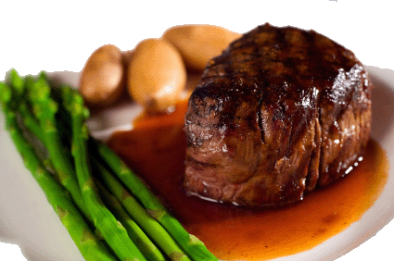
Combinatorial domains (Multi-issue domains)
The set of alternatives can be uniquely characterized by multiple issues
Let I={x₁,...,x_{p}} be the set of p issues
Let D_{i} be the set of values that the i-th issue can take, then C=D₁×... ×D_{p}
Example:
Issues={ Main course, Wine }
Alternatives={ } ×{ }

Slide 39
Example: joint plan [Brams, Kilgour & Zwicker SCW 98]
The citizens of LA county vote to directly determine a government plan
Plan composed of multiple sub-plans for several issues
E.g.,
# of alternatives is exponential in the # of issues

Slide 40
Overview
Combinatorial voting
New criteria used
to evaluate rules
Strategic considerations
An example of
voting language/rule
Compare new approaches
to existing ones

Slide 41
Criteria for combinatorial voting
Criteria for the voting language
Compactness
Expressiveness
Usability: how comfortable voters are about it
Informativeness: how much information is contained
Criteria for the voting rule
Computational efficiency
Whether it satisfies desirable axiomatic properties

Slide 42
CP-net [Boutilier et al. JAIR-04]
An CP-net consists of
A set of variables x₁,...,x_{p}, taking values on D₁,...,D_{p}
A directed graph G over x₁,...,x_{p}
Conditional preference tables (CPTs) indicating the conditional preferences over x_{i}, given the values of its parents in G
c.f. Bayesian network
Conditional probability tables
A BN models a probability distribution, a CP-net models a partial order

Slide 43
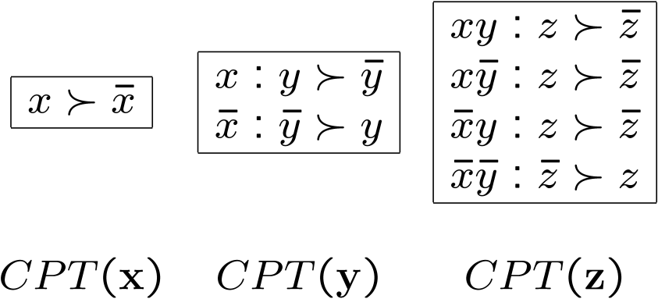
CP-nets: An example
Variables: x,y,z.
Graph CPTs
This CP-net encodes the following partial order:
x
y
z

Slide 44
Sequential voting rules [Lang IJCAI-07, Lang&Xia MSS-09]
Issues: main course, wine
Order: main course > wine
Local rules are majority rules
V₁: > , : > , : >
V₂: > , : > , : >
V₃: > , : > , : >
Step 1:
Step 2: given , is the winner for wine
Winner: ( , )

Slide 45
Previous approaches
Voting rule | Computational efficiency | Compactness | Expressiveness
 |  |  | Usability | Informativeness
Plurality | High | High | High | Low
Borda, etc. | Low | Low | High | High
Issue-by-issue | High | High | Low | Medium
We want a balanced rule!

Slide 46
Sequential voting vs. issue-by-issue voting
Voting rule | Computational efficiency | Compactness | Expressiveness
 |  |  | Usability | Informativeness
Plurality | High | High | High | Low
Borda, etc. | Low | Low | High | High
Issue-by-issue | High | High | Low | Medium
Sequential voting | High | Usually high | Medium | Medium
Acyclic CP-nets
(compatible with the same ordering)

Slide 47
H-composition vs. Sequential rules
Yet another approach
Voting rule | Computational efficiency | Compactness | Expressiveness
 |  |  | Usability | Informativeness
Plurality | High | High | High | Low
Borda, etc. | Low | Low | High | High
Issue-by-issue | High | High | Low | Medium
Sequential voting | High | Usually high | Medium | Medium
H-composition [Xia et al. AAAI-08] | Low-High | Usually high | High | Medium
MLE approach [Xia , Conitzer, & LangAAAMAS-10] | Low-High | Usually high | High | Medium
Voting rule | Computational efficiency | Compactness | Expressiveness
 |  |  | Usability | Informativeness
Plurality | High | High | High | Low
Borda, etc. | Low | Low | High | High
Issue-by-issue | High | High | Low | Medium
Sequential voting | High | Usually high | Medium | Medium
H-composition [Xia, Conitzer, &Lang AAAI-08] | Low-High | Usually high | High | Medium

Slide 48
AI may help!
Computing local/global Condorcet winner
CSP with cardinality constraints [Li, Vo, & Kowalczyk AAMAS-11]
Applying common voting rules (including Borda) to preferences represented by lexicographic preference trees
Weighted MAXSAT solver [Lang, Mengin, & Xia CP-12]

Slide 49
Overview
Combinatorial voting
New criteria used
to evaluate rules
Strategic considerations
An example of
voting language/rule
Compare new approaches
to existing ones

Slide 50
Strategic consideration
When voters are strategic
how to evaluate the harm?
how to prevent strategic behavior?

Slide 51
Strategic sequential voting [Xia,Conitzer,&Lang EC-11]
What if we want to apply sequential rules anyway?
Often done in real life
Ignore usability concerns
Voters vote strategically

Slide 52
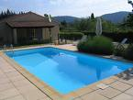
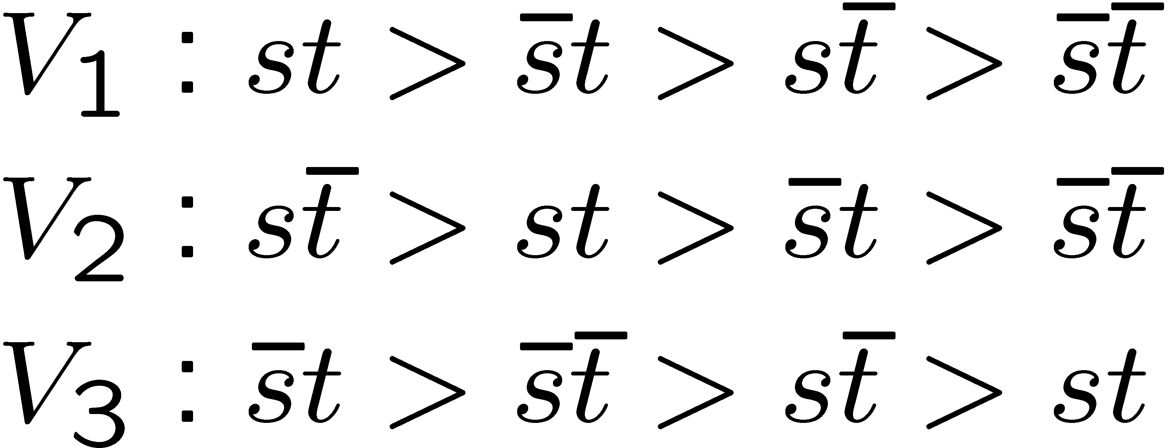
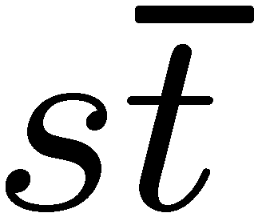
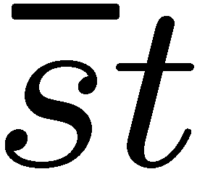
Example
S
T
In the first stage, the voters vote simultaneously to determine S; then, in the second stage, the voters vote simultaneously to determine T
If S is built, then in the second step so the winner is
If S is not built, then in the 2nd step so the winner is
In the first step, the voters are effectively comparing and , so the votes are , and the final winner is

Slide 53
Strategic sequential voting (SSP)
Binary issues (two possible values each)
Voters vote simultaneously on issues, one issue after another
For each issue, the majority rule is used to determine the value of that issue
No equilibrium selection problem
Unique SSP winner

Slide 54
Strategic behavior can be extremely harmful (ordinal PoA)
Main theorem (informally). For any p≥2, there exists a profile such that the SSP winner is
ranked almost at the bottom by every voter
Pareto dominated by almost every other alternative
an almost Condorcet loser
Strategic behavior of the voters is extremely harmful in the worst case

Slide 55
Food for thought
Tradeoff
Computational efficiency
Expressiveness

Slide 56
1. Game-theoretic aspects
2. Combinatorial voting
Complexity of strategic behavior
Complexity of representation and aggregation
Computational thinking + optimization algorithms
CS
Social Choice
Thank you!
Strategic thinking + methods/principles of aggregation
1. Game-theoretic aspects
2. Combinatorial voting
Stackelberg voting games
Strategic sequential voting

