Slide 1
Generalized Scoring Rules
Paper by Lirong Xia and Vincent Conitzer
Presentation by Yosef Treitman

Slide 2
Positional Scoring Rules
There is a preference profile P, where each voter ranks the alternatives from favorite to least favorite.
--Example: 1@ a>b>c, 2@ b>a>c, 5@ c>a>b
--Non-example: 1@ 45% a, 35% b, 20% c;
2@ 50% b, 30% c, 20% a;

Slide 3
Positional scoring rules (continued)
Assigns a score to each alternative based purely on the number of times the alternative is given each position.
The rule can be thought of as a vector r.
Example: Baseball MVP:
r = [14 9 8 7 6 5 4 3 2 1]’
Borda: [m-1, m-2, … 3, 2, 1, 0]’

Slide 4
Example of Borda Rule
Preference profile:
1@ a>b>c, 2@ b>a>c, 5@ c>a>b
Alternative a gets 1 first-place vote and 7 second-place votes, for a score of 9.
Alternative b gets a score of 5 and c gets a score of 10.
Borda selects the alternative with the highest score. (In this case, option c.)

Slide 5
Condorcet Method
Given a preference profile P of the same form as what we had before
Compare the results of head-to-head competitions
If one alternative “sweeps” the competitions, that alternative is the Condorcet winner
Otherwise, there is no Condorcet winner
Condorcet Consistent: always selects Condorcet winner.

Slide 6
Condorcet winner: examples
Consider profile:
1@ a>b>c, 2@ b>a>c, 5@ c>a>b
c is Condorcet winner
For 3@ a>b>c, 4@ b>c>a, 5@ c>a>b, there is no Condorcet winner

Slide 7
Maximin method
Compute the head to head competitions
Assess each alternative by its worst head-to-head result
Choose the alternative with the best worst-case result
Condorcet consistent

Slide 8
Maximin examples
Consider two profiles from before:
For 1@ a>b>c, 2@ b>a>c, 5@ c>a>b,
Winner: Alternative c
Condorcet winner is alternative c
 | vs. a | vs. b | vs. c | score
a |  | 4 | -2 | -2
b | -4 |  | -2 | -4
c | 2 | 2 |  | 2

Slide 9
Another example
For 3@ a>b>c, 4@ b>c>a, 5@ c>a>b,
Winner: Alternative c
No Condorcet winner
 | vs. a | vs. b | vs. c | score
a |  | 4 | -6 | -6
b | -4 |  | 2 | -4
c | 6 | -2 |  | -2

Slide 10
What makes a good voting rule?
Condorcet consistency
Is Borda Condorcet consistent?
No!
P = {39 @ a>b>c, 40 @ b>a>c, 81 @ c>a>b}
Alternative c is Condorcet winner, alternative a is Borda winner
No positional scoring rule works!

Slide 11
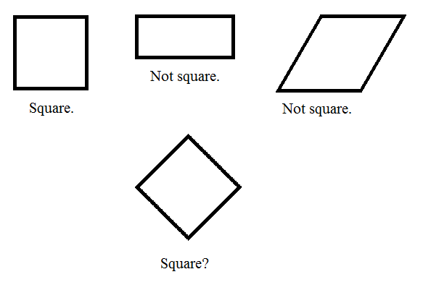
Isn’t this “backwards thinking?”
In mathematics, results follow axioms.
We can have a preconceived target to describe.

Slide 12
Generalized scoring rules
Given same form of preference profile P
Function f that assigns a score to each alternative for each voter
The winner is chosen as a function of the order of the summed scores for each alternative. {Winner = g(Order(f(P)))}
Borda is a GSR, as are all positional scoring rules.

Slide 13
g and f need not be so intuitive
For maximin, let f map each vote to an m² dimensional vector.
For voter n, Fx(Vn) = 1 if ai > aj, -1 if ai < aj, 0 otherwise, where i = ceiling(x/m); j = x mod m.
Depends on order alone
Example: 3@ a>b>c, 4@ b>c>a, 5@ c>a>b

Slide 14
More axiomatic properties
Anonymity, (achieved for generalized scoring rules)
Finite Local Consistency:
-- Not as strict as consistency
-- Set of all possible profiles can be partitioned into finitely many consistent parts
-- All consistent methods satisfy finite local consistency

Slide 15
Finite Local Consistency
Example: Borda & other positional scoring rules
maximin
Example: 2nd-most 1st-place votes
--Partition: a loses to b, a loses to c, etc.
Non-example: Dodgson’s rule
Finite Local Consistency implies homogeneity

Slide 16
Inhomogeneity of Dodgson’s rule
2 | 2 | 2 | 2 | 2 | 1 | 1
D | B | C | D | A | A | D
C | C | A | B | B | D | A
A | A | B | C | C | B | B
B | D | D | A | D | C | C

Slide 17
But what if we triple the number of Voters?
All GSR’s satisfy anonymity and FLC, and vice versa. [Xia and Conitzer, 2009.]
6 | 6 | 6 | 6 | 6 | 3 | 3
D | B | C | D | A | A | D
C | C | A | B | B | D | A
A | A | B | C | C | B | B
B | D | D | A | D | C | C

Slide 18
Generality of GSR’s
General enough to include positional scoring rules, maximin, STV, and many of the other rules we’ve studied
Not too general, as they satisfy the axioms of anonymity and finite local consistency

Slide 19
Advantages of using GSR’s
There are known results applying manipulability to GSR’s (Same rule of applies)
Mathematically equivalent to using hyperplane rules
Can be used as a compromise between Borda rule and Condorcet rules

Slide 20
More advantages of GSR’s
No Condorcet rule is consistent, but they can be finitely locally consistent
It allows consistency among preference profiles that share a given characteristic
Can be applied to machine learning

Slide 21
Questions for discussion
Are GSR’s too general? What’s the weirdest rule that is a GSR?
Are they not general enough? Are there useful rules that are not GSR’s?

