Slide 1
Dominating Manipulations in Voting with Partial Information
Paper by:
Vincent Conitzer, Toby Walsh
and Lirong Xia
Presented by:
John Postl
James Thompson

Slide 2
Motivation
If there is a single manipulator among truthful voters, when can the manipulator vote strategically to change the outcome, if ever?
No information: Many voting rules are immune to strategic behavior from the manipulator.
Complete information: In many cases, she can efficiently determine if she should vote strategically instead of truthfully.
What happens if we take away some information (but not all) about the other voters?

Slide 3
Definitions (Complete Information)
Domination: Vote U dominates vote V if the manipulator is strictly better off by voting U instead of V.
Dominating Manipulation: If U dominates the true preferences of the manipulator, then U is a dominating manipulation.

Slide 4
Definitions
Immune: The true preferences of the manipulator are never dominated by another vote.
Resistant: Computing whether the true preferences are dominated by another vote is NP-hard.
Vulnerable: Computing whether the true preferences are dominated is in P.

Slide 5
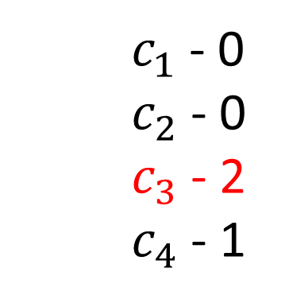
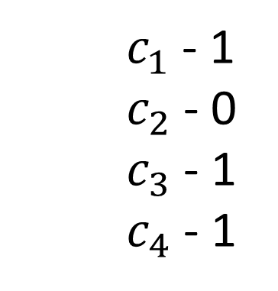
Complete Information
Tie Breaker: $c_{4}⊱c_{3}⊱c_{2}⊱c_{1}$
Manipulator :
A : $c_{3}⊱c_{2}⊱c_{4}⊱c_{1}$
B : $c_{4}⊱c_{3}⊱c_{2}⊱c_{1}$
$$c_{1}⊱c_{2}⊱c_{3}⊱c_{4}$$
$$c_{3}⊱c_{2}⊱c_{1}⊱c_{4}$$
$c_{1}$ - 0
$c_{2}$ - 0
$c_{3}$ - 2
$c_{4}$ - 1
$c_{1}$ - 1
$c_{2}$ - 0
$c_{3}$ - 1
$c_{4}$ - 1
Plurality Scores
Plurality Scores

Slide 6
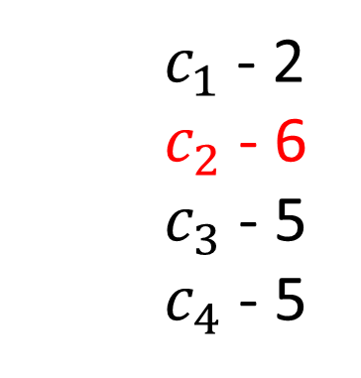
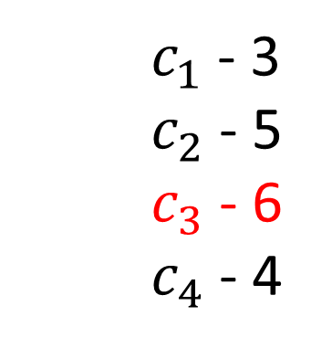
Complete Information
Tie Breaker: $c_{4}⊱c_{3}⊱c_{2}⊱c_{1}$
Manipulator :
A : $c_{3}⊱c_{2}⊱c_{4}⊱c_{1}$
B : $c_{4}⊱c_{3}⊱c_{2}⊱c_{1}$
$$c_{2}⊱c_{1}⊱c_{4}⊱c_{3}$$
$$c_{1}⊱c_{2}⊱c_{3}⊱c_{4}$$
$c_{1}$ - 2
$c_{2}$ - 6
$c_{3}$ - 5
$c_{4}$ - 5
$c_{1}$ - 3
$c_{2}$ - 5
$c_{3}$ - 6
$c_{4}$ - 4
Borda Scores

Slide 7
Gibbard – Satterthwaite Theorem
If $m≥3$, then for every deterministic voting rule, one of the following three things must hold:
1.) The rule is a dictatorship.
2.) There is a candidate who can never win.
3.) The rule is susceptible to tactical voting in a complete information setting.

Slide 8
Complete Information Results
 | Voting Rules
Resistant
Vulnerable
Single Transferrable Vote (STV)
Ranked Pairs
Any positional scoring rule
Copeland
Voting trees
Maximin

Slide 9

No Information Results
 | Voting Rules
Immune
Resistant
Any Condorcet-consistent rule
Borda
Any positional scoring rule (with $n ≥6(m−2))$

Slide 10





Information Sets
$c_{1}⊱c_{2}⊱c_{3}⊱c_{4}⊱c_{5}⊱c_{6}$
$$c_{1}⊱c_{2}⊱c_{3}⊱c_{4}⊱c_{6}⊱c_{5}$$
$$c_{1}⊱c_{2}⊱c_{3}⊱c_{5}⊱c_{4}⊱c_{6}$$
$$c_{1}⊱c_{2}⊱c_{5}⊱c_{3}⊱c_{4}⊱c_{6}$$
$$c_{1}⊱c_{2}$$
$$c_{1}⊱c_{3}$$
$$c_{1}⊱c_{4}$$
$$c_{1}⊱c_{5}$$
$$c_{1}⊱c_{6}$$
$$c_{2}⊱c_{3}$$
$$c_{2}⊱c_{4}$$
$$c_{2}⊱c_{5}$$
$$c_{2}⊱c_{6}$$
$$c_{3}⊱c_{4}$$
$$c_{3}⊱c_{5}$$
$$c_{3}⊱c_{6}$$
$$c_{4}⊱c_{5}$$
$$c_{4}⊱c_{6}$$
$$c_{5}⊱c_{6}$$

Slide 11
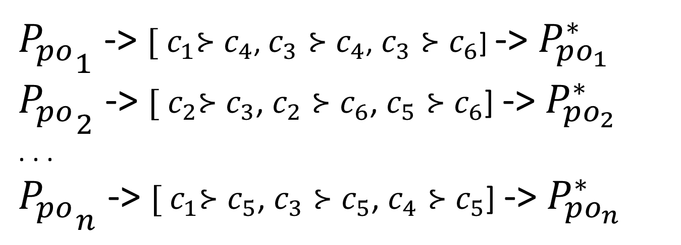
Information Sets
${P_{po}}_{1}$ -> ${[ c}_{1}⊱c_{4}$, $c_{3}⊱c_{4}$, $c_{3}⊱c_{6}$] -> $P_{po_{1}}^{∗}$
${P_{po}}_{2}$ -> ${[ c}_{2}⊱c_{3}$, $c_{2}⊱c_{6}$, $c_{5}⊱c_{6}$] -> $P_{po_{2}}^{∗}$
. . .
${P_{po}}_{n}$ -> ${[ c}_{1}⊱c_{5}$, $c_{3}⊱c_{5}$, $c_{4}⊱c_{5}$] -> $P_{po_{n}}^{∗}$
E = ${P_{po}^{∗}}_{1} × {P_{po}^{∗}}_{2} × … ×{P_{po}^{∗}}_{n}$

Slide 12
Definitions
Domination: Vote U dominates vote V if for every P in E, we have $r\left(P ∪\left\{U\right\}\right)≽r\left(P∪\left\{V\right\}\right)$ and there exists P’ such that $r\left(P ∪\left\{U\right\}\right)≻r\left(P∪\left\{V\right\}\right)$.
Dominating Manipulation: If U dominates the true preferences of the manipulator, then U is a dominating manipulation.

Slide 13
Introduction to Flows
Flow network: directed graph G = (V, E) such that there exists one source node and one sink node and each edge e has nonnegative integral capacity c_{e}
What is the maximum flow that can be routed on our network?
Solvable in polynomial time using Ford-Fulkerson algorithm

Slide 14
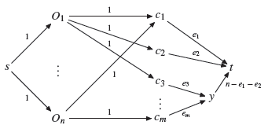
Plurality with Partial Information
Plurality with partial information is vulnerable.
We construct the following network flow:

Slide 15
Known/proven-from-paper results
 | Dominating Manipulation | Domination
STV | Resistant
Ranked Pairs | Resistant
Borda | Resistant | NP-Hard
Copeland | Resistant | NP-Hard
Voting Trees | Resistant | NP-Hard
Maximin | Resistant | NP-Hard
Plurality | Vulnerable | P
Veto | Vulnerable | P

Slide 16
An Alternate Framework
1. Probability distribution over possible profiles.
2. Coalitions of more than 1 voter.
3. The coalition wants some alternative d to win.
New Goal: Find the voting strategy that maximizes the probability of alternative d winning.

Slide 17
Impact on Social Welfare
Regret :
SW( winner of truthful votes ) – SW( winner with coalition )
Positional Scoring Rules:
$$≤c[\left(a_{1}−a_{m}\right)P\left(r\left(v_{n}\right)≠d, r\left(v\right)=d\right)+\left(a_{2}−a_{m}\right)P\left(r\left(v_{n}\right)≠r\left(v\right), r\left(v\right)≠d\right)]$$
K-approval Scoring Rule:
$$≤ \left[\left\lceil \frac{ck}{m}\right\rceil −1\right]P\left(r\left(v_{n}\right)≠d, r\left(v\right)=d\right)+ P\left(r\left(v_{n}\right)≠r\left(v\right), r\left(v\right)≠d\right)$$
Usually relatively small

