Slide 1
Stackelberg Voting Games
John Postl
James Thompson

Slide 2
Motivation
Do voters need to vote simultaneously?
Is this a reasonable model? In which situations does this type of voting system arise?
If the voters vote in sequence, have complete information, and are strategic, what kind of outcomes can arise?

Slide 3
Price of Anarchy
How do we state undesirable outcomes in such a voting system?
In game theory: compare the optimal outcome (i.e. alternative that maximizes social welfare) to actual outcome (i.e. winning alternative under strategic voting)
Can we use the same approach?
Not very well, since we only have ordinal information.
We need to select the appropriate equilibrium concept as well.

Slide 4
Stackelberg Voting Game
Extensive-form game with perfect information.
True preferences of the voters are known by everyone.
Defined with respect to any voting rule r
Strategy of a voter: Strict linear order over the alternatives.
At each stage, one voter casts their vote.
A leaf node corresponds to a preference profile, which determines the winner under r.

Slide 5
Backwards Induction

Slide 6
Compilation Complexity
Can we represent a vote under some specific voting rule using fewer bits?
In some cases, yes, if many votes are “essentially the same.”
Plurality: for any vote, we can discard everything except the top choice.

Slide 7
Domination Index
Non-imposition: Any alternative can win under some profile.
Domination index: If a voting rule r has non-imposition, the domination index is the smallest q such that $\left\lfloor \frac{n}{2}\right\rfloor$ + q votes can guarantee any alternative wins under r.
Examples:
Majority consistent rule: 1.
Nomination: $\left\lceil \frac{n}{2}\right\rceil$.

Slide 8
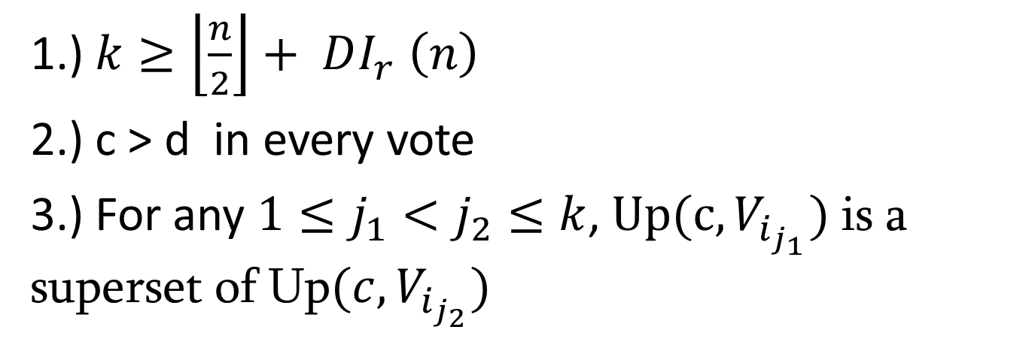
Lemma 1
An alternative d will not win in a voting profile P if there exists a subprofile $P_{k}=\left(V_{i_{1}}…V_{i_{k}}\right)$where:
1.) $k≥\left\lfloor \frac{n}{2}\right\rfloor + DI_{r} \left(n\right)$
2.) c > d in every vote
3.) For any $1≤j_{1}<j_{2}≤k$, $Up(c, V_{i_{j_{1}}})$ is a superset of Up$(c, V_{i_{j_{2}}})$

Slide 9
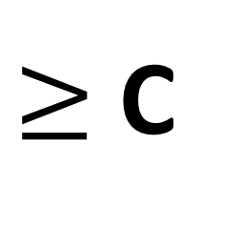
C wins!
$≥$ C

Slide 10
Theorem 1
Using any voting rule r that satisfies non-imposition and any number of voters, there exists a profile such that the winner of the Stackelberg game voting system is ranked in one of the bottom two positions of $n −2DI_{r}\left(n\right)$ votes. In addition, if $DI_{r}\left(n\right)<\frac{n}{4}$, the winner loses in all pairwise elections but one.
$$\left\lfloor n/2\right\rfloor −DI_{r}(n)$$
$$2∗DI_{r}(n)$$
$$\left\lceil n/2\right\rceil −DI_{r}(n)$$

Slide 11
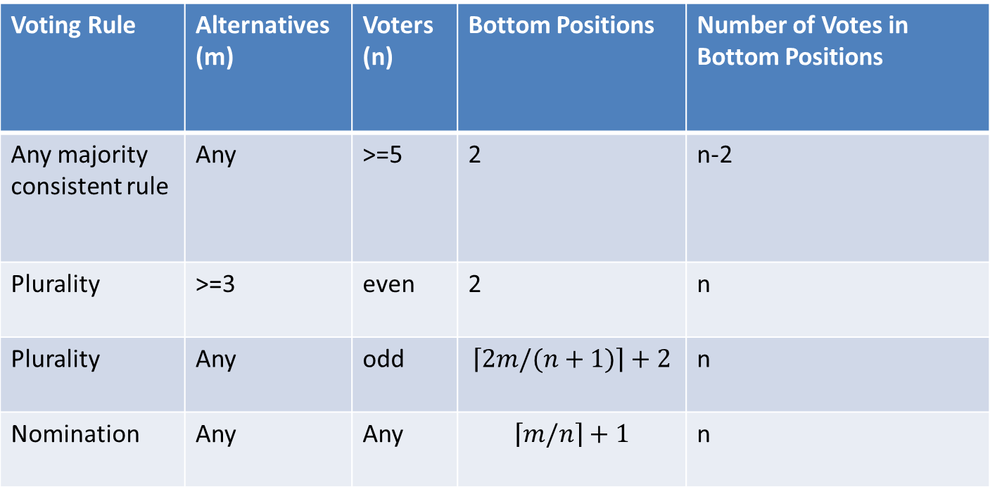
Results from Theorem 1
Voting Rule | Alternatives (m) | Voters (n) | Bottom Positions | Number of Votes in Bottom Positions
Any majority consistent rule | Any | >=5 | 2 | n-2
Plurality | >=3 | even | 2 | n
Plurality | Any | odd | $$\left\lceil 2m/(n+1)\right\rceil +2$$ | n
Nomination | Any | Any | $$\left\lceil m/n\right\rceil +1$$ | n

Slide 12
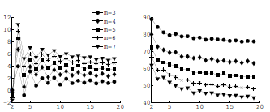
Experimental Results
The backwards induction winner is preferred to the truthful winner under plurality.

