Slide 1
Mobility, garbage collection, load balancing, visualization (SALSA) Fault-tolerance, hot code loading (Erlang) (PDCS 9; CPE 7*)
Carlos Varela
Rensselaer Polytechnic Institute
October 22, 2019
* Concurrent Programming in Erlang, by J. Armstrong, R. Virding, C. Wikström, M. Williams

Slide 2
Advanced Features of Actor Languages
SALSA and Erlang support the basic primitives of the actor model:
Actors can create new actors.
Message passing is asynchronous.
State is encapsulated.
Run-time ensures fairness.
SALSA also introduces advanced coordination abstractions: tokens, join blocks, and first-class continuations; SALSA supports distributed systems development including actor mobility and garbage collection. Research projects have also investigated load balancing, malleability (IOS), scalability (COS), and visualization (OverView).
Erlang introduces a selective receive abstraction to enforce different orders of message delivery, including a timeout mechanism to bypass blocking behavior of receive primitive. Erlang also provides error handling abstractions at the language level, and dynamic (hot) code loading capabilities.

Slide 3
Universal Actor Names (UAN)
Consists of human readable names.
Provides location transparency to actors.
Name to locator mapping updated as actors migrate.
UAN servers provide mapping between names and locators.
Example Universal Actor Name:
uan://wwc.cs.rpi.edu:3030/cvarela/calendar
Name server address and (optional) port.
Unique relative actor name.

Slide 4
Universal Actor Locators (UAL)
Theaters provide an execution environment for universal actors.
Provide a layer beneath actors for message passing and migration.
When an actor migrates, its UAN remains the same, while its UAL changes to refer to the new theater.
Example Universal Actor Locator:
rmsp://wwc.cs.rpi.edu:4040
Theater’s IP address and (optional) port.

Slide 5
Migration
Obtaining a remote actor reference and migrating the actor.
TravelAgent a = (TravelAgent)
TravelAgent.getReferenceByName
(“uan://myhost/ta”);
a <- migrate( “yourhost:yourport” ) @
a <- printItinerary();

Slide 6
Agent Migration Example
module migrate;
behavior Migrate { void print() { standardOutput<-println( "Migrate actor is here." ); } void act( String[] args ) { if (args.length != 3) { standardError<-println("Usage: salsa migrate.Migrate <UAN> <srcUAL> <destUAL>");
return; } UAN uan = new UAN(args[0]); UAL ual = new UAL(args[1]); Migrate migrateActor = new Migrate() at (uan, ual); migrateActor<-print() @ migrateActor<-migrate( args[2] ) @ migrateActor<-print(); } }

Slide 7
Migration Example
The program must be given valid universal actor name and locators.
Appropriate name server and theaters must be running.
Theater must be run from directory with access to the code for the migrating actor’s behavior.
After remotely creating the actor. It sends the print message to itself before migrating to the second theater and sending the message again.

Slide 8
Compilation and Execution
$ salsac migrate/Migrate.salsa
SALSA Compiler Version 1.0: Reading from file Migrate.salsa . . .
SALSA Compiler Version 1.0: SALSA program parsed successfully.
SALSA Compiler Version 1.0: SALSA program compiled successfully.
$ salsa migrate.Migrate
Usage: salsa migrate.Migrate <UAN> <srcUAL> <destUAL>
Compile Migrate.salsa file into Migrate.java, and then bytecode (.class files.)
Execute Name Server
Execute Theater 1 and Theater 2 (with access to migrate directory)
Execute Migrate in any computer with Internet access

Slide 9
Migration Example
UAN Server
theater 1
theater 2
The actor will print "Migrate actor is here." at theater 1 then at theater 2.

Slide 10
World Migrating Agent Example
Host
Location
OS/JVM
Processor
yangtze.cs.uiuc.edu
Urbana IL, USA
Solaris 2.5.1 JDK 1.1.6
Ultra 2
vulcain.ecoledoc.lip6.fr
Paris, France
Linux 2.2.5 JDK 1.2pre2
Pentium II 350Mhz
solar.isr.co.jp
Tokyo, Japan
Solaris 2.6 JDK 1.1.6
Sparc 20
Local actor creation
386us
Local message sending
LAN message sending
WAN message sending
148 us
30-60 ms
2-3 s
LAN minimal actor migration
LAN 100Kb actor migration
WAN minimal actor migration
WAN 100Kb actor migration
150-160 ms
240-250 ms
3-7 s
25-30 s

Slide 11
Reference Cell Service Example
module dcell;
behavior Cell implements ActorService{
Object content;
Cell(Object initialContent) {
content = initialContent;
}
Object get() {
standardOutput <- println (“Returning: ”+content);
return content;
}
void set(Object newContent) {
standardOutput <- println (“Setting: ”+newContent);
content = newContent;
}
}
implements ActorService signals that actors with this behavior are not to be garbage collected.

Slide 12
Moving Cell Tester Example
module dcell;
behavior MovingCellTester {
void act( String[] args ) {
if (args.length != 3){
standardError <- println(“Usage:
salsa dcell.MovingCellTester <UAN> <UAL1> <UAL2>”);
return;
}
Cell c = new Cell(“Hello”) at (new UAN(args[0]), new UAL(args[1]));
standardOutput <- print( ”Initial Value:” ) @
c <- get() @ standardOutput <- println( token ) @
c <- set(“World”) @
standardOutput <- print( ”New Value:” ) @
c <- get() @ standardOutput <- println( token ) @
c <- migrate(args[2]) @
c <- set(“New World”) @
standardOutput <- print( ”New Value at New Location:” ) @
c <- get() @ standardOutput <- println( token );
}
}

Slide 13
Address Book Service
module addressbook;
import java.util.*
behavior AddressBook implements ActorService {
Hashtable name2email;
AddressBook() {
name2email = new HashTable();
}
String getName(String email) { … }
String getEmail(String name) { … }
boolean addUser(String name, String email) { … }
void act( String[] args ) {
if (args.length != 0){
standardOutput<-println(“Usage: salsa -Duan=<UAN> -Dual=<UAL>
addressbook.AddressBook”);
}
}
}

Slide 14
Address Book Migrate Example
module addressbook;
behavior MigrateBook {
void act( String[] args ) {
if (args.length != 2){
standardOutput<-println(“Usage: salsa
addressbook.MigrateBook <AddressBookUAN> <NewUAL>”);
return;
}
AddressBook book = (AddressBook)
AddressBook.getReferenceByName(new UAN(args[0]));
book<-migrate(args(1));
}
}

Slide 15
Actor Garbage Collection
Implemented since SALSA 1.0 using pseudo-root approach.
Includes distributed cyclic garbage collection.
For more details, please see:
Wei-Jen Wang and Carlos A. Varela. Distributed Garbage Collection for Mobile Actor Systems: The Pseudo Root Approach. In Proceedings of the First International Conference on Grid and Pervasive Computing (GPC 2006), Taichung, Taiwan, May 2006. Springer-Verlag LNCS.
Wei-Jen Wang, Carlos Varela, Fu-Hau Hsu, and Cheng-Hsien Tang. Actor Garbage Collection Using Vertex-Preserving Actor-to-Object Graph Transformations. In Advances in Grid and Pervasive Computing, volume 6104 of Lecture Notes in Computer Science, Bologna, pages 244-255, May 2010. Springer Berlin / Heidelberg.

Slide 16
Challenge 1: Actor GC vs. Object GC

Slide 17
Challenge 2: Non-blocking communication
Following references to mark live actors is not safe!

Slide 18
Challenge 2: Non-blocking communication
Following references to mark live actors is not safe!
What can we do?
We can protect the reference from deletion and mark the sender live until the sender knows the message has arrived
A
B
Protected
Reference
Marked
Live
Actor
Blocked
Actor
Message
Reference

Slide 19
Challenge 2: Non-blocking communication (continued)
How can we guarantee the safety of an actor referenced by a message?
The solution is to protect the reference from deletion and mark the sender live until the sender knows the message has arrived
A
B
C
Protected
Reference
Marked
Live
Actor
Blocked
Actor
Message
Reference

Slide 20
Challenge 3: Distribution and Mobility
What if an actor is remotely referenced?
We can maintain an inverse reference list (only visible to the garbage collector) to indicate whether an actor is referenced.
Three operations change inverse references: actor creation, reference passing, and reference deletion.
The inverse reference registration must be based on non-blocking and non-First-In-First-Out communication!

Slide 21
The Pseudo Root Approach
Pseudo roots:
Treat unblocked actors, migrating actors, and roots as pseudo roots.
Map in-transit messages and references into protected references and pseudo roots
Use inverse reference list (only visible to garbage collectors) to identify remotely referenced actors
Actors which are not reachable from any pseudo root are garbage.

Slide 22
IOS: Load Balancing and Malleability
Middleware
A software layer between distributed applications and operating systems.
Alleviates application programmers from directly dealing with distribution issues
Heterogeneous hardware/O.S.s
Load balancing
Fault-tolerance
Security
Quality of service
Internet Operating System (IOS)
A decentralized framework for adaptive, scalable execution
Modular architecture to evaluate different distribution and reconfiguration strategies
K. El Maghraoui, T. Desell, B. Szymanski, and C. Varela, “The Internet Operating System: Middleware for Adaptive Distributed Computing”, International Journal of High Performance Computing and Applications, 2006.
K. El Maghraoui, T. Desell, B. Szymanski, J. Teresco and C. Varela, “Towards a Middleware Framework for Dynamically Reconfigurable Scientific Computing”, Grid Computing and New Frontiers of High Performance Processing, Elsevier 2005.
T. Desell, K. El Maghraoui, and C. Varela, “Load Balancing of Autonomous Actors over Dynamic Networks”, HICSS-37 Software Technology Track, Hawaii, January 2004. 10pp.

Slide 23
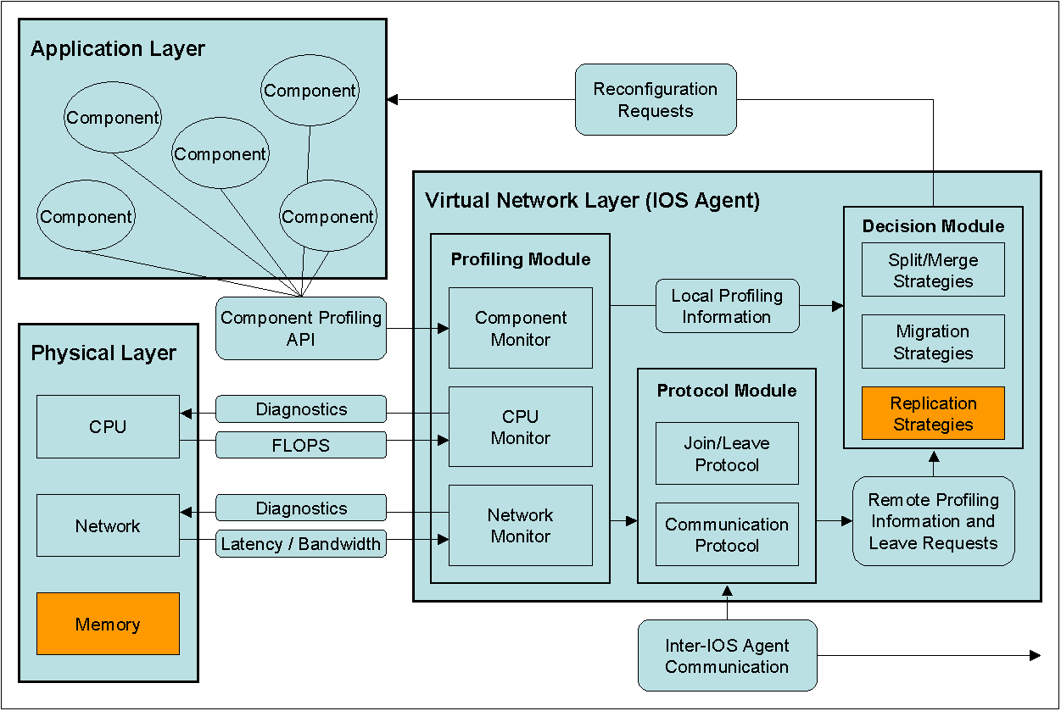
Middleware Architecture

Slide 24
IOS Architecture
IOS middleware layer
A Resource Profiling Component
Captures information about actor and network topologies and available resources
A Decision Component
Takes migration, split/merge, or replication decisions based on profiled information
A Protocol Component
Performs communication with other agents in virtual network (e.g., peer-to-peer, cluster-to-cluster, centralized.)

Slide 25
A General Model for Weighted Resource-Sensitive Work-Stealing (WRS)
Given:
A set of resources, R = {r₀ … r_{n}}
A set of actors, A = {a₀ … a_{n}}
ω is a weight, based on importance of the resource r to the performance of a set of actors A
0 ≤ ω(r,A) ≤ 1
Σ^{all r} ω(r,A) = 1
α(r,f) is the amount of resource r available at foreign node f
υ(r,l,A) is the amount of resource r used by actors A at local node l
M(A,l,f) is the estimated cost of migration of actors A from l to f
L(A) is the average life expectancy of the set of actors A
The predicted increase in overall performance Γ gained by migrating A from l to f, where Γ ≤ 1:
Δ(r,l,f,A) = (α(r,f) – υ(r,l,A)) / (α(r,f) + υ(r,l,A))
Γ = Σ^{all r} (ω(r,A) * Δ(r,l,f,A)) – M(A,l,f)/(10+log L(A))
When work requested by f, migrate actor(s) A with greatest predicted increase in overall performance, if positive.

Slide 26
Impact of Process/Actor Granularity
Experiments on a dual-processor node (SUN Blade 1000)
Notes:
In this example having one process per processor did not give the best performance but increasing the number of processes beyond a certain point also introduces a performance penalty.

Slide 27
Component Malleability
New type of reconfiguration:
Applications can dynamically change component granularity
Malleability can provide many benefits for HPC applications:
Can more adequately reconfigure applications in response to a dynamically changing environment:
Can scale application in response to dynamically joining resources to improve performance.
Can provide soft fault-tolerance in response to dynamically leaving resources.
Can be used to find the ideal granularity for different architectures.
Easier programming of concurrent applications, as parallelism can be provided transparently.

Slide 28
Component Malleability
Modifying application component granularity dynamically (at run-time) to improve scalability and performance.
SALSA-based malleable actor implementation.
MPI-based malleable process implementation.
IOS decision module to trigger split and merge reconfiguration.
For more details, please see:
El Maghraoui, Desell, Szymanski and Varela,“Dynamic Malleability in MPI Applications”, CCGrid 2007, Rio de Janeiro, Brazil, May 2007, nominated for Best Paper Award.

Slide 29
Distributed Systems Visualization
Generic online Java-based distributed systems visualization tool
Uses a declarative Entity Specification Language (ESL)
Instruments byte-code to send events to visualization layer.
For more details, please see:
T. Desell, H. Iyer, A. Stephens, and C. Varela. OverView: A Framework for Generic Online Visualization of Distributed Systems. In Proceedings of the European Joint Conferences on Theory and Practice of Software (ETAPS 2004), eclipse Technology eXchange (eTX) Workshop, Barcelona, Spain, March 2004.
Gustavo A. Guevara S., Travis Desell, Jason Laporte, and Carlos A. Varela. Modular Visualization of Distributed Systems. CLEI Electronic Journal, 14:1-17, April 2011. Note: Best papers from CLEI 2010.

Slide 30
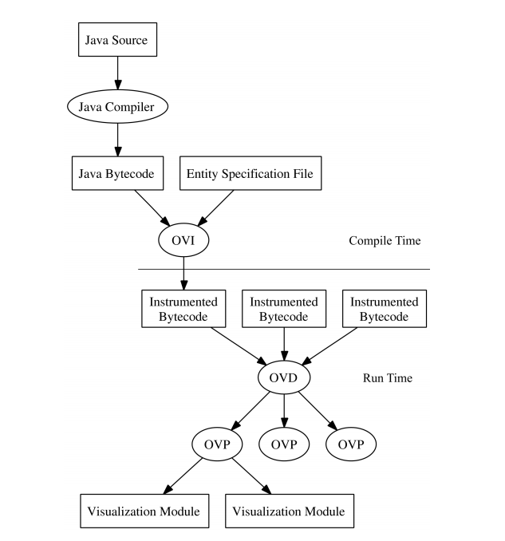
Overview Architecture

Slide 31
Example Specifications for SALSA
entity UniversalActor is salsa.language.UniversalActor$State {
when start putMessageInMailbox(salsa.language.Message message)
-> communication(message.getSource().getId(),
message.getTarget().getId());
when finish finalize()
-> deletion(this.getId());
}
entity WWCSystem is wwc.messaging.WWCSystem$State {
when start createActor(salsa.naming.UAN uan,
salsa.naming.UAL ual,
java.lang.String className)
-> creation(uan.getId(), ual.getHostAndPort());
when start addActor(salsa.language.Actor actor)
-> migration(actor.getUAN().getId(),
actor.getUAL().getHostAndPort());
}

Slide 32
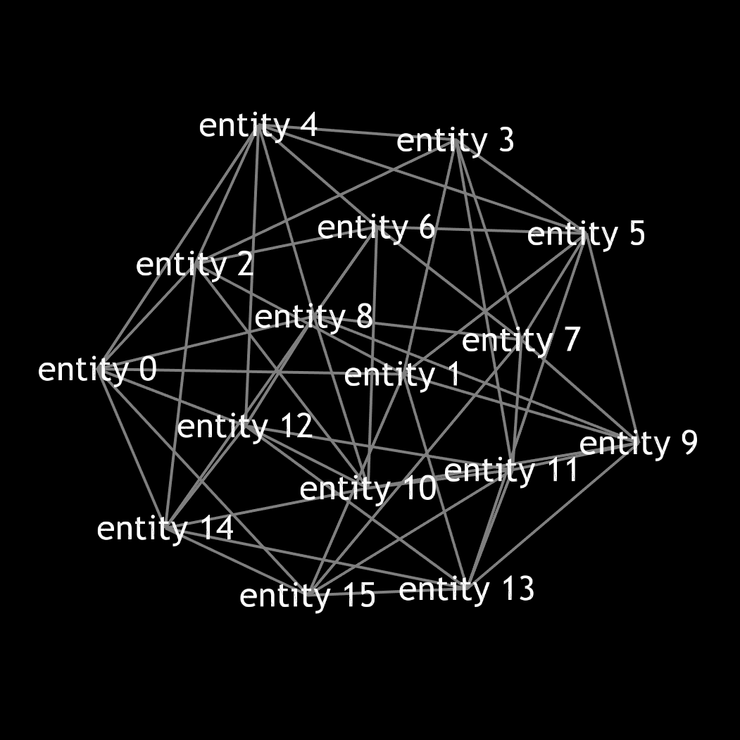
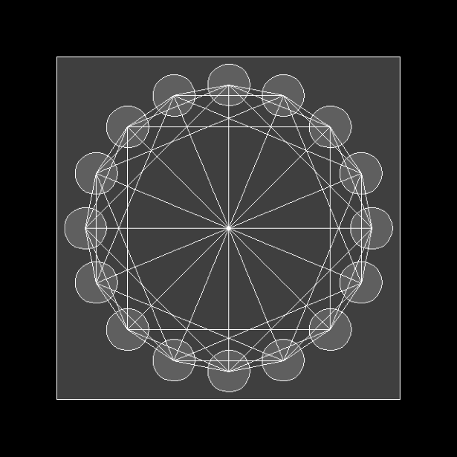
Chord application topology

Slide 33
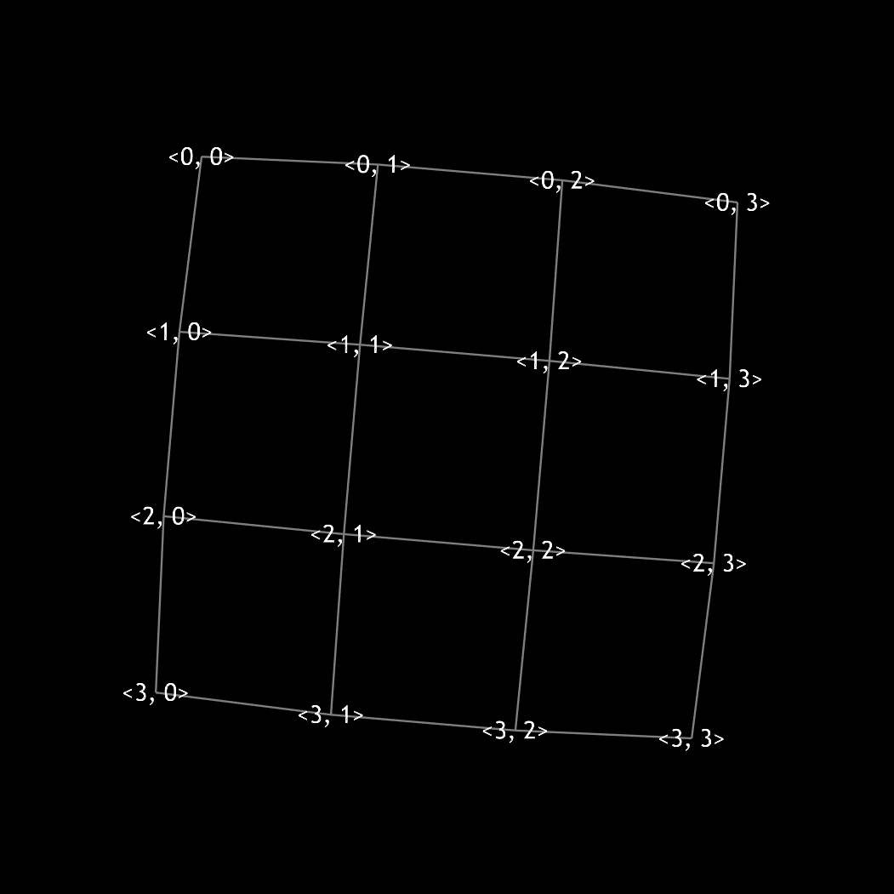
2D-Mesh application topology

Slide 34
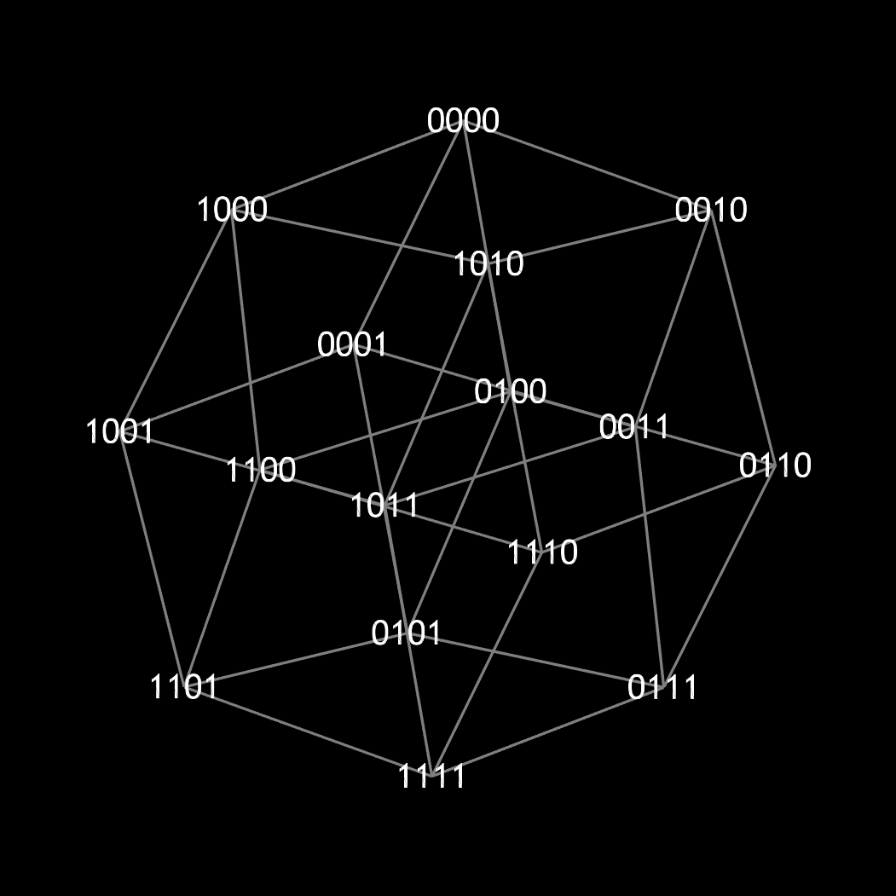
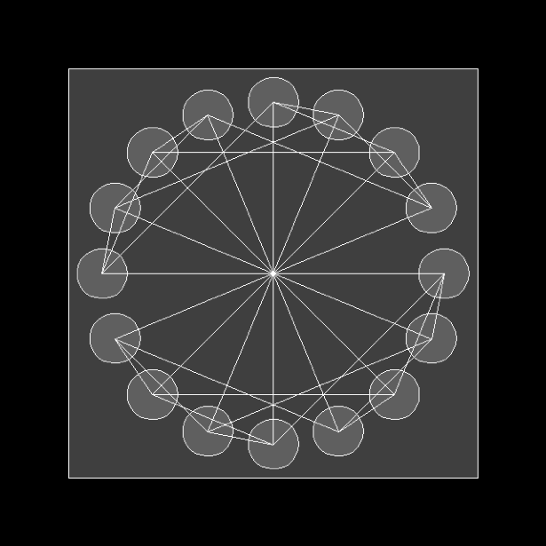
Hypercube application topology

Slide 35
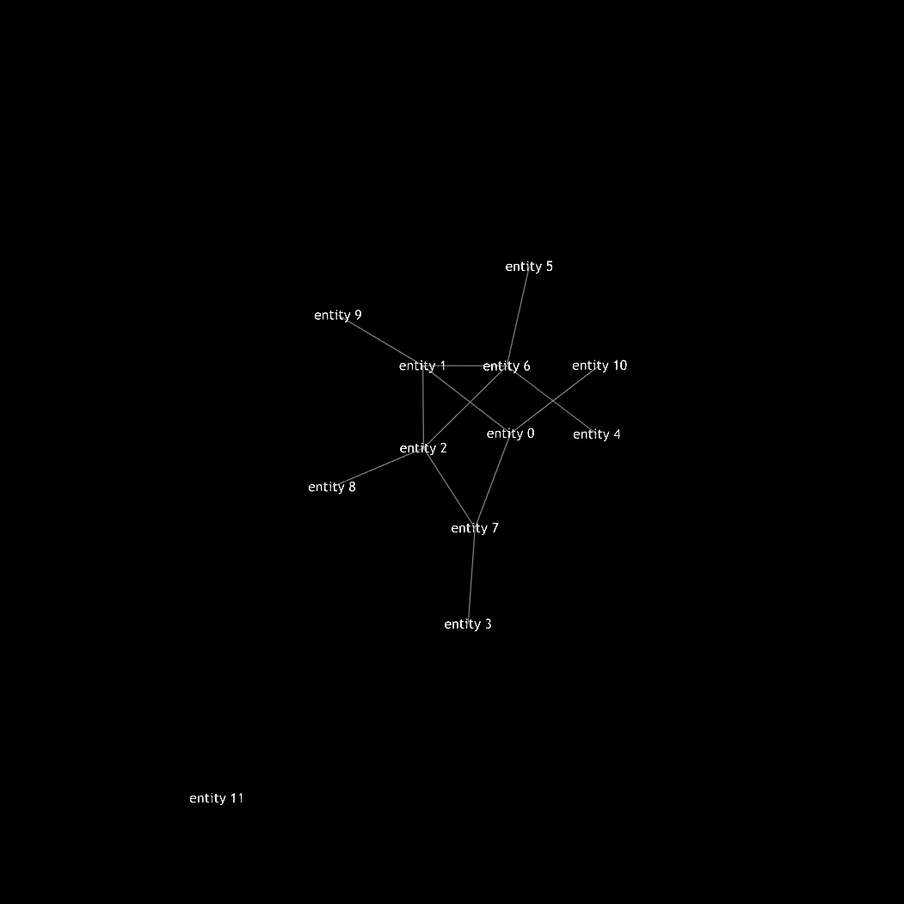
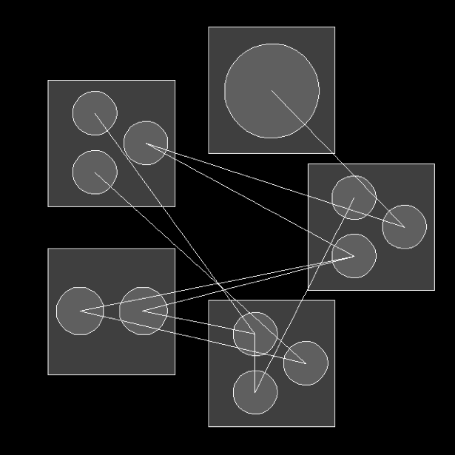
Visualizing distribution and mobility

Slide 36
Open Source Code
Consider to contribute!
Visit our web pages for more info:
SALSA: http://wcl.cs.rpi.edu/salsa/
IOS: http://wcl.cs.rpi.edu/ios/
OverView: http://wcl.cs.rpi.edu/overview/
COS: http://wcl.cs.rpi.edu/cos/
PILOTS: http://wcl.cs.rpi.edu/pilots/
MilkyWay@Home: http://milkyway.cs.rpi.edu/

Slide 37
Erlang Language Support for Fault-Tolerant Computing
Erlang provides linguistic abstractions for:
Error detection.
Catch/throw exception handling.
Normal/abnormal process termination.
Node monitoring and exit signals.
Process (actor) groups.
Dynamic (hot) code loading.

Slide 38
Exception Handling
To protect sequential code from errors:
catch Expression
To enable non-local return from a function:
throw({ab_exception, user_exists})
If failure does not occur in Expression evaluation, catch Expression returns the value of the expression.

Slide 39
Address Book Example
-module(addressbook).
-export([start/0,addressbook/1]).
start() ->
register(addressbook, spawn(addressbook, addressbook, [[]])).
addressbook(Data) ->
receive
{From, {addUser, Name, Email}} ->
From ! {addressbook, ok},
addressbook(add(Name, Email, Data));
…
end.
add(Name, Email, Data) ->
case getemail(Name, Data) of
undefined ->
[{Name,Email}|Data];
_ -> % if Name already exists, add is ignored.
Data
end.
getemail(Name, Data) -> …

Slide 40
Address Book Example with Exception
addressbook(Data) ->
receive
{From, {addUser, Name, Email}} ->
case catch add(Name, Email, Data) of
{ab_exception, user_exists} ->
From ! {addressbook, no},
addressbook(Data);
NewData->
From ! {addressbook, ok},
addressbook(NewData)
end;
…
end.
add(Name, Email, Data) ->
case getemail(Name, Data) of
undefined ->
[{Name,Email}|Data];
_ -> % if Name already exists, exception is thrown.
throw({ab_exception,user_exists})
end.

Slide 41
Normal/abnormal termination
To terminate an actor, you may simply return from the function the actor executes (without using tail-form recursion). This is equivalent to calling:
exit(normal).
Abnormal termination of a function, can be programmed:
exit({ab_error, no_msg_handler})
equivalent to:
throw({’EXIT’,{ab_error, no_msg_handler}})
Or it can happen as a run-time error, where the Erlang run-time sends a signal equivalent to:
exit(badarg) % Wrong argument type
exit(function_clause) % No pattern match

Slide 42
Address Book Example with Exception and Error Handling
addressbook(Data) ->
receive
{From, {addUser, Name, Email}} ->
case catch add(Name, Email, Data) of
{ab_exception, user_exists} ->
From ! {addressbook, no},
addressbook(Data);
{ab_error, What} -> … % programmer-generated error (exit)
{’EXIT’, What} -> … % run-time-generated error
NewData->
From ! {addressbook, ok},
addressbook(NewData)
end;
…
end.

Slide 43
Node monitoring
To monitor a node:
monitor_node(Node, Flag)
If flag is true, monitoring starts. If false, monitoring stops. When a monitored node fails, {nodedown, Node} is sent to monitoring process.

Slide 44
Address Book Client Example with Node Monitoring
-module(addressbook_client).
-export([getEmail/1,getName/1,addUser/2]).
addressbook_server() -> 'addressbook@127.0.0.1'.
getEmail(Name) -> call_addressbook({getEmail, Name}).
getName(Email) -> call_addressbook({getName, Email}).
addUser(Name, Email) -> call_addressbook({addUser, Name, Email}).
call_addressbook(Msg) ->
AddressBookServer = addressbook_server(),
monitor_node(AddressBookServer, true),
{addressbook, AddressBookServer} ! {self(), Msg},
receive
{addressbook, Reply} ->
monitor_node(AddressBookServer, false),
Reply;
{nodedown, AddressBookServer} ->
no
end.

Slide 45
Process (Actor) Groups
To create an actor in a specified remote node:
Agent = spawn(host, travel, agent, []);
To create an actor in a specified remote node and create a link to the actor:
Agent = spawn_link(host, travel, agent, []);
An ’EXIT’ signal will be sent to the originating actor if the host node does not exist.

Slide 46
Group Failure
Default error handling for linked processes is as follows:
Normal exit signal is ignored.
Abnormal exit (either programmatic or system-generated):
Bypass all messages to the receiving process.
Kill the receiving process.
Propagate same error signal to links of killed process.
All linked processes will get killed if a participating process exits abnormally.

Slide 47
Dynamic code loading
To update (module) code while running it:
-module(m).
-export([loop/0]).
loop() ->
receive
code_switch ->
m:loop();
Msg -> ...
loop()
end.
code_switch message dynamically loads the new module code. Notice the difference between m:loop() and loop().

Slide 48
Exercises
Download and execute the Migrate.salsa example.
Download OverView and visualize a Fibonacci computation in SALSA. Observe garbage collection behavior.
Download social networking example (PDCS Chapter 11) in SALSA and execute it in a distributed setting.
PDCS Exercise 11.8.2 (page 257).
Create a ring of linked actors in Erlang.
Cause one of the actors to terminate abnormally and observe default group failure behavior.
Modify default error behavior so that upon an actor failure, the actor ring reconnects.
Modify the cell example, so that a new “get_and_set” operation is supported. Dynamically (as cell code is running) upgrade the cell module code to use your new version.

