Slide 1
Actors (PDCS 4) AMST actor language syntax, semantics, join continuations
Carlos Varela
Rennselaer Polytechnic Institute
October 8, 2021

Slide 2
Advantages of concurrent programs
Reactive programming
User can interact with applications while tasks are running, e.g., stopping the transfer of a large file in a web browser.
Availability of services
Long-running tasks need not delay short-running ones, e.g., a web server can serve an entry page while at the same time processing a complex query.
Parallelism
Complex programs can make better use of hardware resources in multi-core processor architectures, SMPs, LANs, WANs, grids, and clouds, e.g., scientific/engineering applications, simulations, games, etc.
Controllability
Tasks requiring certain preconditions can suspend and wait until the preconditions hold, then resume execution transparently.

Slide 3
Disadvantages of concurrent programs
Safety
« Nothing bad ever happens »
Concurrent tasks should not corrupt consistent state of program.
Liveness
« Anything ever happens at all »
Tasks should not suspend and indefinitely wait for each other (deadlock).
Non-determinism
Mastering exponential number of interleavings due to different schedules.
Resource consumption
Concurrency can be expensive. Overhead of scheduling, context-switching, and synchronization.
Concurrent programs can run slower than their sequential counterparts even with multiple CPUs!

Slide 4
Overview of concurrent programming
There are four main approaches:
Sequential programming (no concurrency)
Declarative concurrency (streams in a functional language)
Message passing with active objects (Erlang, SALSA)
Atomic actions on shared state (Java, C++)
The atomic action approach is the most difficult, yet it is the one you will probably be most exposed to!
But, if you have the choice, which approach to use?
Use the simplest approach that does the job: sequential if that is ok, else declarative concurrency if there is no observable nondeterminism, otherwise use actors and message passing.

Slide 5
Actors/SALSA
Actor Model
A reasoning framework to model concurrent computations
Programming abstractions for distributed open systems
G. Agha, Actors: A Model of Concurrent Computation in Distributed Systems. MIT Press, 1986.
Agha, Mason, Smith and Talcott, “A Foundation for Actor Computation”, J. of Functional Programming, 7, 1-72, 1997.
SALSA
Simple Actor Language System and Architecture
An actor-oriented language for mobile and internet computing
Programming abstractions for internet-based concurrency, distribution, mobility, and coordination
C. Varela and G. Agha, “Programming dynamically reconfigurable open systems with SALSA”, ACM SIGPLAN Notices, OOPSLA 2001, 36(12), pp 20-34.

Slide 6
Agha, Mason, Smith & Talcott
Extend a functional language (call-by-value λ calculus + ifs and pairs) with actor primitives.
Define an operational semantics for actor configurations.
Study various notions of equivalence of actor expressions and configurations.
Assume fairness:
Guaranteed message delivery.
Individual actor progress.

Slide 7
Open Distributed Systems
Addition of new components
Replacement of existing components
Changes in interconnections

Slide 8
Synchronous vs. Asynchronous Communication
The π-calculus (and other process algebras such as CCS, CSP) uses synchronous communication.
The actor model assumes asynchronous communication is the most primitive interaction mechanism.

Slide 9
Communication Medium
In the π-calculus, channels are explicitly modeled. Multiple processes can share a channel, potentially causing interference.
In the actor model, the communication medium is not explicit. Actors (active objects) are first-class, history-sensitive (stateful) entities with an explicit identity used for communication.

Slide 10
Fairness
The actor model theory assumes fair computations:
Message delivery is guaranteed.
Infinitely-often enabled computations must eventually happen.
Fairness is very useful for reasoning about equivalences of actor programs but can be hard/expensive to guarantee; in particular when distribution, mobility, and failures are considered.

Slide 11
λ-Calculus as a Model for Sequential Computation
Syntax:
e ::= v variable
| λv.e function
| e(e) application
Example of beta-reduction:
λx.x²(3)
x²{3/x}
λx.x²
3
3²

Slide 12
λ-Calculus extended with pairs
pr(x,y) returns a pair containing x & y
ispr(x) returns t if x is a pair; f otherwise
1st(pr(x,y)) = x returns the first value of a pair
2nd(pr(x,y)) = y returns the 2nd value of a pair

Slide 13
Actor Primitives
send(a,v)
Sends value v to actor a.
new(b)
Creates a new actor with behavior b (a λ-calculus functional abstraction) and returns the identity/name of the newly created actor.
ready(b)
Becomes ready to receive a new message with behavior b.

Slide 14
AMST Actor Language Examples
b5 = rec(λy.λx.seq(send(x,5),ready(y)))
receives an actor name x and sends the number 5 to that actor, then it becomes ready to process new messages with the same behavior y (b5).
Sample usage:
send(new(b5), a)
A sink, an actor that disregards all messages:
sink = rec(λb.λm.ready(b))

Slide 15
Reference Cell
cell =
rec(λb.λc.λm.if(get?(m),
seq(send(cust(m),c),
ready(b(c))),
if(set?(m),
ready(b(contents(m))),
ready(b(c)))))
Using the cell:
let a = new(cell(0)) in seq(send(a,mkset(7)),
send(a,mkset(2)),
send(a,mkget(c)))

Slide 16
Join Continuations
Consider:
treeprod = rec(λf.λtree.
if(isnat(tree),
tree,
f(left(tree))*f(right(tree))))
which multiplies all leaves of a tree, which are numbers.
You can do the “left” and “right” computations concurrently.

Slide 17
Tree Product Behavior
B_{treeprod} =
rec(λb.λm.
seq(if(isnat(tree(m)),
send(cust(m),tree(m)),
let newcust=new(B_{joincont}(cust(m))),
lp = new(B_{treeprod}),
rp = new(B_{treeprod}) in
seq(send(lp,
pr(left(tree(m)),newcust)),
send(rp,
pr(right(tree(m)),newcust)))),
ready(b)))

Slide 18
Tree Product (continued)
B_{joincont} =
λcust.λfirstnum.ready(λnum.
seq(send(cust,firstnum*num),
ready(sink)))

Slide 19
Sample Execution
f(tree,cust)
f(left(tree),JC)
f(right(tree),JC)
JC
JC
cust
cust
cust
JC
(a)
(b)

Slide 20
Sample Execution
f(left(tree),JC)
JC’
JC’
JC'
firstnum
JC'
JC’
JC
JC
firstnum
firstnum
JC
cust
cust
cust
firstnum
cust
JC
(c)
(d)

Slide 21
Sample Execution
num
JC
firstnum * num
cust
firstnum
cust
cust
(e)
(f)

Slide 22
Operational Semantics of AMST Actor Language
Operational semantics of actor language as a labeled transition relationship between actor configurations:
[label]
k₁ k₂
Actor configurations model open system components:
Set of individually named actors
Messages “en-route”

Slide 23
Actor Configurations
k = α || µ
α is a function mapping actor names (represented as free variables) to actor states.
µ is a multi-set of messages “en-route.”

Slide 24
Syntactic restrictions on configurations
Given A = Dom(α):
If a in A, then fv(α(a)) is a subset of A.
If <a <= v> in µ, then {a} U fv(v) is a subset of A.

Slide 25
Reduction contexts and redexes
Consider the expression:
e = send(new(b5),a)
The redex r represents the next sub-expression to evaluate in a left-first call-by-value evaluation strategy.
The reduction context R (or continuation) is represented as the surrounding expression with a hole replacing the redex.
send(new(b5),a) = send(☐,a) new(b5)
e = R r where
R = send(☐,a)
r = new(b5)

Slide 26
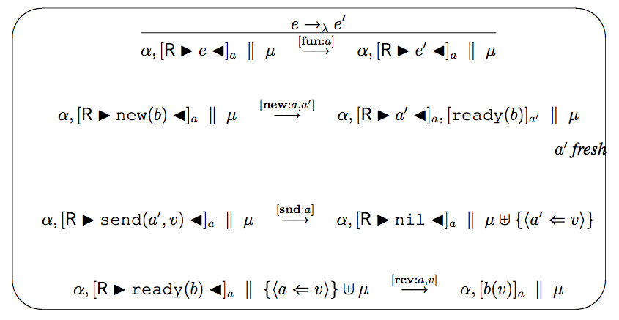
Labeled Transition Relation

Slide 27
Exercises
Write get? cust set? contents mkset mkget to complete the reference cell example in the AMST actor language.
Modify the cell behavior to notify a customer when the cell value has been updated.
PDCS Exercise 4.6.6 (page 77).
PDCS Exercise 4.6.7 (page 78).

