Slide 1
Distributed Biconnectivity
Ian Bogle¹² George Slota¹ Sivasankaran Rajamanickam² Karen Devine²
¹Rensselaer Polytechnic Institute Troy, NY
²Sandia National Laboratories Albuquerque, NM

Slide 2
Graph Biconnectivity is a stronger version of graph connectivity
Biconnected Components of a graph remain connected if any single vertex is removed.
Articulation Points (or Cut Vertices) are vertices that disconnect the graph if removed.
Graph Biconnectivity finds all biconnected components in an input graph

Slide 3
Efficient Distributed Biconnectivity algorithms have practical applications
Biconnectivity algorithms are useful for finding single points of failure in power and communications networks, as well as processing social networks
Finding articulation points in meshes can help solvers converge
We are not aware of any distributed parallel biconnectivity algorithms
Efficient shared memory biconnectivity algorithms may not lend themselves to an efficient distributed memory implementation
A new approach could lead to a more efficient distributed biconnectivity algorithm

Slide 4
Our previous work implemented a distributed algorithm that solved a similar problem
Determined whether certain parts of an Ice Sheet mesh were adequately connected
During this work we realized we could use this Ice Sheet Connectivity algorithm (ICE-CONN) to find biconnected components in a general graph
The distributed biconnectivity algorithm (BCC-ICE) we propose leverages the ICE-CONN algorithm

Slide 5
Degenerate Features are Parts of the Mesh That Can Rotate or Translate
Icebergs
Floating Peninsulas
(Floating Hinges)
Any part of the mesh that can freely rotate or translate makes the velocity solution not unique
Blue ice is floating
Brown ice is on the ground

Slide 6
Previous Work: Efficiently Detect Degenerate Mesh Features
Ice sheet simulations fail to converge due to features like hinged peninsulas and icebergs in meshes
New algorithm that detects all degenerate features
Distributed memory implementation provides good strong scaling and weak scaling up to 4096 processors
Detection takes at most 0.4% of a simulation step’s runtime
46,000x faster than previously used preprocessing on highest resolution meshes
This work won a Best Paper award, published in Bogle, Devine, Perego, Rajamanickam, and Slota. “A Parallel Graph Algorithm for Detecting Mesh Singularities in Distributed Memory Ice Sheet Simulations.” Proceedings of the 48th International Conference on Parallel Processing. 2019.

Slide 7
Application Provides a Mesh and Grounding Information
Legend
Floating
Touching Ground

Slide 8
Degenerate Mesh Features Have at Most One Connection to the Ground
These two vertices allow for two unique connections to ground.
Only one unique connection to ground exists, it is through this vertex.
There are no Degenerate Features
These are Degenerate Features
Vertex that is floating in the water
Vertex that is touching the ground

Slide 9
We Identify Parts of the Mesh with No Degenerate Features
Legend
Degenerate
Not Degenerate

Slide 10
The ICE-CONN Algorithm Propagates Grounding Information Through the Mesh
The ICE-CONN algorithm has two steps:
Find Potential Articulation Points
Propagate Grounding Information
We exploit mesh boundary information to identify potential articulation points
Propagating grounding information reveals degenerate mesh features
Note: Examples show quad meshes, but the approach works with triangular meshes as well.

Slide 11
Step 1: Find Potential Articulation Points
Application identifies boundary edges at interfaces between ice and water

Slide 12
Step 1: Find Potential Articulation Points
This is the only actual Articulation Point
Vertices with more than two incident red edges are Potential Articulation Points

Slide 13
Step 2: Propagate Grounding Information
Legend
Start with grounding given from the application
Floating
Initially Grounded
1 Path to Ground
2 Paths to Ground
P
Potential Articulation Point
P
P
P

Slide 14
Step 2: Propagate Grounding Information
Legend
Initially grounded vertices have one path to ground
Floating
Initially Grounded
1 Path to Ground
2 Paths to Ground
P
Potential Articulation Point
P
P
P

Slide 15
Step 2: Propagate Grounding Information
Legend
Propagate only from vertices that have changed color
Floating
Initially Grounded
1 Path to Ground
2 Paths to Ground
P
Potential Articulation Point
P
P
P

Slide 16
Step 2: Propagate Grounding Information
Legend
Stop the propagation at the Potential Articulation Points
Floating
Initially Grounded
1 Path to Ground
2 Paths to Ground
P
Potential Articulation Point
P
P
P

Slide 17
Step 2: Propagate Grounding Information
Legend
Floating
Initially Grounded
1 Path to Ground
2 Paths to Ground
P
Potential Articulation Point
P
P
P
These two Potential Articulation Points allow for two paths to ground

Slide 18
Final Result of the ICE-CONN Algorithm
Legend
Keep all vertices with two unique paths to the ground
Floating
Initially Grounded
1 Path to Ground
2 Paths to Ground
P
Potential Articulation Point
P
P
P
The yellow vertices only have one unique path through this vertex
These green vertices have two unique paths through both Potential Articulation Points

Slide 19
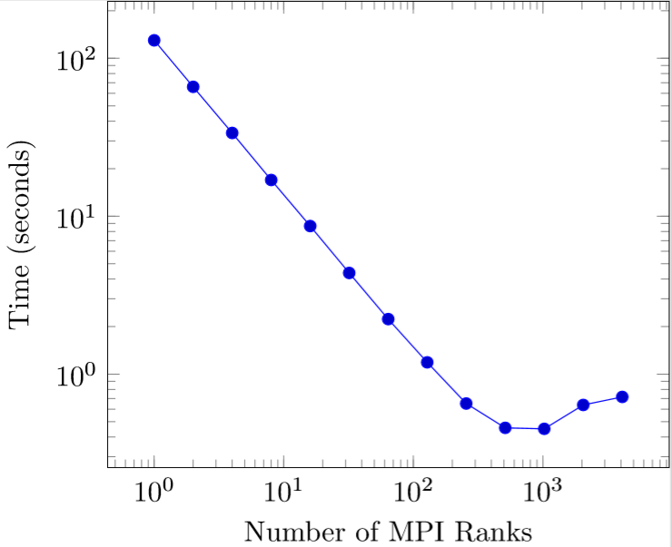
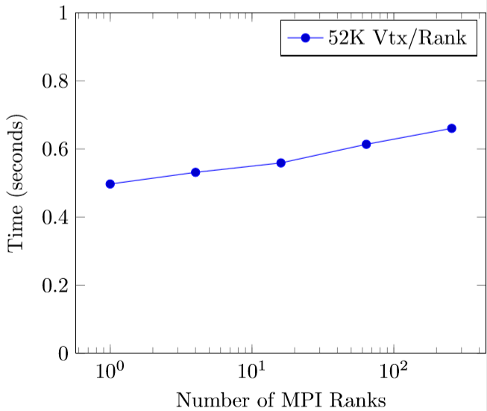
The ICE-CONN Algorithm scales well for mesh inputs
Strong scaling
13 Million vertices
# Vertices | Our Algorithm (Ranks) | Matlab Preprocessing
52,465 | 0.0176 s (6) | 1.04 s
210,170 | 0.0217 s (24) | 5.65 s
841,346 | 0.0414 s (96) | 34.60 s
3,368,275 | 0.0407 s (384) | 245.00 s
13,479,076 | 0.0561 s (1536) | 2630.00 s
Weak scaling
52k Vertices/Rank
Comparison against Matlab preprocessing in
Tuminaro, Perego, Tezaur, Salinger, Price. “A matrix dependent/algebraic multigrid approach for extruded meshes with applications to ice sheet modeling”. SIAM Journal on Scientific Computing 38.5 (2016): C504-C532

Slide 20
With slight modifications, the ICE-CONN algorithm generalizes to solve graph biconnectivity
We ground two neighboring vertices – the smallest biconnected component
We use a more general heuristic to find potential articulation points
We use the ICE-CONN to find biconnected components iteratively
This distributed biconnectivity algorithm will be referred to as BCC-ICE

Slide 21
We use a novel distributed LCA algorithm to find potential articulation points
Need to find all Articulation Points,
False positives are allowed.
First, root a Breadth-First Search tree at any vertex
This method is a distributed version of the algorithm presented in Chaitanya, Meher, and Kishore Kothapalli. “Efficient multicore algorithms for identifying biconnected components.” International Journal of Networking and Computing 6.1 (2016): 87-106

Slide 22
Lowest Common Ancestor(LCA) traversals start from non-tree edges and end at the first mutual parent

Slide 23
Lowest Common Ancestor(LCA) traversals start from non-tree edges and end at the first mutual parent
This vertex is the first mutual parent, or Lowest Common Ancestor
Move the lower BFS level
endpoint to its parent
Start at these two endpoints of
a nontree edge

Slide 24
Lowest Common Ancestor(LCA) traversals start from non-tree edges and end at the first mutual parent

Slide 25
We use a novel distributed LCA algorithm to find potential articulation points
Start at endpoints of non-tree edges
Follow parent-edges until a mutual parent is found
Any endpoints of unvisited tree edges are articulation points
Tree edge
Non-Tree edge
Traversal In Progress
Potential Articulation Point

Slide 26
We use the ICE-CONN algorithm to find Biconnected Components Iteratively
Initially ground two neighboring vertices
Remove yellow labels, green labels are a Biconnected Component
Use label propagation to find a BCC
Floating
Initially Grounded
1 Path to Ground
2 Paths to Ground
Potential Articulation Point

Slide 27
We use the ICE-CONN algorithm to find Biconnected Components Iteratively
Propagate wherever possible
Ground one neighbor of each actual articulation point found
1
1
1
1
Floating
Initially Grounded
1 Path to Ground
2 Paths to Ground
Potential Articulation Point

Slide 28
We use the ICE-CONN algorithm to find Biconnected Components Iteratively
Repeat the process until no propagation is possible
1
1
4
1
3
1
4
4
Floating
Initially Grounded
3
2
1 Path to Ground
2 Paths to Ground
Potential Articulation Point

Slide 29
Experimental Setup
Tests were run on Sandia National Labs’ Blake platform
40 nodes equipped with dual socket Intel Xeon Platinum CPUs.
We generated synthetic graphs with a known number of biconnected components to validate our implementations.

Slide 30
We implemented the shared-memory Tarjan-Vishkin algorithm in distributed memory as a baseline
Presented by Tarjan and Vishkin, 1985
Tarjan, Robert E., and Uzi Vishkin. “An efficient parallel biconnectivity algorithm.” SIAM Journal on Computing 14.4 (1985): 862-874.
Optimal in a shared-memory architecture
Requires a Breadth-First-Search, the computation of preorder labels and the number of descendants for each vertex
Constructs an auxiliary graph
# Vtx in auxiliary graph = # edges in original graph
Filter edges based on values computed for each vertex
Connected components in auxiliary graph correspond to biconnected components in the original graph

Slide 31
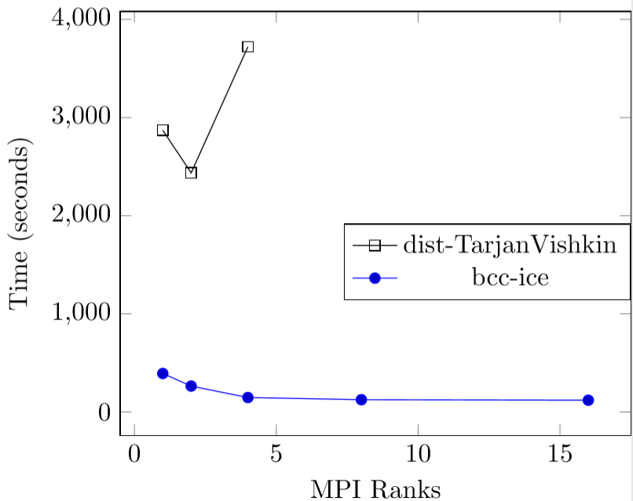
Our BCC-ICE approach outperforms our distributed implementation of the Tarjan-Vishkin algorithm
10 Million Vertices
Avg degree 16
10 Biconnected Components
Our Tarjan-Vishkin implementation does not scale well
Constructing the auxiliary graph is expensive in distributed memory
Final labeling of the input graph requires communication and is nontrivial

Slide 32
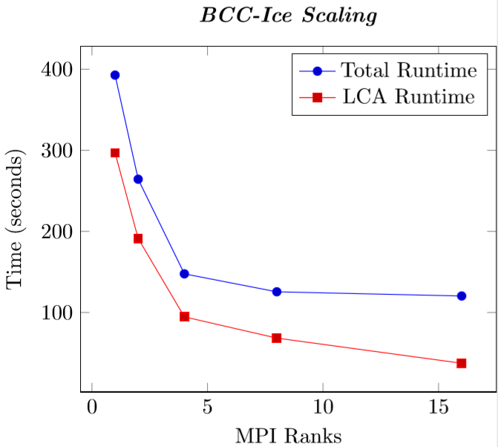
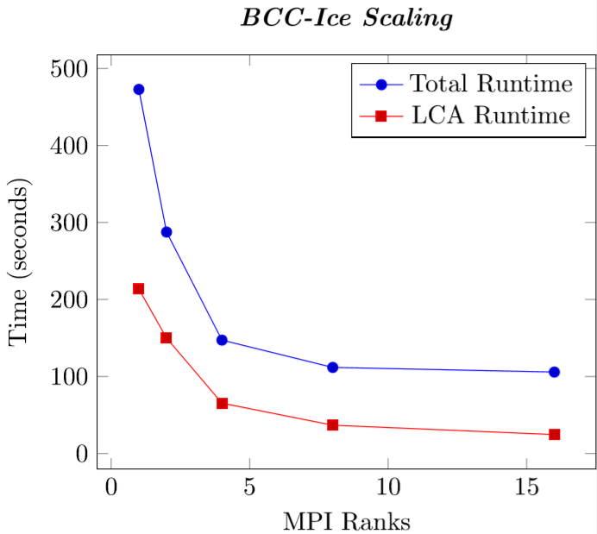
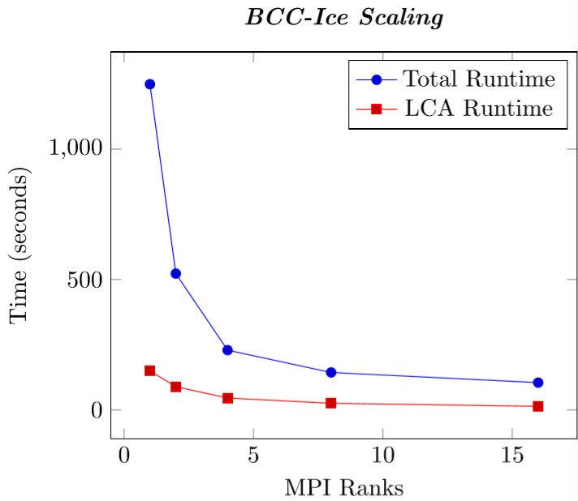
Our BCC-ICE algorithm’s scaling depends on the structure of the input graph
10 Biconnected Components
100 Biconnected Components
1000 Biconnected Components
All inputs have 10 Million vertices and
average degree 16

Slide 33
Conclusions and Future Work
Our ICE-CONN algorithm efficiently detects degenerate features of ice-sheet meshes in distributed memory.
We generalize ICE-CONN to solve biconnectivity in distributed memory
This direct generalization (BCC-ICE) is more efficient than our distributed implementation of the Tarjan-Vishkin shared-memory algorithm
We are currently exploring optimizations to these approaches.
Contact Me: boglei@rpi.edu

Slide 34
This work was supported in part by the U.S. Department of Energy, Oﬃce of Science, Oﬃce of Advanced Scientiﬁc Computing Research, Scientiﬁc Discovery through Advanced Computing (SciDAC) program through the FASTMath Institute under Contract No. DE-AC02-05CH11231 at Rensselaer Polytechnic Institute and Sandia National Laboratories and through the SciDAC ProSPect project at Sandia National Laboratories. Sandia National Laboratories is a multimission laboratory managed and operated by National Technology and Engineering Solutions of Sandia, LLC., a wholly owned subsidiary of Honeywell International, Inc., for the U.S. Department of Energy’s National Nuclear Security Administration under contract DE-NA-0003525.

Slide 35
Conclusions and Future Work
Our parallel ice-sheet propagation algorithm efficiently detects degenerate features of ice-sheet meshes.
We generalize this algorithm to solve biconnectivity in distributed memory
This direct generalization is more efficient than our distributed implementation of the Tarjan-Vishkin shared-memory algorithm
We are currently exploring optimizations to these approaches.
Contact Me: boglei@rpi.edu

